Slide 1
Daniel Palazzolo
Professor of Political Science
University of Richmond
“Presidential Politics and the US Economy”
VRMCA Fall Conference
October 3, 2016

Slide 2
Outline
Forecasting Models: Trump over Clinton
State of the Race
Economic Conditions
Fiscal Policy Considerations

Slide 3
Time For Change (Alan Abramowitz)
State of US Economy
Presidential Approval
Consecutive Terms by Party
Trump 51% Clinton 49%

Slide 4
13 Keys to the White House (Allan Lichtman)
Losing Keys
-Party Mandate in Midterm (#1)
-Contest: No serious Nomination (#2)
-Incumbency: Sitting President (#3)
-Third Party: Not threat (#4)
-Major Policy Change/2nd Term (#7)
-Major Foreign Policy Success (#11)
-Incumbent Party Candidate Charisma (#12)
*6 or more Losing Keys and Incumbent Party Loses
Winning Keys
-Short term economy: No recession (#5)
-Long term economy: Growth over terms (#6)
-Social Unrest: No (#8)
-Scandal: No (#9)
-Foreign Policy Failure ((#10)
-Challenger Charisma (#11)

Slide 5
RealClearPolitics Average: Tracking Poll (Source: Realclearpolitics.com)

Slide 6
Electoral College Projection: Toss Ups (realclearpolitics.com)
Party won in 2012
AZ (11) CO (9 NH (4)
GA (16) FL (29) NV (6)
NC (15) IA (6) OH (18
ME (1) PA (20)
MI (16) WI (10)
MN (10)

Slide 7
Electoral College Projection: No Toss Ups (realclearpolitics.com)
AZ (11) FL (29)
CO (9) MI (16)
GA (16) MN (10)
IA (6) NH (4)
ME (1) PA (20)
NV (6) WI (10)
NC (15)
OH (18)

Slide 8
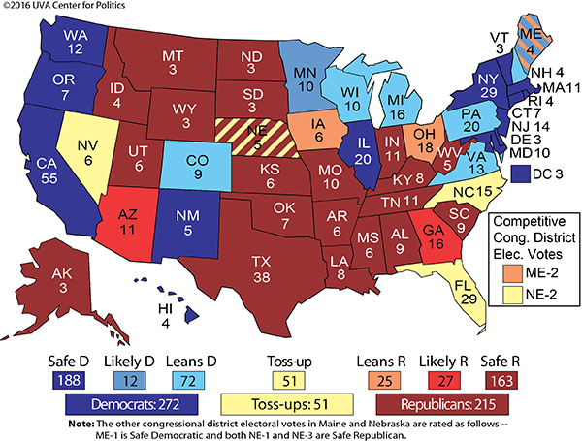

Slide 9
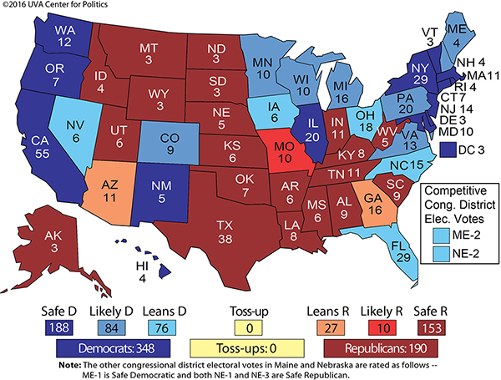
Crystal Ball: Electoral College Ratings (9/15/2016) (Source: UVA Center for Politics)

Slide 10
Ave Favorable Ratings (9/21-30) (source: realclearpolitics)

Slide 12
Youth Vote: 2012

Slide 13
Youth Vote: 2016

Slide 14
US Senate Seats by Party (Source: UVA Center for Politics)

Slide 15
House Elections (Sources: UVA Center for Politics)
114th House: 247 GOP 186 Democrats
-Projected 10-15 seat gain for Democrats; short of the 30 to win a majority.
-Toss ups 14 GOP 2 Democrats;
-Leans GOP 8; Leans Democrat 9;

Slide 16
Economic Conditions (Source: Wall Street Journal)
Positive
Negative
Unemployment: 5.5%
Gas $2.50 per gallon
Median Income +5%
Consumer confidence highest since Aug 2007
Slow Growth
Decline in home ownership
Median income still 1.9% lower than Aug 2007
Ave salary of Male worker down $150 compared with 1998

Slide 17
Fiscal Policy Highlights
Trump
Clinton
Major Tax Cuts (lower rates, increase standard deduction; cut corporate rate to 15%; eliminate estate tax)
No Mandatory Spending Cuts
Infrastructure +$500 billion over 5 year-
________________
More growth, huge deficits
Increase Taxes on high income: estate, cap deductions; 28%; $1 mill 30% min; $5mill surtax 4%) targeted breaks small business and families
No Mandatory Spending Cuts
Infrastructure +$275 billion over 5 years
_________________
No growth, smaller deficits

Slide 18
Spending and Revenue Plans Effects on Deficits (Committee for a Responsible Budget)

Slide 19
Questions?

