Slide 1
VRMCA Human RESOURCES
Committee report for Spring 2015 Conference

Slide 2
Agenda
ACA Employer Reporting
Medical Exams and MVR Regulations
Wellness Incentives and the EEOC

Slide 3
Affordable Care Act
Requires employers and insurers to report certain plan and coverage information to the IRS in 2016 for year 2015
Reporting is on a calendar year basis regardless of plan year
Notes:
Join a ‘consortium’ of other small businesses
Very similar to the way companies are insured for workers compensation and other insurance coverage
If you have a broker and they are not familiar with this I can give you the name of one who is
I DO NOT receive commissions

Slide 4
Employer Reporting of Health Coverage
Draft forms Released 7/24/2014
To provide information to the IRS about health coverage offered
(or not ) to employees
Forms and instructions
have been released
Notes:
One of the provisions of the Affordable Care Act is that employers must report to the IRS about the health coverage if any they offer to their employees
The IRS released draft versions of these forms in July
Due to the one-year extension on ACA requirement these forms must be filed in March 2016 for the 2015 year (unless extended again)

Slide 5
AfforDable Care Act
Who is required to report?
Employers with 50 or more employees
Notes:
An HRA is a Health Reimbursement Account
Usually a person pays so much of the deductible and anything over that amount they file for reimbursement
So one company in this group might fund the HRA with $1000 for each person while another may fund $2500 for each person

Slide 6
Affordable Care Act
Section 6056
Requires Applicable Large Employers (ALES) to file information returns with the IRS and provide statements (similar to a W-2) to their full-time employees about the health insurance coverage the employer offered
Notes:
This silly slide is just a way to remember that the EEOC priorities are about Perspective and Point of View
What we as employers may see as “fair and consistent treatment” may not seem that way to employees

Slide 7
Affordable Care act
An ALE may be a single entity or may consist of a group of related entities
1094-B and 1094-C are Transmittal forms
1095-B and 1095-C are the reporting forms

Slide 8
Affordable Care act
Small employers (less than 50) who offer only fully-insured plans are not subject to reporting requirements
Health insurance companies will report individual participant coverage details to the IRS
Notes:
Their strategic plan is enforcement and outreach efforts on priorities that have a significant impact on equal employment
On this second bullet the intent is to improve customer service

Slide 9
Affordable Care act
Every person that provides minimum essential coverage to an individual during a calendar year must file an information return and a transmittal. Most filers will use Forms 1094-B (transmittal) and 1095-B (return).
Employers (including government employers) subject to the employer shared responsibility provisions sponsoring self-insured group health plans will report information about the coverage in Part III of Form 1095-C,
Notes:
Americans with Disabilities Act Amendment Act has changed the interpretation of disability as we knew it under the ADA
Under the ADA what you see here was the definition of a disability

Slide 10
Affordable Care act
Notes:
But under the ADAAA major life activities have been expanded to include major bodily functions – so in reality all of us are probably ‘disabled’ at some point or another
And impairments need not prevent or severely restrict a major life activity
Episodic or in remission will cover individuals with cancer
Remember, if an employee comes to you about ADAAA claim, always always engage in a dialogue about ‘reasonable accommodation’

Slide 11
Affordable Care act
Notes:
Gestational diabetes is not uncommon – just one example

Slide 12
Affordable Care act
What action do I take now?
Collect your employee data!
You should already have:
Employee name, ss# and DOB
Covered dependents
What you might not have:
Employee dependents who are not covered under your health or another benefit plan
Notes:
The EEOC is also concerned about discrimination against ex-offenders.
There is a move afoot for “Ban the Box” which means eliminating the question like you see here on an application.
We see funny things in HR sometimes. This person told us he was convicted for a Mr. Minor instead of a misdemeanor when someone saw him changing his pans through the window.
I guess he was in the kitchen?

Slide 13
Government Rules
REMEMBER, RULES ARE RULES!
Don't ever let common sense get in the way of a
Government Regulation.
Notes:
Rule # 1 apparently doesn’t apply to the IRS…
Remember Patience and Wisdom
What would a juror think if they saw your email that said “Joe can’t do squat with that bum leg of his…”
Don’t be sarcastic in your emails
Get in a habit of reviewing what you’ve typed before hitting the send button
If you want to have a hard copy of something that’s showing a date….in most cases it’s safer to compose your email and then print it, delete it and hand deliver the hard copy.

Slide 14
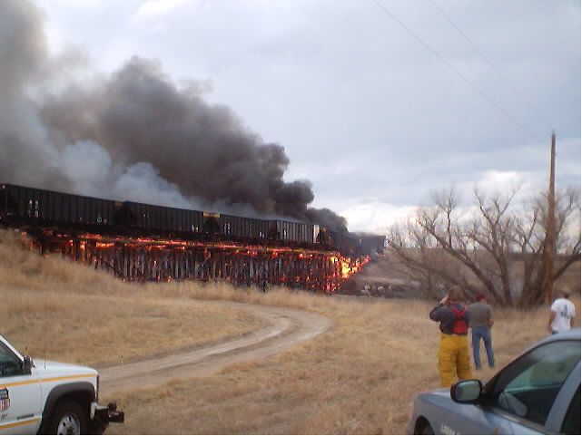
Government Rules
Notes:
And the EEOC does hold seminars around the region. Go to this website to find the dates and locations.

Slide 15
Government Rules

Slide 16
Medical Exams and MVRs
CDL Drivers will have his/her license suspended unless they keep a current medical card with the DMV
Your company may use a copy of the medical certificate as proof of driver’s medical certification for up to 15 days after the date it was issued.
Notes:
Federal Contractors must use E-verify to confirm eligibility of employees to work on a federal contract in the U.S.
Some Virginia state contracts (VDOT) are requiring a contractor to begin using E-Verify for all new hires if they are awarded the contract.
Other employers can do it voluntarily for new hires. First you enroll and then every new hire after that you have 3 days to enter them into the E-verify system
One Immigration attorney I heard speak at a conference in August recommends: “Don’t do it if you are not required to so it.”
It does not replace the paper I-9 forms
But I must say of the many government agencies I’ve contacted for help….the E-verify customer service people at the toll free number are very helpful. And they offer some very good webinars.

Slide 17
Wellness incentives and EEOC
Participatory Wellness Programs
Join a fitness program
Attend tobacco cessation counseling
Health-Contingent Wellness Programs
Must satisfy a ‘standard’ to obtain a ‘reward’
Must meet 5 requirements

Slide 18
Wellness incentives and EEOC
Opportunity to qualify at least once a year
Cannot exceed 30% of total cost of coverage
Tobacco cessation can be up to 50%
3. Reasonable Design - to improve health and not be overburdensome
Same, full reward must be available by satisfying an alternative standard
Disclosure – If terms of the wellness program are described the plan must disclose in all materials the availability of a reasonable alternative

Slide 19
VRMCA Human Resources
Questions?

