Slide 1
2009 Virginia Uniform Statewide Building Code
(USBC)
Concrete Specifications
By: Teck L. Chua, PE
Director - Technical Services
NVCAC, April 11, 2013

Slide 2
Overview
The law (people with handcuffs).
Detail Code requirements on concrete.
When the Virginia Code provides no details – what’s next?

Slide 3
Effective March 1, 2011

Slide 6
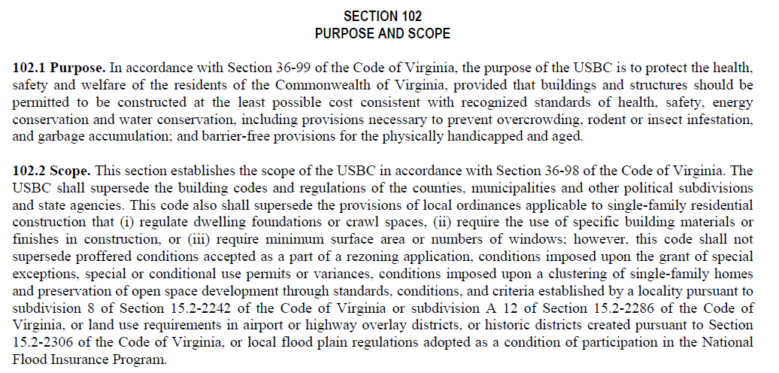

Slide 7
Deadline: March 1, 2012

Slide 10

Code Requirements – the Details on concrete

Slide 11
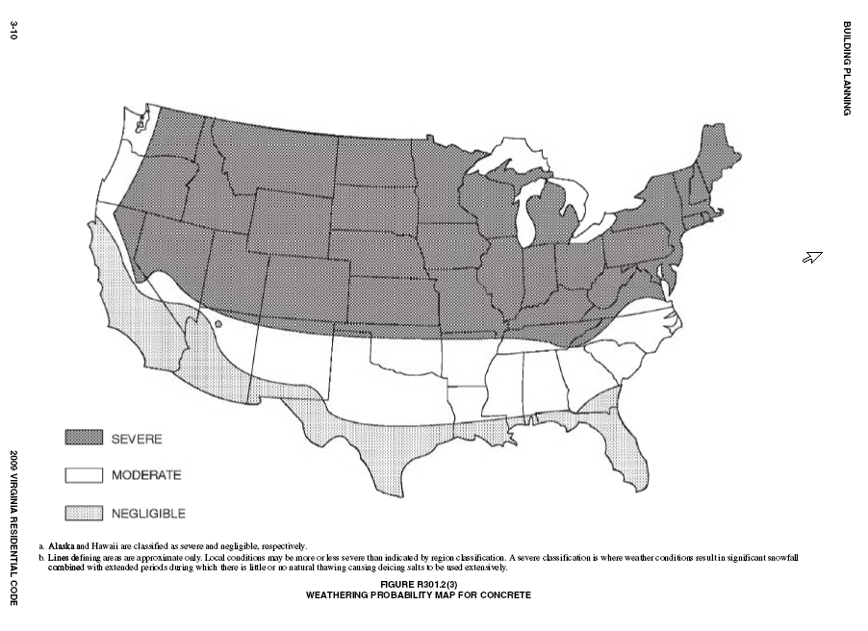

Two zones in Virginia

Slide 12
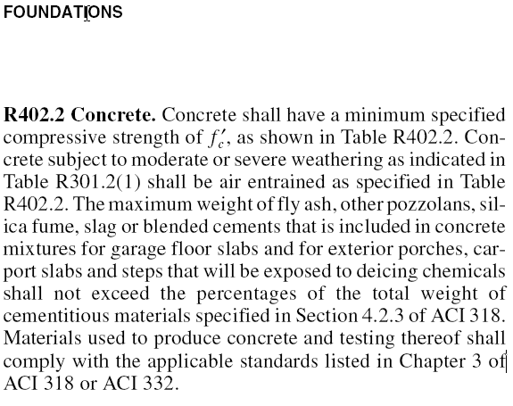
Should have been named concrete requirements

Slide 13
Deicing chemical exposure limits content of fly ash, slag cement, other pozzolans

Slide 14
Material Standards: ACI 318-08 Ch. 3 or ACI 332
The usual ASTMs covering cementitious materials, aggregates, water, admixtures, ready mixed concrete, sampling and testing.

Slide 15
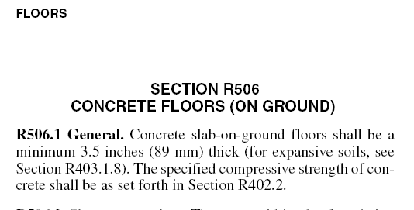

Slide 16
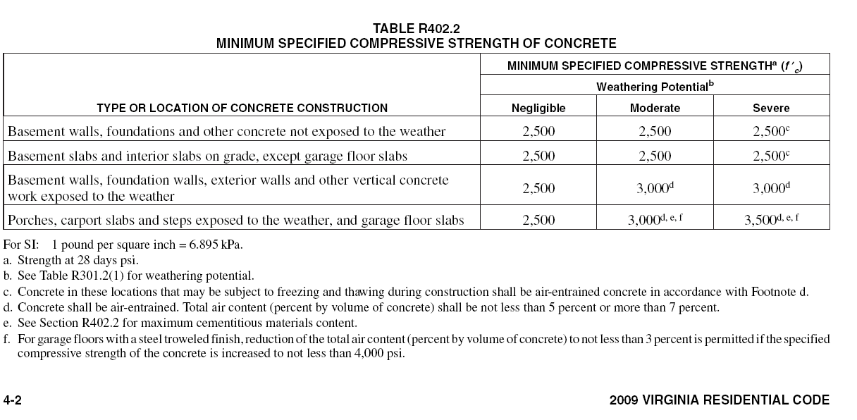
Driveway and Walkway are not mentioned!

Slide 17
When the Virginia Code has no details – Anything goes?

Slide 18
What if “generally recognized standards of performance ARE available . . . ?“

Slide 19
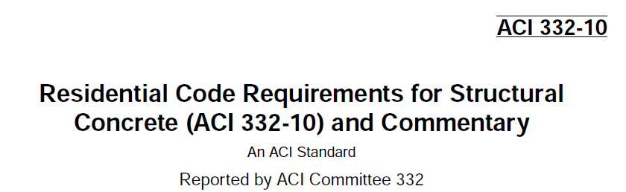

Slide 20
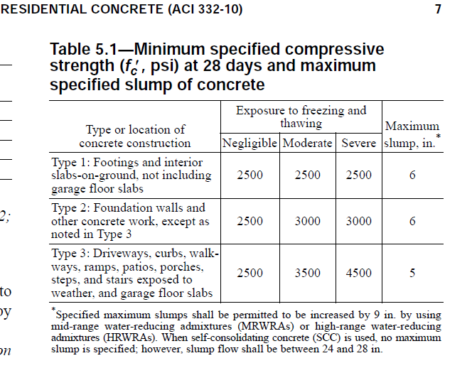
IRC:

Slide 23
“Cal” – calcium chloride
Reinforced: yes, when dry or protected
Plain: yes, all conditions
“2.0% by weight of cementitious materials”
  450pcy*2% < 9 pcy
  530pcy*2% < 10.6 pcy
Molecular weight: calcium chloride 2X chloride ion
  ACI332-2% < ACI 318-0.15%

Slide 24
Placement time > 90 min

Slide 29
Jt. Depth: Min 3.5”*0.25 = 0.875” = 7/8”

Slide 31
WWF – reinforcement?

Slide 32
Summary
Residential concrete construction is governed by a Code that is as tough as commercial concrete construction.
Concrete exposed to deicing chemicals, such as driveways, requires 4500psi concrete.

Slide 33
Questions ?

