Slide 1
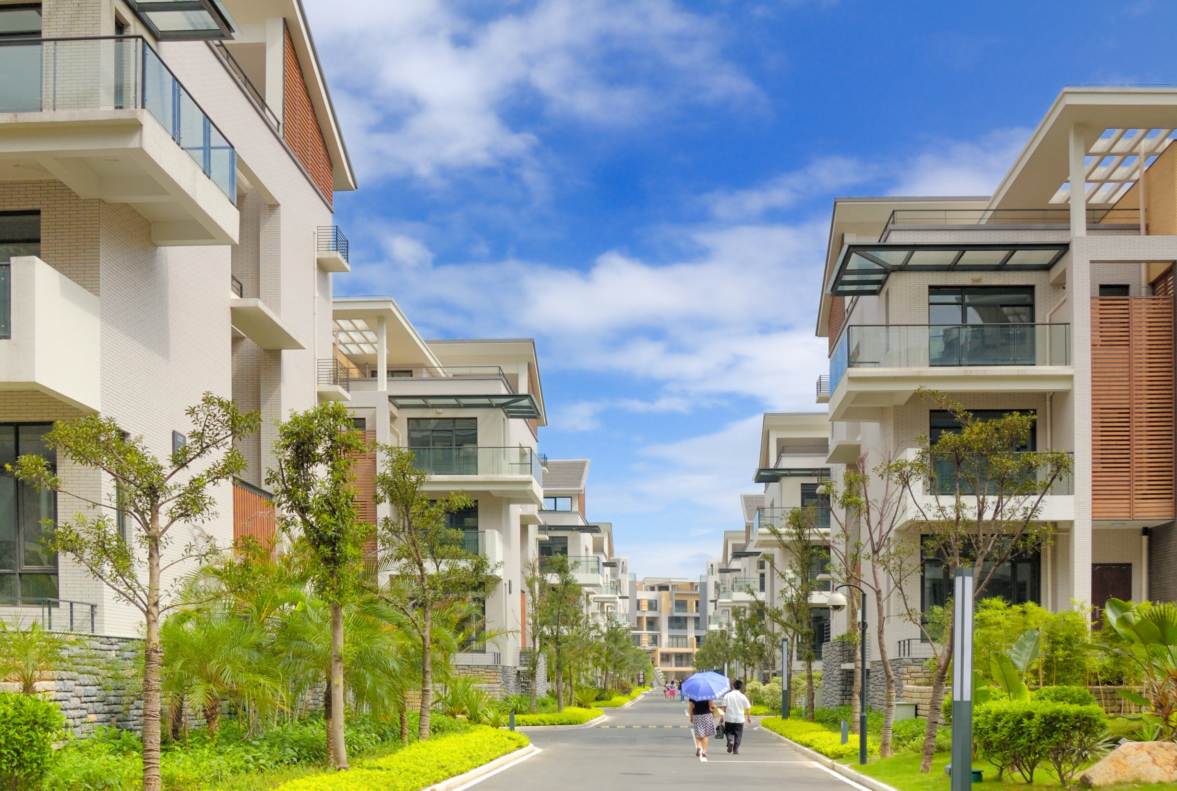
Opportunities and Threats for Concrete in Low/Mid-Rise Buildings

Slide 2
SITUATION
STRATEGIES
RESOURCES

Slide 3
SITUATION

Slide 5
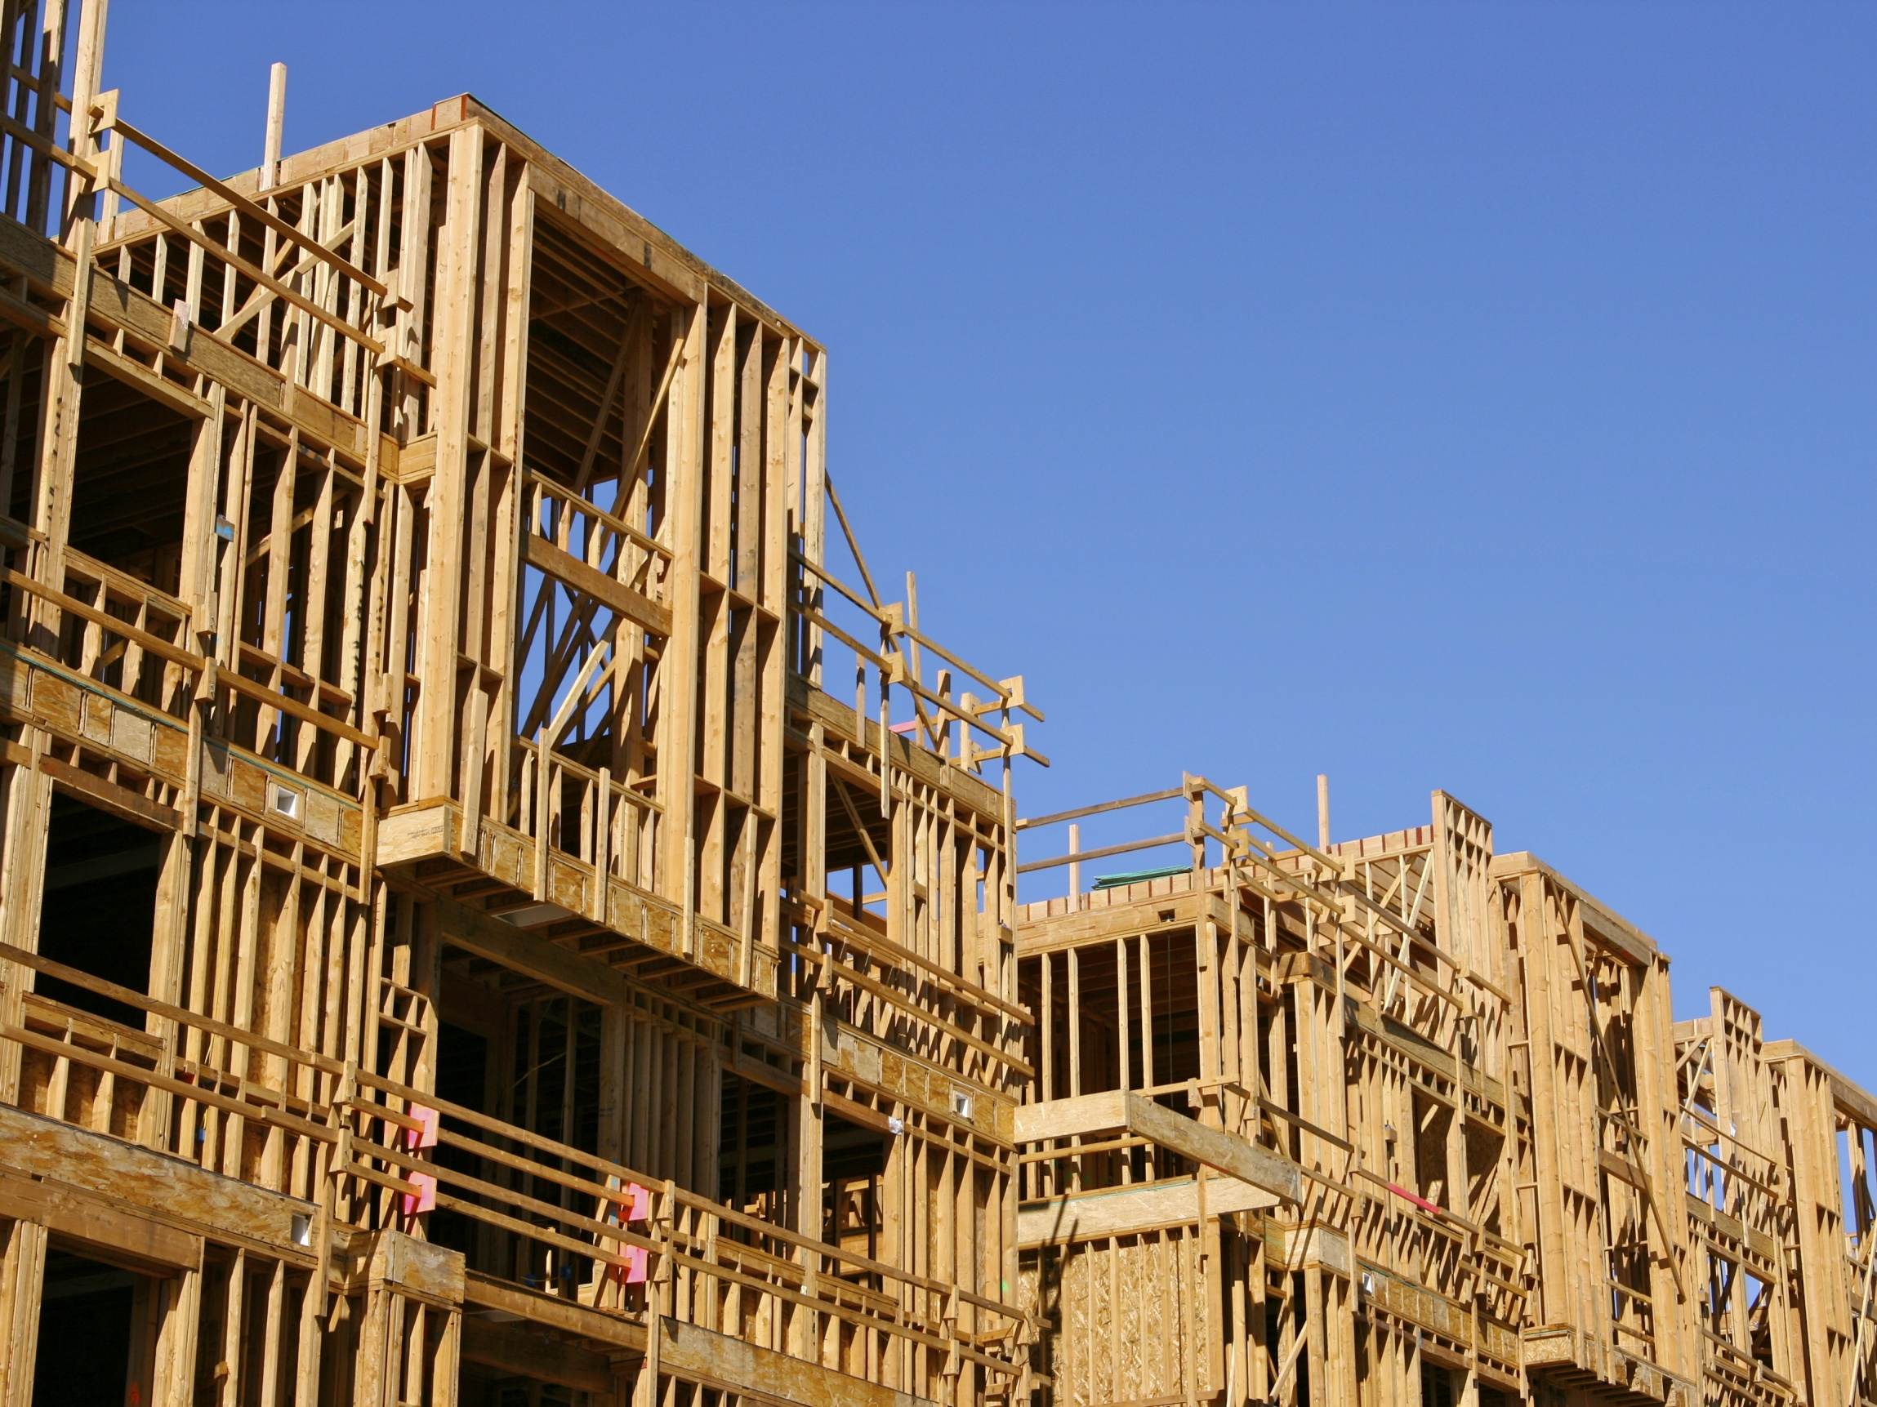
“
Through education and direct project support, WoodWorks helps architects, engineers, designers and developers select softwood lumber in non-residential and multi-family construction. In the process, WoodWorks is growing a community of wood champions. In 2014, Woodworks influenced and converted 380 projects…Half were three stories or taller.
”
Softwood Lumber Board
2014 Annual Report

Slide 6
$33M
Softwood Lumber Board
2014 Annual Report

Slide 7
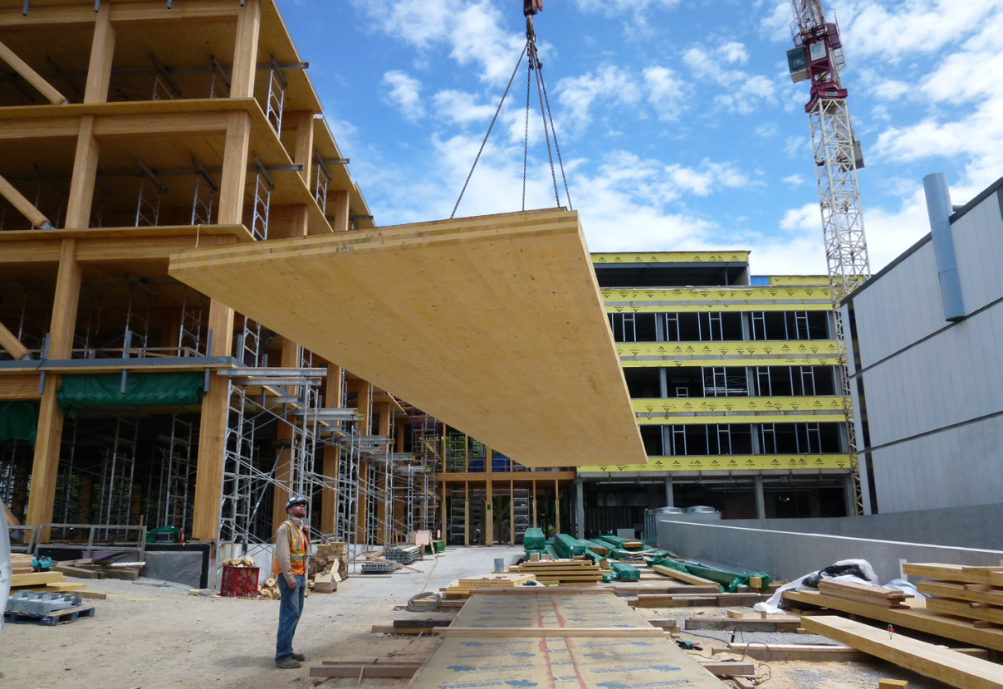
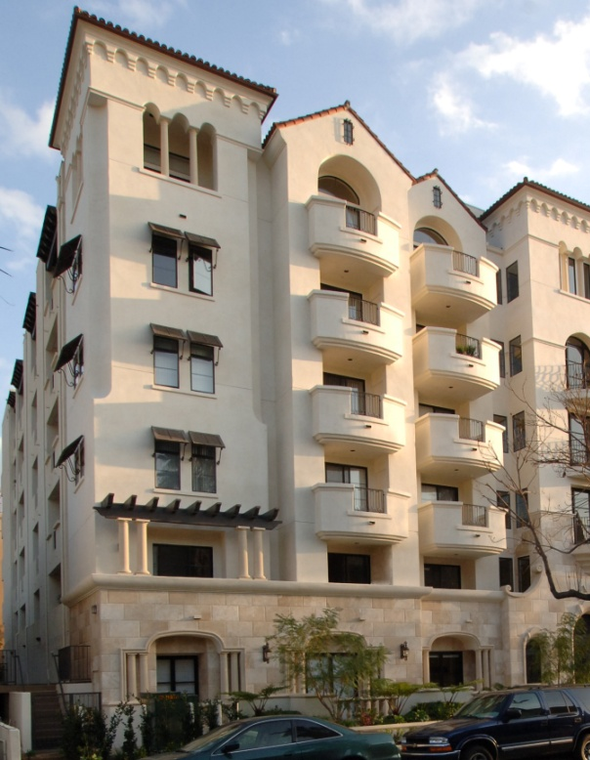
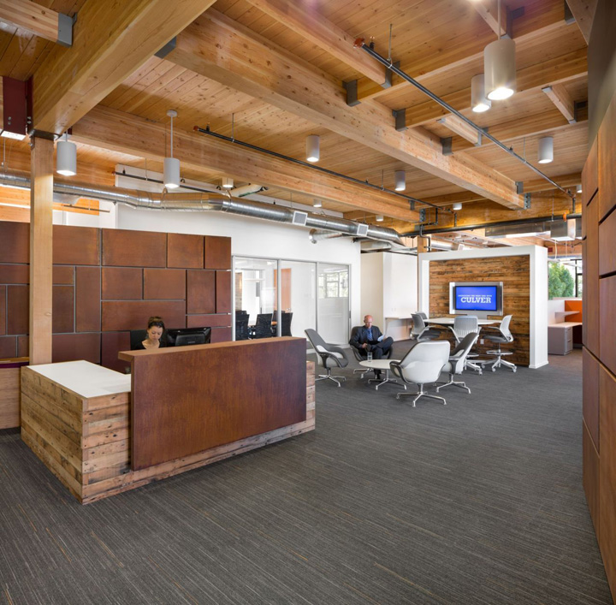
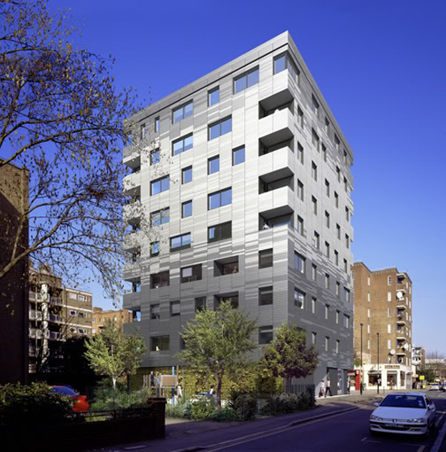
Notes:
Since the inception of softwood lumber board, wood industry has invested $33 million to promote wood applications.
Wood check-off
$14 million in 2013
$19 million in 2014
Current threat is mainly from wood frame which is limited by code to 65 feet (by code and structural limitations)
Major future threat is from Cross Laminated Timber (can go up much higher) to threaten exclusive concrete markets

Slide 8
WOOD
HUMAN
RESOURCES
54+
WOOD
FINANCIAL
RESOURCES
$$$$$$$$$$
$$$$$$$$$
19 Million +

Slide 9
WOOD MARKETING RESULTS
Programs | FY14
Website Visitors | 654,000
Tradeshows Attended | 68
Conferences Hosted | 9
Building Awards | 1
Case Studies | 18

Slide 10
STEEL
WOOD
CONCRETE

Slide 11
WOOD
PROJECTS
INFLUENCED
380 projects
in 2014
16 in 2014
290 programs
in 2014
WOOD
EDUCATION
PROGRAMS
32,000 attendees
in 2014
WOOD
CODES
ADVOCACY
530 proposals reviewed and proposed
20

Slide 12
Green Building Initiatives
WOOD (2014)
Environmental Product Declarations IW EPD for 8 wood products 0 product specific EPDs
Responsible Sourcing FSC (Forest Stewardship Council) accepted by USGBC – resisted by wood industry SFI (Sustainable Forestry Initiative) not accepted by USGBC – preferred by wood industry
Material Ingredient Disclosure Likely exempt for sawn lumber Required for engineered lumber (none to date)

Slide 13
RM Concrete use by sector (2014)
U.S. Buildings = 83% = 270 million yd³
Virginia Buildings = 5.4 million yd³
Source: 2015 NRMCA Industry Data Survey

Slide 14
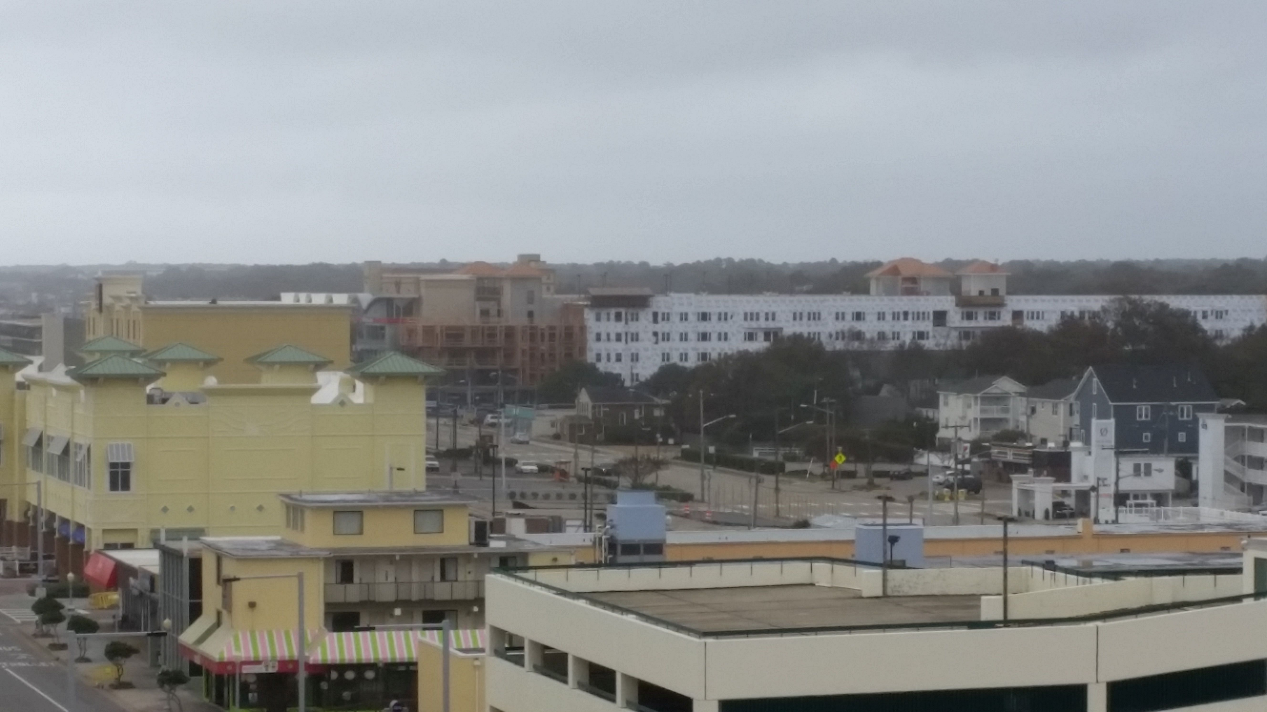

Slide 15
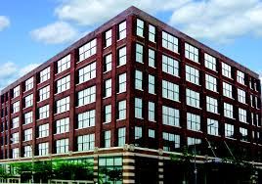
7,000 yd³
6 stories, 200,000 ft²
We lose 5,000 yd³
- or -
$500,000 revenue
2,000 yd³

Slide 17
Mix of Construction Trend
SOURCE: FMI Construction Outlook - 2nd Quarter 2015

Slide 18
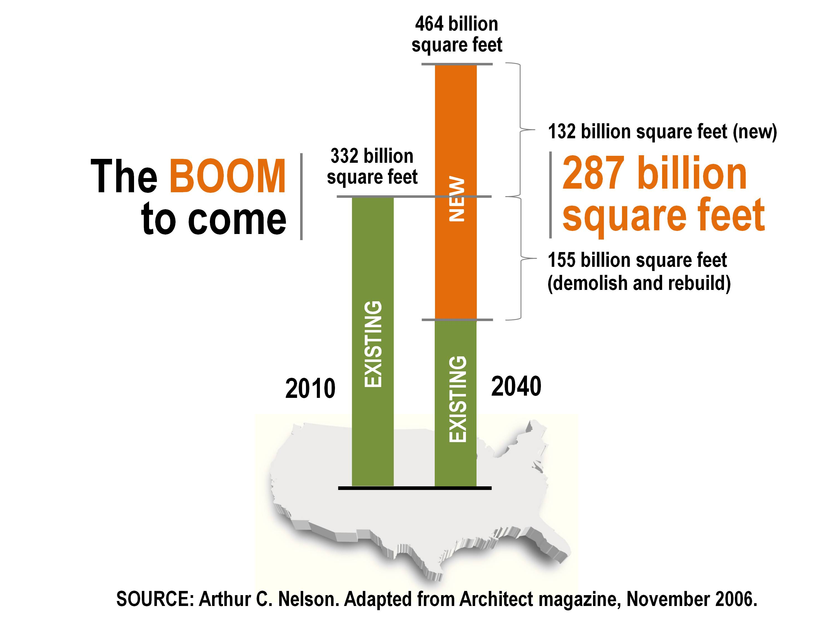

Slide 19
SOURCE: McGraw Hill Green Outlook 2013

Slide 20
SOURCE: McGraw Hill Green Outlook 2013

Slide 22
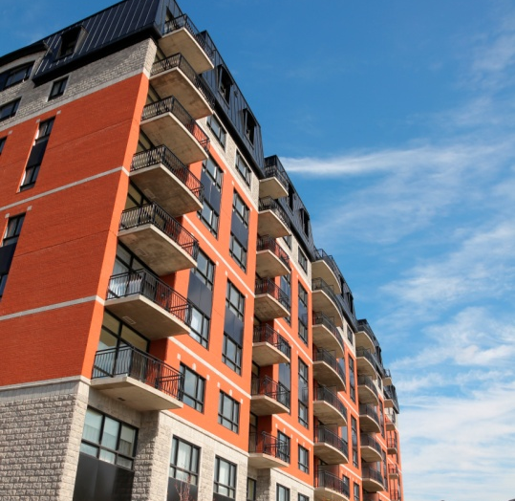
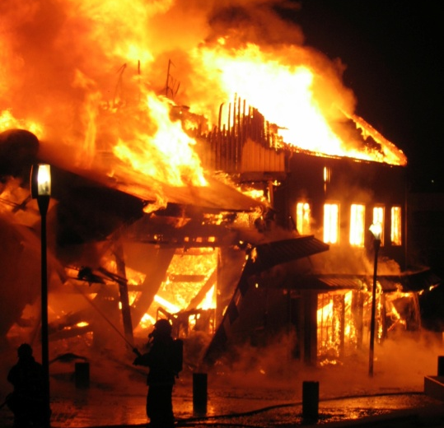
Fire
✓

Slide 23
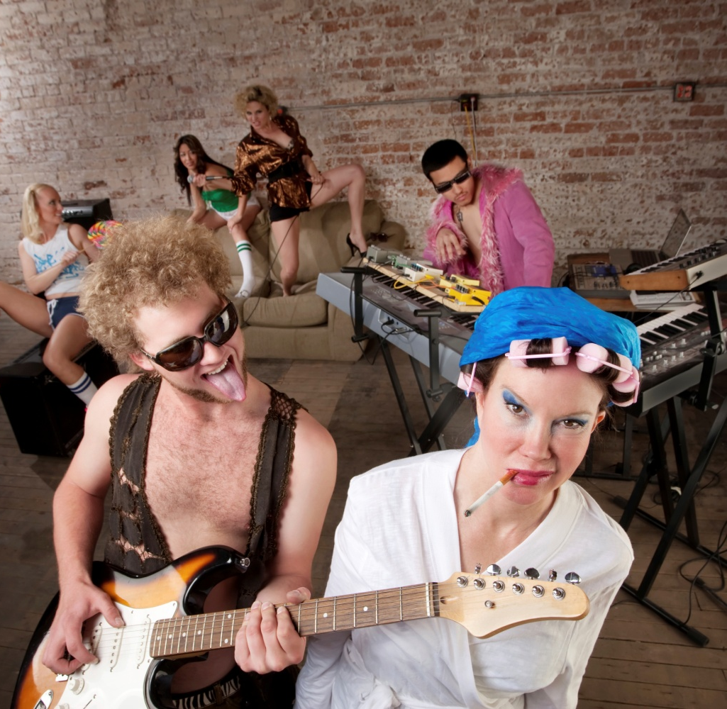
Noise
✓

Slide 24
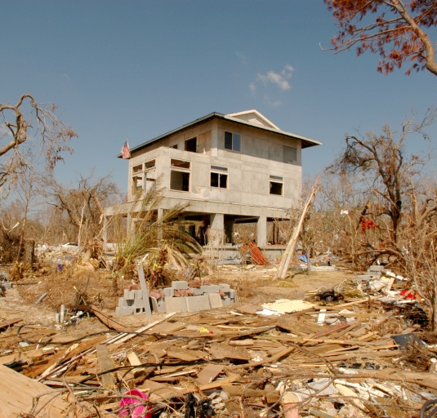
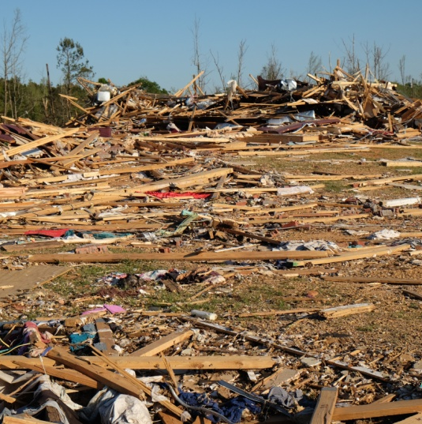
Resilience
✓

Slide 25
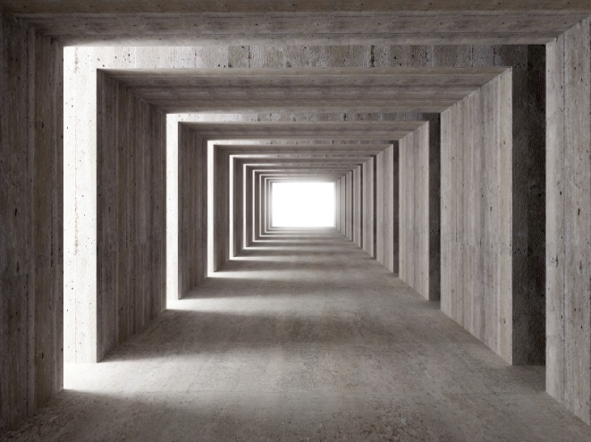
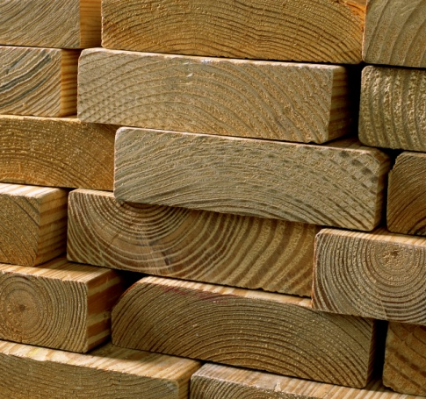
Green Building
✓

Slide 27
Wood = Low Cost (First Cost)

Slide 28
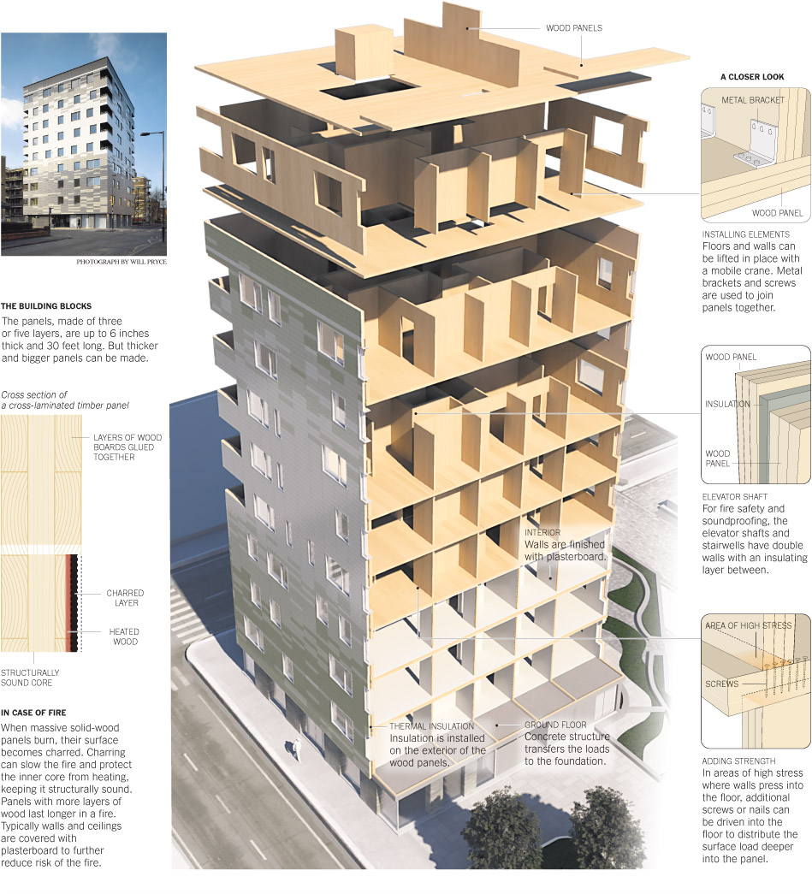
Wood = Innovation
Engineered Wood
Glue Lam
Cross Laminated Timber
Tall Buildings

Slide 29
Wood = Low Carbon (embodied)

Slide 30
Caution
We need to understand decision makers
Resist developing messages based on our feelings (we are too close to concrete)
Must identify key decision makers
Must identify key building sectors

Slide 31
STRATEGIES

Slide 33
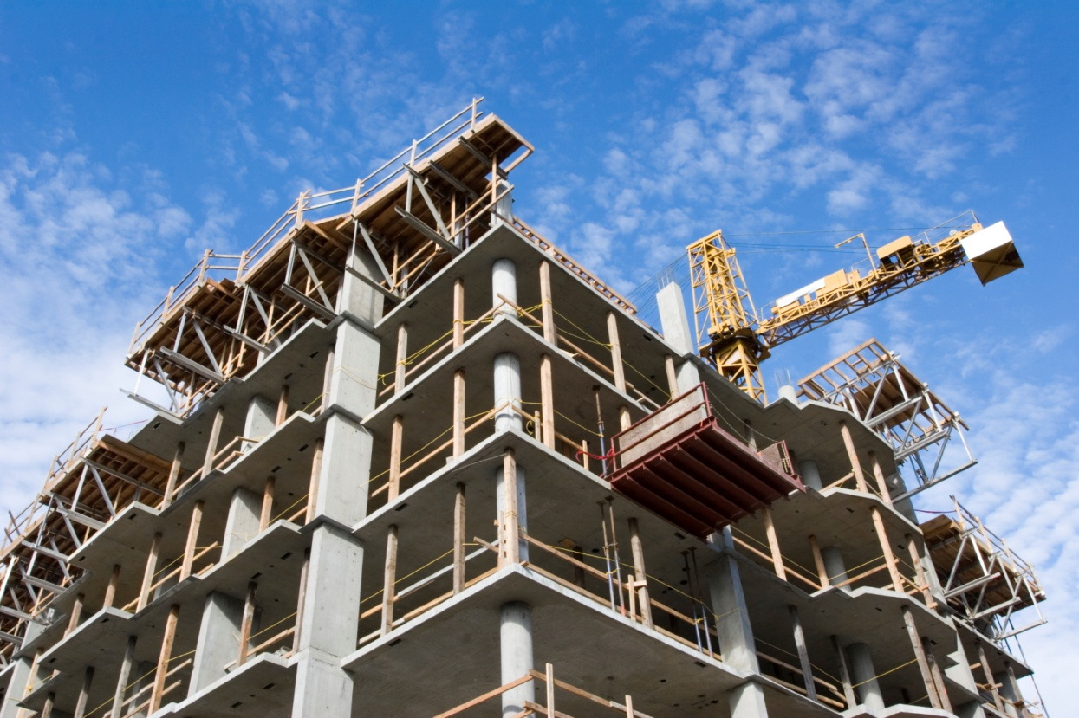
PRIMARY GOAL
Increase share of concrete in low- and mid-rise residential and non-residential construction by 50% in 5 years
33%
22%

Slide 34
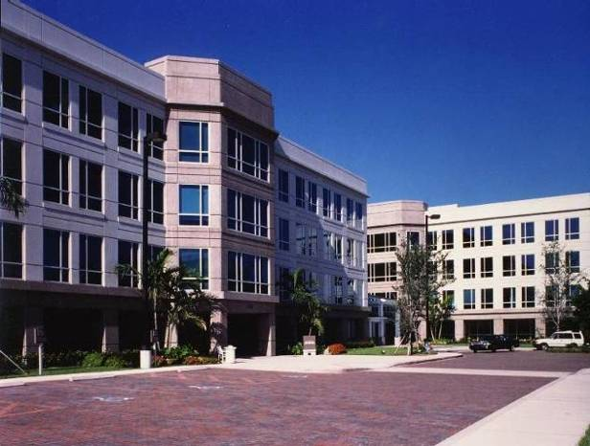
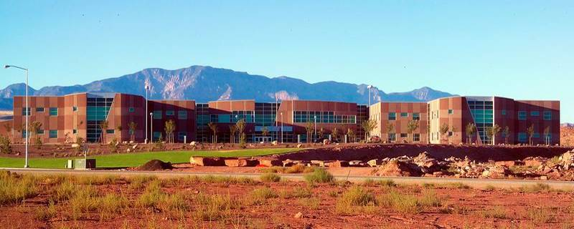
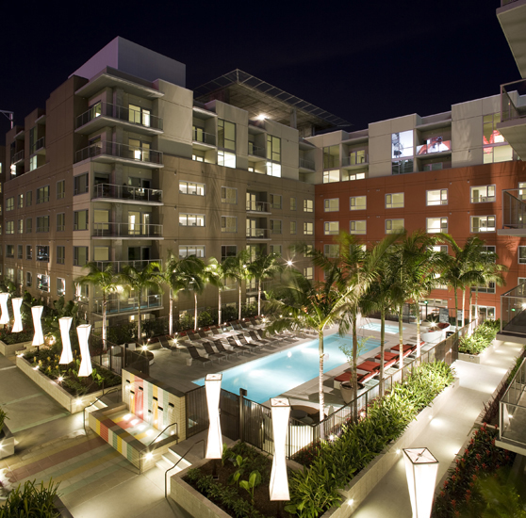
Notes:
Target Markets
Low- to mid-rise residential
Apartments
Hotels
Motels
Assisted Living
Dormitories
Low- to mid-rise non-residential
Office buildings
Schools
Retail
Manufacturing

Slide 35
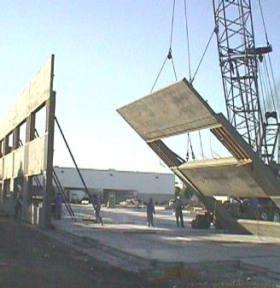
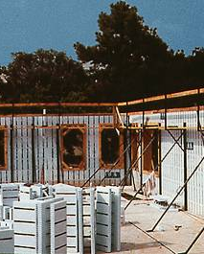
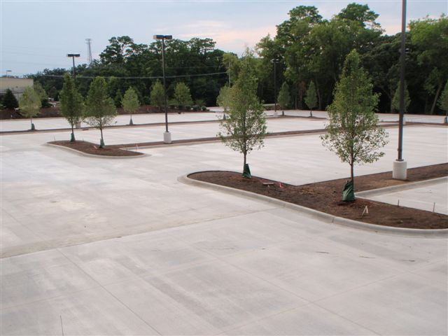
Notes:
Customer Focused
Offer solutions to their construction needs
Concrete frame, conventional and post-tensioned
Tunnel forms
ICFs
Tilt-up
Parking

Slide 37
STRATEGIES
Communications
Direct Project Promotion
Advocacy

Slide 38
PROJECT PROMOTION: Goals
Convert buildings to concrete
Increase knowledge of economical concrete construction
Increase knowledge of concrete benefits
Notes:
Di

Slide 39
PROJECT PROMOTION: Key Components
Personal consultative services
Design assistance for walls and floors
Feasibility and cost study
Education on economical design
Education on the benefits of concrete
Notes:
Di

Slide 40
UNDERSTANDING DEVELOPERS
First cost is the biggest hurdle
Understand value of concrete –durability, noise, fire
Would appreciate seeing concrete alternatives
REIT’s understand risks of wood vs. benefits of concrete
Increasing preference for “green building” among tenants

Slide 41
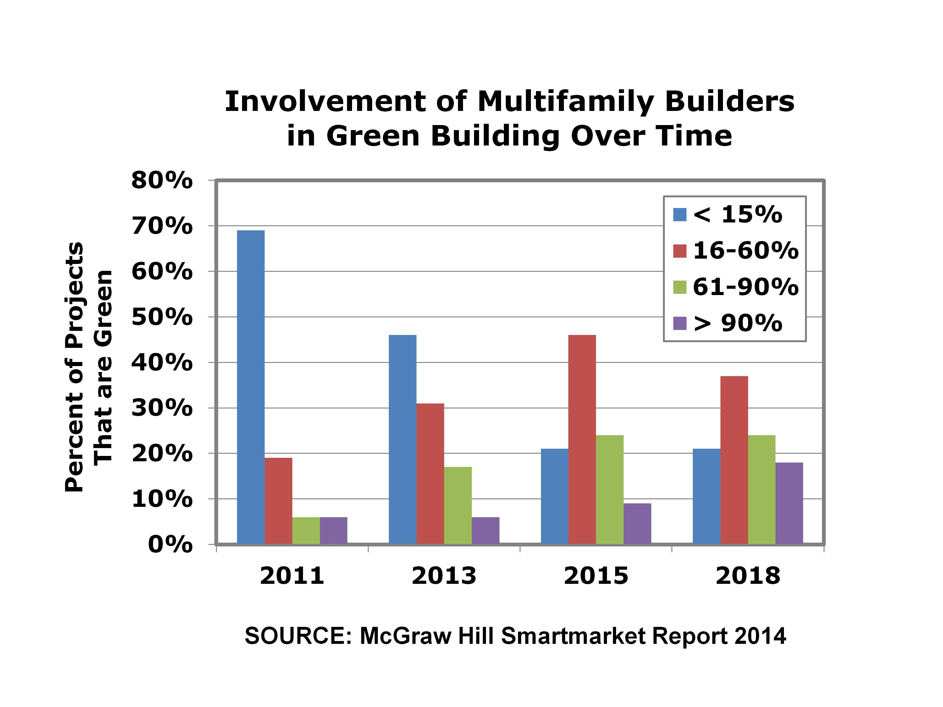

Slide 42
ADVOCACY: Goals
Adopt local building code changes favorable to concrete
Adopt resilient design standards
Stop wood gains in codes
Position industry for green building

Slide 43
ADVOCACY: Key Components
Engage local building code consultants
Engage national building code consultants
Pass federal resilience tax credits
Pass state lower resilience insurance rates
Pass local limits on wood construction
Accelerate green building certifications

Slide 44
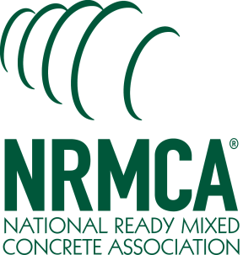
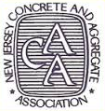

Slide 45
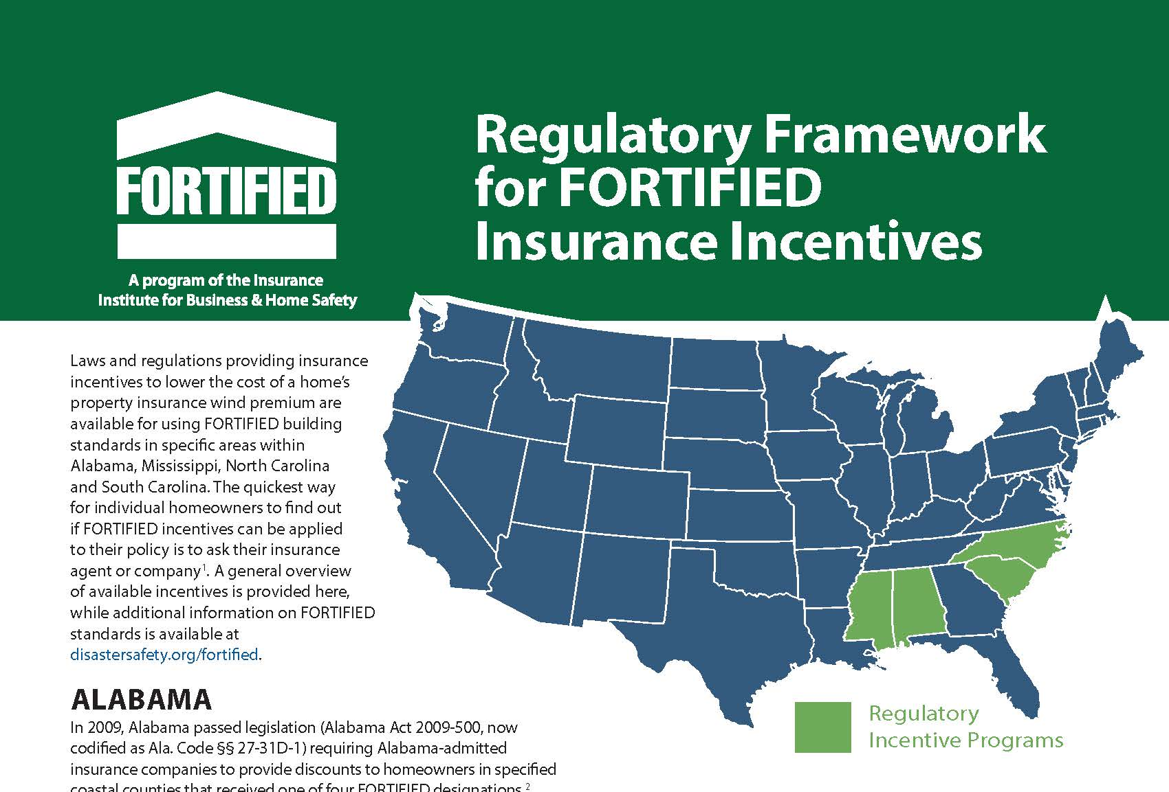

Slide 46
COMMUNICATIONS: Goals
Improve attitudes and perceptions
Increase use of design assistance
Increase attendance at education programs

Slide 47
COMMUNICATIONS: Key Components
Conduct market research
Advertise in key media outlets
Promote design assistance
Promote education programs
Exhibit at trade shows
Promote local code changes
Utilize MIT research

Slide 48
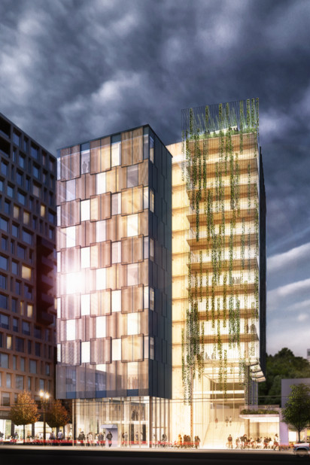
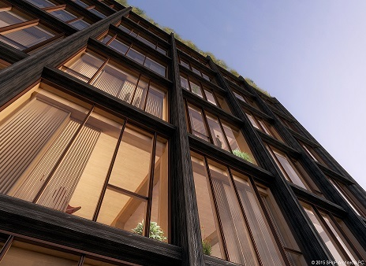
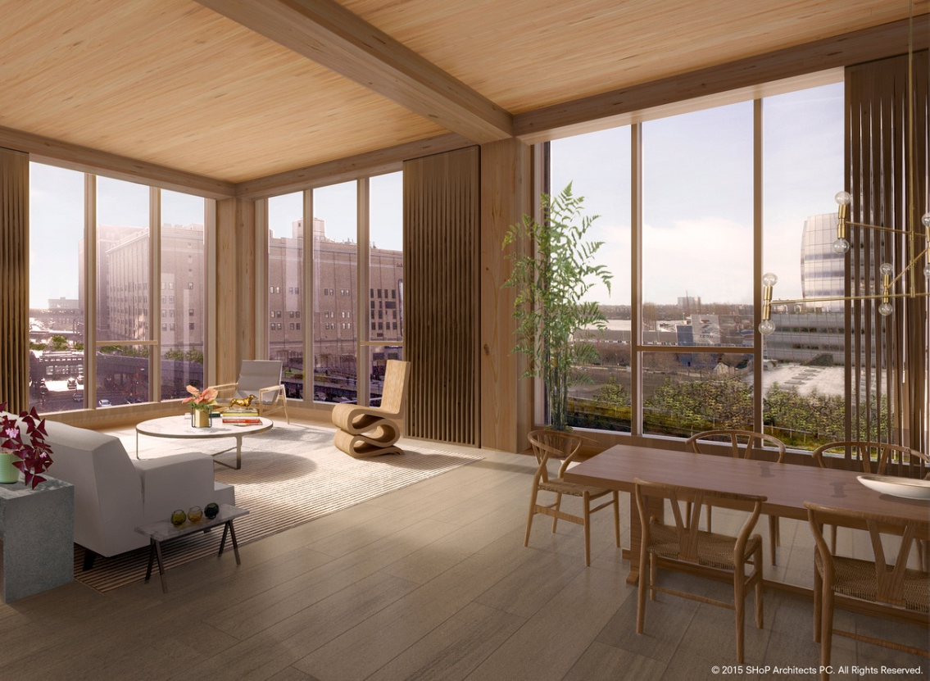
Proposals for Portland, New York Win US Tall Wood Building Prize

Slide 49
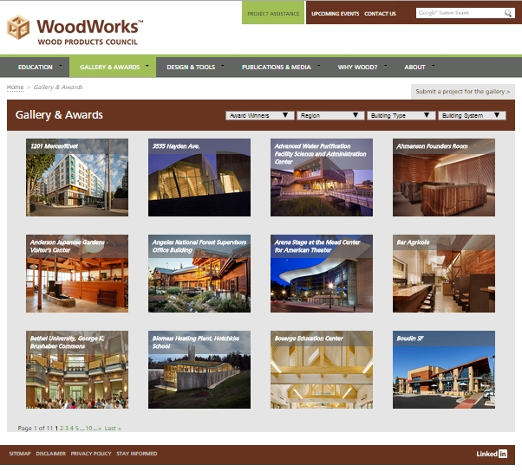

Slide 50
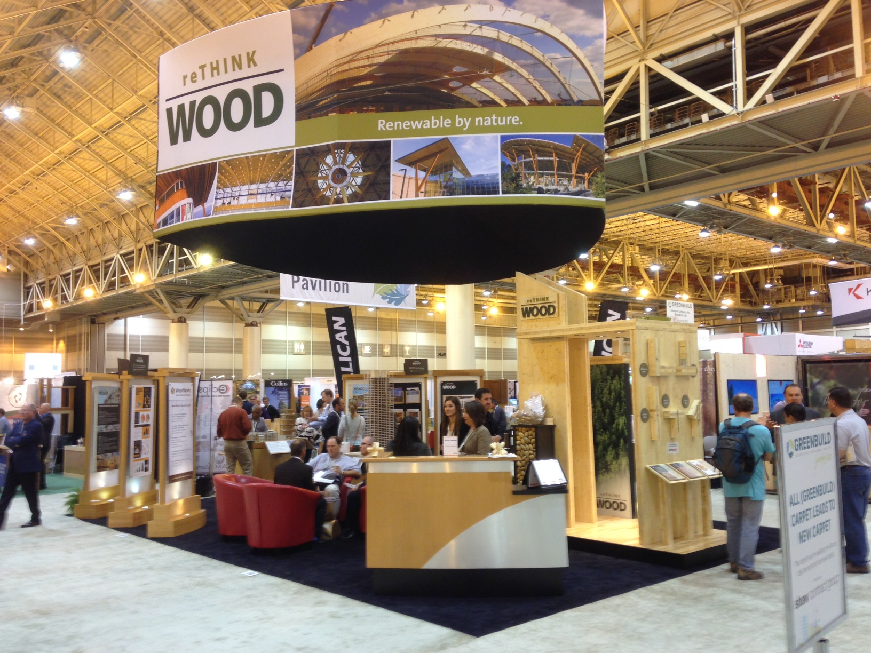

Slide 51
RESOURCES

Slide 52
New NRMCA Professionals
 | FY16 | FY17 | FY18
Project/Design Professionals
Communications Professional
Advocacy Professional
TOTALS | 6 | 2 | 2

Slide 53
New NRMCA Financial Resources
FISCAL YEAR | PROGRAM COSTS | HUMAN RESOURCES | TOTAL
FY16 | $2.05M | $1.50M | $3.55M
FY17 | $2.30M | $1.60M | $3.90M
FY18 | $2.35M | $2.00M | $4.35M
FY19 | $2.35M | $2.00M | $4.35M
FY20 | $2.35M | $2.00M | $4.35M

Slide 54
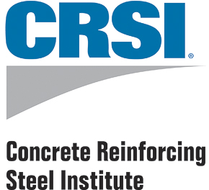
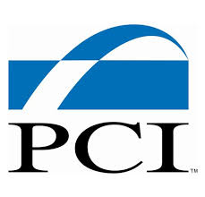
POTENTIAL PARTNERS

Slide 55
CONCRETE
HUMAN
RESOURCES
NRMCA New
Existing
22+
State Affiliates
PCA
CRSI
$$$$ $
CONCRETE
FINANCIAL
RESOURCES
NRMCA New
Existing
12 Million +
$$ $$ $$$
Affiliates
PCA
CRSI

Slide 56
Communication Targets
Concrete Programs | 2016 | 2017 | 2018 | 2019 | 2020
Website Visitors | 100,000 | 200,000 | 400,000 | 400,000 | 400,000
Tradeshows Attended | 3 | 6 | 6 | 6 | 6
Conferences Hosted | 1 | 1 | 1 | 1 | 1
Building Awards | 0 | 1 | 0 | 1 | 0
Case Studies | 4 | 8 | 12 | 12 | 12

Slide 57
CONCRETE
DESIGN
ASSISTANCE
150 projects
in 2018 and beyond
8 in 2018 and beyond
CONCRETE
EDUCATION
PROGRAMS
50
programs in 2018 and beyond
5,000 attendees in 2018 and beyond
CONCRETE
CODES
ADVOCACY
100
proposals reviewed and proposed
3 (2 new, 1 existing) by 2017

Slide 58
Green Building Targets
CONCRETE (FY16-FY18)
Environmental Product Declarations IW EPD for 48 Products 2000 product specific EPDs FY15 5000 product specific EPDs FY18
Responsible Sourcing CSC Certification FY16 Target acceptance by USGBC FY17 Target 5 companies certified FY16 Target 10 companies certified FY17 Target 20 companies certified FY18
Material Ingredient Disclosure Guide for concrete in FY16 Industry wide disclosure FY17 10 companies with HPDs FY17 20 companies with HPDs FY18

Slide 59
Integrating National and Local Resources

Slide 60
Potential Partnering
Identify developers /designers
Identify concrete contractors
Host education programs
Assist with advocacy
Exhibit and present at local trade shows
Advertise

Slide 61
Strategy for Promoting Concrete For Low/Mid-Rise Buildings

