Slide 1
NEW STORMWATER REGULATION
9VAC25
830 – Chesapeake Bay Act (CBA)
840 – Erosion and Sediment Control (ESC) (VESC)
850 – ESC & SWM Certification Regulations
870 – Stormwater Management Program (SWM) (VSMP)
880 – General VPDES for Discharges of Stormwater from Construction Activities
890 – General VPDES Permit for Discharges of Stormwater from Small Municipal Separate Storm Sewer Systems.

Slide 2
New Methods
BMP’s to be used
1. Vegetated Roof | 8. Extended Detention Pond
2. Rooftop Disconnection | 9. Sheetflow to Filter/Open Space
3. Permeable Pavement | 10. Wet Swale (Coastal Plain)
4. Grass Channel | 11. Filtering Practices
5. Dry Swale | 12. Constructed Wetland
6. Bioretention | 13. Wet Ponds
7. Infiltration | 14. Manufactured BMP
The first 3 are for both new and retrofit projects without increase in land disturbance

Slide 3
University of New Hampshire
Asphalt
Concrete
The UNHSC porous asphalt lot’s performance remains steady even in freeze thaw conditions. Researchers observed some of the highest inﬁltration rates in the winter—on average more than 1,000 inches an hour. Researchers observed frost penetration to depths of 27 inches in the ﬁlter media. While the pavement froze sooner, deeper, and for longer periods than the reference condition, the pores remained open and well- drained year round. The ability to maintain drainage minimized freezing and thawing in the subbase, contributing to the porous asphalt’s durability.
The winter performance of the pervious concrete system was exceptional year round for water quality, hydraulics, and inﬁltration capacity. Throughout the winter, the surface inﬁltration capacity averaged approximately 4,000 inches per hour with minimal change. Researchers observed frost penetration to depths of 15 inches in the ﬁlter media. While the pavement froze sooner, deeper, and for longer periods than the reference condition, the pores remained open and well-drained year round. This ability to maintain drainage limits freezing and thawing and contributes to the pavement’s long-term durability.

Slide 4
University of New Hampshire
Asphalt
Concrete

Slide 5
University of New Hampshire
Asphalt
Concrete

Slide 6
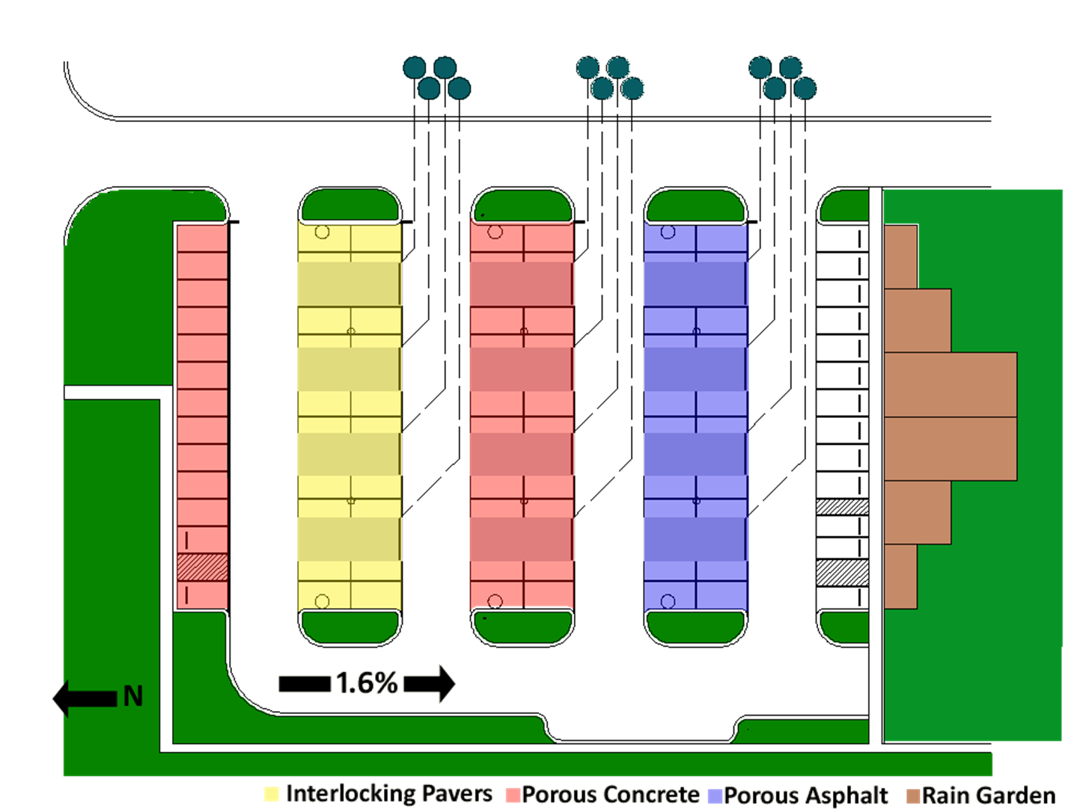
Test Sites
EPA Site Edison NJ
http://www.epa.gov/ednnrmrl/

