Slide 1
VRMCA 2015 Annual Meeting VA Beach, October 6 “Presidential Politics and the US Economy” Daniel Palazzolo Professor of Political Science University of Richmond

Slide 2
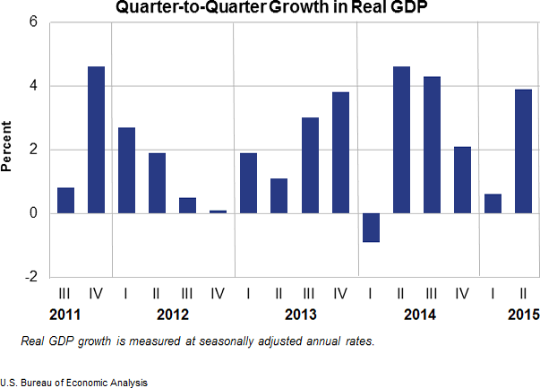

Slide 5
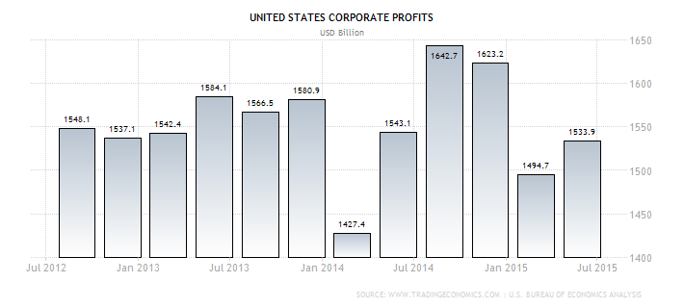

Slide 6
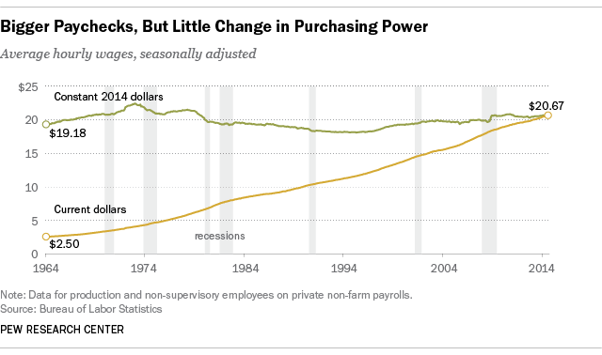

Slide 7
Trump Tax Plan Goals
Middle Class Tax Relief
Maintain deductions and credits for middle class
Eliminate Marriage penalty and Alternative Minimum Tax
Simplification
Four brackets
Eliminate all estate taxes
Economic Growth
Corporate Tax Rate 15%
Repatriate Corporate Profits at 10% rate
Eliminate Corporate Loopholes
“Reasonable” Business Expensing
Fiscal Responsibility?

Slide 8
Trump Tax Rates
Income Tax Rate | Long Term Cap Gains/ Dividends Rate | Single Filers | Married Filers | Heads of Household
0% | 0% | $0 to $25,000 | $0 to $50,000 | $0 to $37,500
10% | 0% | $25,001 to $50,000 | $50,001 to $100,000 | $37,501 to $75,000
20% | 15% | $50,001 to $150,000 | $100,001 to $300,000 | $75,001 to $225,000
25% | 20% | $150,001 and up | $300,001 and up | $225,001 and up

Slide 9
Trump Effects (Tax Foundation)
Strategy makes sense and gains over 10 years
11.5% GDP growth
29% increase in capital investment
5.3 million jobs
But…
-Revenues decline by $10.2 trillion
-Publicly held debt would increase from 77% to 125% of GDP

Slide 10
Jeb Bush Tax Plan
Individual Income Taxes
Three rates from seven: 28%, 25% and 10%
Double the Standard Deduction
Eliminates Marriage Penalty and ATM
Expands Income Tax Credit
Maintain charitable deductions
Cap deductions for the wealthy
Corporate Taxes
Cut rate from 35% to 20%
Repatriate Corporate Profits at 8.75% (10 years)

Slide 11
Bush Effects (Tax Foundation)
Gains over 10 years
10% GDP growth
28.8% increase in capital investment
2.7 million jobs
Increase revenues by $1.6 trillion

Slide 12
Marco Rubio Tax Plan
Individual Taxes
Two simple brackets—15% and 35%.
Replace standard deduction with personal exemption and credit
New child credit of $2500
Eliminate the marriage penalty and estate taxes
Corporate
25% top rate
Full expenses of investments
Exempt business from repatriating cash

Slide 13
Rubio Effects (Tax Foundation)
Gains over 10 years
15% GDP growth
49% increase in capital investment
2.7 million jobs
Increase revenues by $1.7 trillion

Slide 14
Hillary Clinton Economic Plan
Expansive agenda
See:
https://www.hillaryclinton.com/issues/plan-raise-american-incomes/

Slide 15
Bernie Sanders 10 year Economic Plan
Medicare for All ($15 trillion)
Increase Social Security ($1.2 trillion)
Infrastructure ($1 trillion)
College Affordability ($750 billion)
Paid family leave ($319 billion)
Bolster private pensions ($29 billion)
Youth Jobs Initiative ($5.5 billion)
Increase minimum wage to $15 per hour by 2020
Revenues: ($6.5 trillion)
- Increase income, capital gains, and estate taxes on earners who make $250,000 and above

Slide 16
GOP Nomination Process: Two Schools of Thought
New School
Traditional School
Outsider Prevails
GOP base is tired of politics as usual
GOP Politicians have not delivered needed change
Grassroots needs to takeover the process
50% or more voters are consistently supporting an outsider
Republicans eventually fall in line
Winner needs to raise $
Winner needs organization/endorsements
Too early to make much of polls: voters will come around
Need to link together establishment with grassroots

Slide 17
GOP Tracking Poll: 2015 (realclearpolitics ave: 9/17-10/1)

Slide 18
GOP Nomination 2007-08

Slide 19
GOP Nomination 2011-12

Slide 20
Fundraising (through 2nd quarter)

Slide 21
Endorsements
Bush
5 Governors
7 Senators
25 House Members
15 Statewide
Rubio
1 Governor
5 House Members
5 Statewide

Slide 22
Trump’s Endorsements

Slide 23
Winning in N. Korea
Dennis Rodman
Kim Jong Un

