Slide 1
VRMCA 2014 Annual Meeting VA Beach, September 9 “Economic and Political Forecast” Daniel Palazzolo Professor of Political Science University of Richmond

Slide 2
Economic Good news
Two years ago we thought it would be a sluggish recovery and the economy has improved on several indicators…
GDP Growth up in the 2nd Quarter (4%)
Corporate profits up
Housing sales existing homes up 2.6% in June on pace
for 5.04 million, but below the 5.16 million last year; new homes at 412,000, above the 367,000 last July (NAHB)
Durable goods up 5 of the last 6 months (22% in July)
Consumer confidence up to 92.4 from 90.3 in July
Unemployment below 6.1%
Virginia is doing relatively well in terms of employment at 5.4% , up from 4.9 % in Feb; Mixed throughout the state.

Slide 3
Warning Signs
…But the effects of Fiscal and Monetary policy are either limited or uncertain.
Labor Force Participation down
Wages and benefits increased only slightly and behind profits
Median Family Income down 5% from 2010-13
Health care cost increases have slowed, but projected to grow at 6% per year for the next 8 years.
Annual deficits down from historic highs, but Federal debt projections remain robust.
Effects of Federal Reserve’s QE policies remain uncertain; not sure when the Fed will let up on low interest rates (wisdom and effects of monetary policy are debated).
Federal budget favors transfer payments (i.e. entitlements) and squeezes out discretionary spending.
State budgets are strapped. VA $2.4 billion shortfall; Governor blames on sequestration and cuts in defense in particular

Slide 4
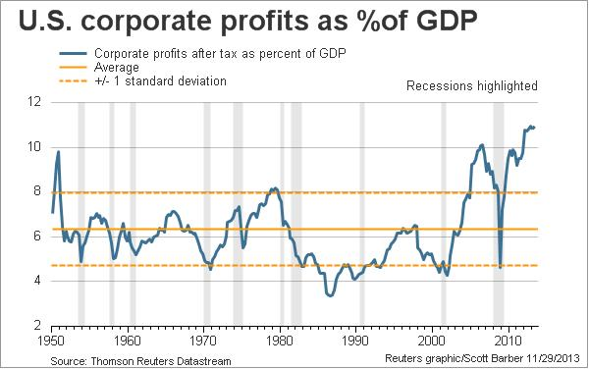

Slide 5
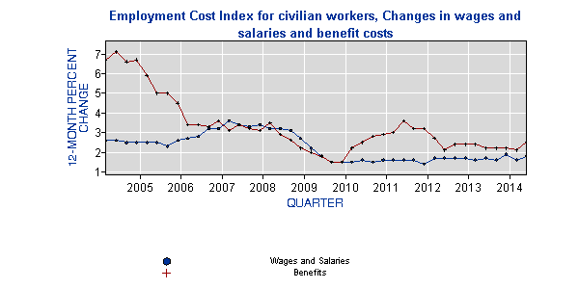

Slide 7
Unemployment Rate: March 2008- Aug 2014 (Bureau of Labor Statistics)

Slide 8
Labor Force Participation Rate: August 2004-August 2014 (Bureau of Labor Statistics)

Slide 9
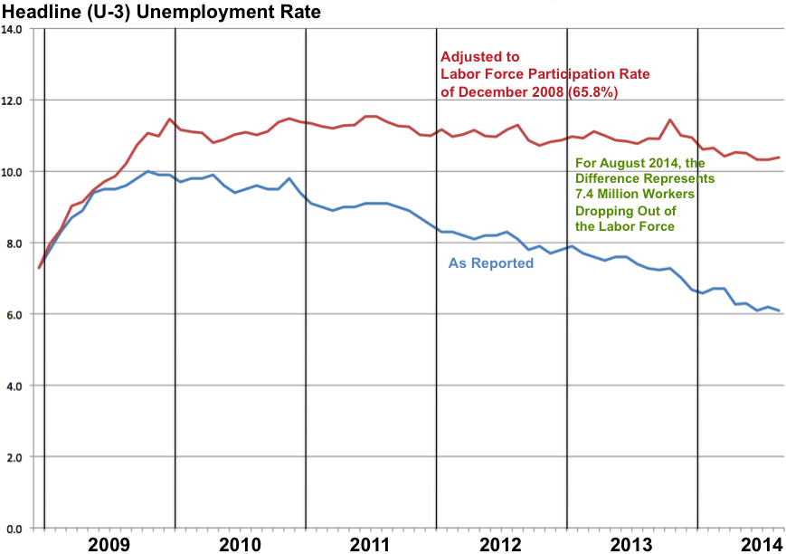

Slide 10
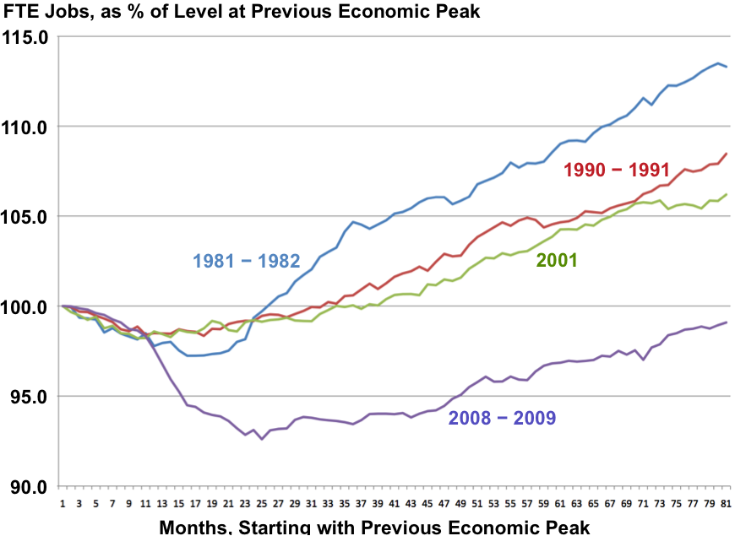

Slide 11
Unemployment in Areas of VA: August 2014

Slide 12
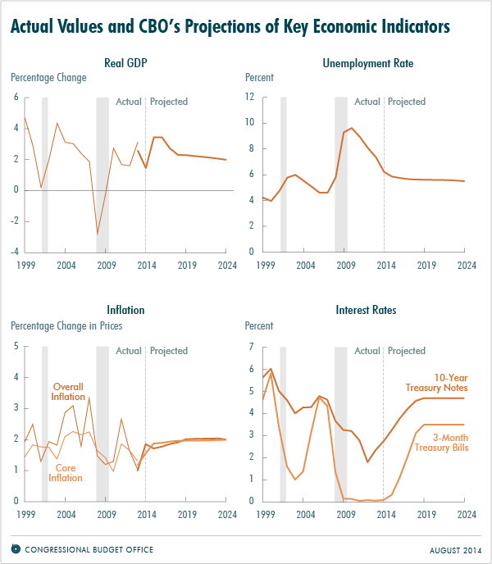

Slide 13
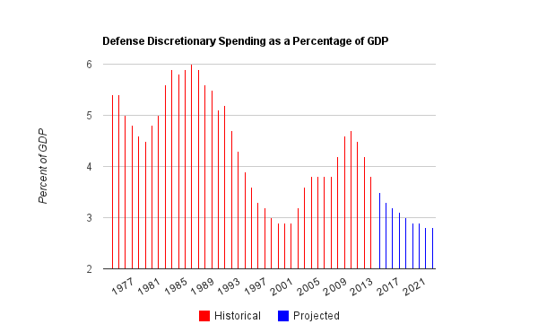

Slide 14
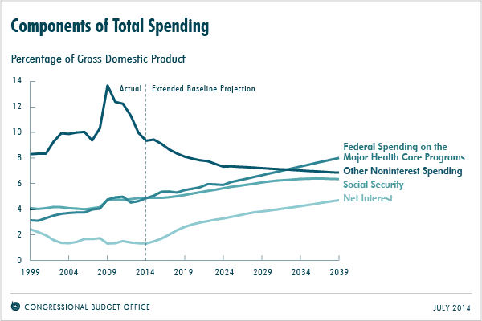

Slide 15
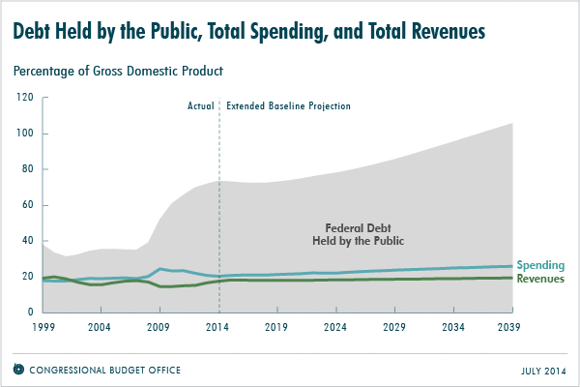

Slide 16
What policies have coincided with the economy?
Bank regulations and health care reform
Tighter credit and more uncertainty, with lower interest rates—selective opportunities for growth
Stimulus through government spending followed by spending cuts and tax increases
Quantitative Easing

Slide 17
National Political Outlook
Divided Government: Democratic president, House GOP majority, and Senate up for grabs.
If GOP takes a majority of Senate?
Policy Agenda: Maybe tax reform
Votes on XL Pipeline, trade agreements, natural gas imports, and repealing the medical device tax.
McConnell: use of budget process has limits
Tea Party and compromise

Slide 18
Virginia Politics
Senate GOP majority, plus Cantor defeat makes Medicaid expansion very difficult
Governor McAuliffe. Will he work across party lines or use the governorship to position himself for another office.

