Slide 1
LEEDv4: Keeping Up with the Acronyms
Tien Peng, Assoc AIA, LEED AP BD+C, PMP
Vice President, Sustainability
tpeng@nrmca.org

Slide 2
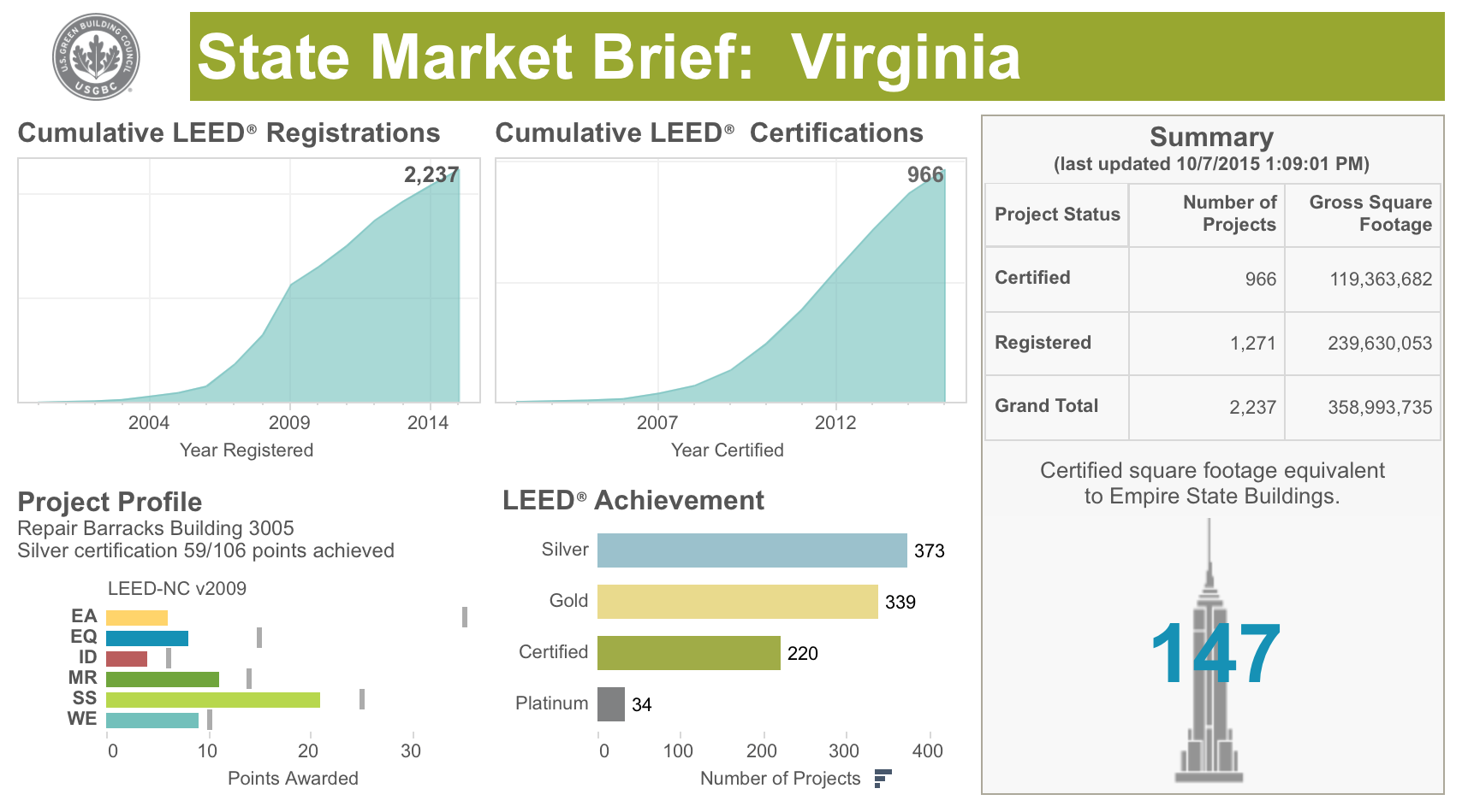

Slide 3
Prius vs. Hummer
CNW Marketing Research, Inc.’s 2007 “Dust to Dust: The Energy Cost of New Vehicles From Concept to Disposal”
50mpg 9mpg
Notes:
The CNW Marketing Research, Inc.’s 2007 “Dust to Dust: The Energy Cost of New Vehicles From Concept to Disposal” claim that a Hummer H3 SUV has a lower life-cycle energy cost than a Toyota Prius hybrid.
According to a study by CNW Marketing, the total combined energy to produce a Prius (consisting of electrical, fuel, transportation, materials and hundreds of other factors over the expected lifetime), is greater than what it takes to produce a Hummer:
The Prius costs an average of $3.25 per mile driven.
The Hummer, on the other hand, costs a more fiscal $1.95 per mile to put on the road.

Slide 4
Interaction Between the Economy and the Environment
Economy / Technosphere
Realm of human activity
- consumption
Notes:
We now know the term “Eco-Friendly” is relative: LCA’s transforms our notions of "green" from what seems a binary judgment—green or not into a far more sophisticated arena of fine distinctions, each showing relatively better or worse impacts along myriad dimensions. The methodology tracks, organizes, and displays the complex inter-relationships among all the steps from extraction and manufacture of goods through their use to their disposal— and summarize how each step matters for ecosystems, whether in the environment or in our body.

Slide 5
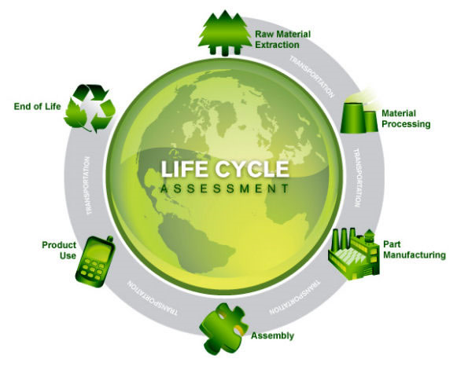
Life Cycle Assessment- "Compilation and evaluation of the inputs and outputs and the potential environmental impacts of a product system throughout its life cycle” Source: ISO 14040
Notes:
Environmental life cycle assessment (LCA) is the investigation and valuation of the environmental impacts of a given product, process or service.
LCA evaluates all stages of a product’s life and considers each stage interdependent, meaning that one operation leads to the next. Later on today I’m going to give a much more detailed explanation of LCA. It is simply investigating and putting a value on environmental impacts.
But before we get into the process of conducting Life Cycle Assessment, I would like to explain what environmental impacts are.

Slide 6
Evaluating different impacts
Human Health
Ecosystem Health
Social
Equity
Respiratory
diseases
Extinction
of species
Reduced
resource
base
Seawater
level
Dying
forests
cancer
Nutriphication
Ozonelayer
Carcinogen
Acidification
Ecotoxicity
Fossil fuel
Radiation
Land-use
Minerals
Smog
Climate
Life cycle inventory of environmental flows – CO2 NOx Pb, land ect

Slide 7
LEED v4 Points by Credit Category
Credit Category | LEED v4 Points | LEED 2009 Points
IP – Integrative Process | 1 | 0
LT - Location & Transportation | 16 | 0
SS - Sustainable Sites | 10 | 26
WE - Water Efficiency | 11 | 10
EA - Energy & Atmosphere | 33 | 35
MR - Materials & Resources | 13 | 14
EQ - Indoor Environmental Quality | 16 | 15
ID - Innovation | 6 | 6
RP - Regional Priority | 4 | 4
TOTAL | 110 | 110
Notes:
LEED is divided into categories. There are 5 main categories and two bonus categories. Each category has a series of pre-requisites and credits associated with that topic. You can see here how the points are weighted and have changed with LEED 2009.

Slide 8
LEED v4 Materials & Resources Credits
Notes:
LEED v4 (was 2012) – 6th Public Comment Period (21,000 since First).
LEED 2009 will be open for registration until June 1, 2015
Sixth public comment will be open till March 31st 2013.
Intend to open ballot June 1 - June 30, 2013.

Slide 9
Marketing

Slide 10
Disclosure

Slide 11
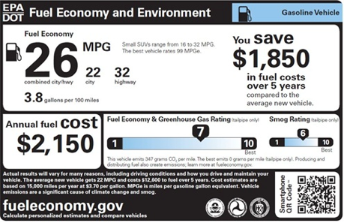
Disclosure
Notes:
The Nutrition Labeling and Education Act (NLEA) (Public Law 101-535) is a 1990 United States Federal law. It was signed into law on November 8, 1990 by President George H. W. Bush

Slide 12
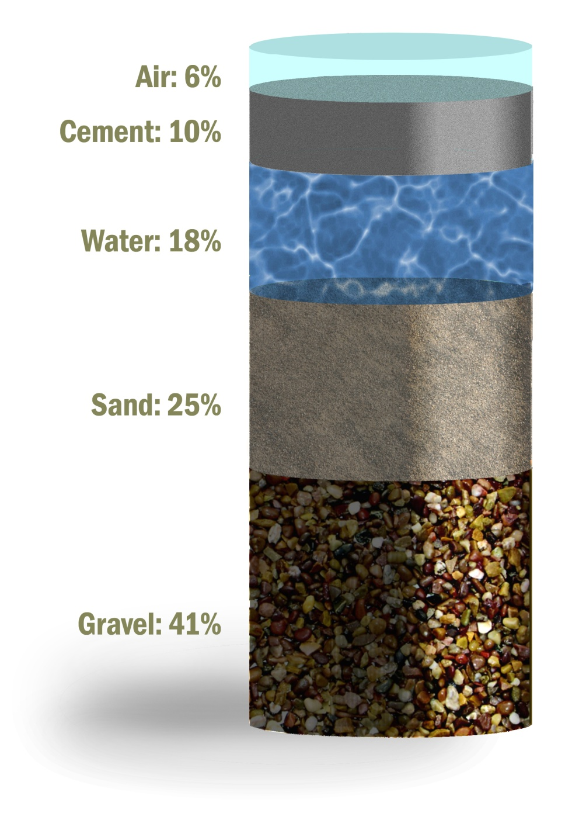
Concrete
Recycled Content
Typical
Potential
0-25%
15-70%
0%
10-100%
0%
10-50%

Slide 13
Holistic- Life Cycle
Single Attributes -
EMBODIED
ENERGY
RENEWABLE
TRANSPORT
DISTANCE
RECYCLED
CONTENT
Notes:
If all products are connected - a shift from substance bans.
With life cycle perspective, the existence of a pollutant in the life cycle is guaranteed.
Therefore, the amounts of pollutant and not the existence of a pollutant which is most important.
Quantification in needed

Slide 14
LEED v4
MATERIALS & RESOURCES POSSIBLE 13
MRp1 | Storage and collection of recyclables | REQ
MRp2 | Construction and demolition waste management planning | REQ
MRC1 | Building life-cycle impact reduction | 5
MRc2 | Building product disclosure and optimization – environmental product declarations | 2
MRc3 | Building product disclosure and optimization – sourcing of raw materials | 2
MRc4 | Building product disclosure and optimization – material ingredients | 2
MRc5 | Construction and demolition waste management | 2
Notes:
LEED2009 14 points

Slide 15
ENVIRONMENTAL PRODUCT DECLARATIONS

Slide 16
Environmental Product Declarations
Option 1 – EPDs (1 point)
20 Permanently Installed Products
Product specific declaration –publicly available (1/4 product)
Industry average EPD – Third party certified Type III (1/2 product)
Product specific EPD – Third party certified Type III (Full product)
USGBC Approved Program
Notes:
To encourage disclosure about environmental attributes and increase the use of products and materials with environmentally, economically, and socially preferable life-cycle impacts.
Achieve one or more of the options below, for a maximum of 2 points.
Option 1. Environmental Product Declaration (EPD) (1 point)
Use at least 20 different permanently installed products sourced from at least five different manufacturers that meet one of the disclosure criteria below.
Product-specific declaration.
o Products with a publicly available, critically reviewed life-cycle assessment conforming to ISO 14044 that have at least a cradle to gate scope.
o Products with a product-specific declaration are valued as one quarter (1/4) of a product for the purposes of calculation.
Industry-wide (generic) EPD.
o Products with third-party certification (Type III), including external verification, in which the manufacturer is explicitly recognized as a participant by the program operator.
o EPD must conform to ISO 14025, 14040, 14044, and 21930 and have at least a cradle to gate scope.
o Products with industry-wide EPDs are valued as one half (1/2) of a product for purposes of calculation.
Product-specific Type III EPD.
o Products with third-party certification (Type III), including external verification.
o EPD must conform to ISO 14025, 14040, 14044, and 21930 and have at least a cradle to gate scope.
o Products with Product-specific Type III EPDs are valued as one whole product for purposes of calculation.
USGBC approved program
o Products that comply with other environmental product declaration frameworks approved by USGBC
Products must be sourced from at least five different manufacturers.

Slide 17
What are EPDs?
EPD
LCA
Data
PCR
Environmental
Product Declarations
Life
Cycle
Assessment
Data:
Life Cycle Inventory Data, plant specific
Product
Category
Rule
Notes:
Envoronmental Product Declarations (EPD) are reports produced by a product manufacturer that provide quality assured and comparable information regarding environmental performance of their product. The EPD is developed from a Life Cycle Assessment (LCA) of the product. Generally, industry trade associations help develop a product category rule for their product category (such as concrete or shampoo or soda bottles). This rule provides instructions on how to conduct the LCA in order to develop the EPD. Plant specific data is required for conducting an LCA for the product.
EPDs will be required by project owners, LEED 2012, Architecture 2030 and IgCC. The output from EPDs are used to then populate data for whole building LCAs.

Slide 18
Prius vs. Hummer – Life Cycle
109,000 379,000
32 lbs
65+lbs
Notes:
One of the shortcomings of the CNW report on vehicles was its methodological inconsistencies, assuming the hybrid travels 109,000 total vehicle lifetime miles while assigning a whopping 379,000 lifetime miles to the Hummer. Clearly, not an “apples to apples” comparison, hence, skewing the conclusions of the report.
The average Hummer H1 is assumed to travel 379,000 miles and last for 35 years, while the average Prius is assumed to last only 109,000 miles over less than 12 years.
By focusing on one component of a vehicle, the hybrid battery, the CNW study neglected to account for the massive quantities of nickel in the steel frame (twice as much in the Hummer than the hybrid battery), chrome plating, and engine block. The thoroughness of the MIT study, in contrast, considered the building operational life as a whole system rather than the component material impact.
Here we see the major challenge with conducting LCAs - information on system boundaries, processes allocation, and impact-weighting need to be spelled out clearly and peer reviewed.
Thus, sharing the story of their analysis to stakeholders in a meaningful, replicable way, which is an important part of the process.

Slide 19
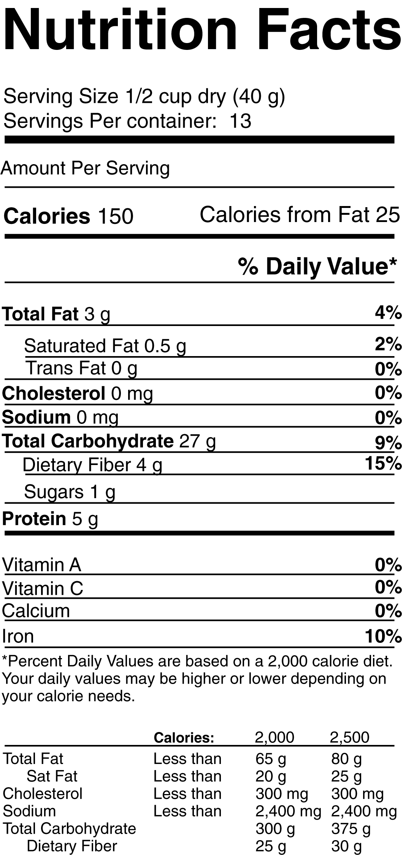
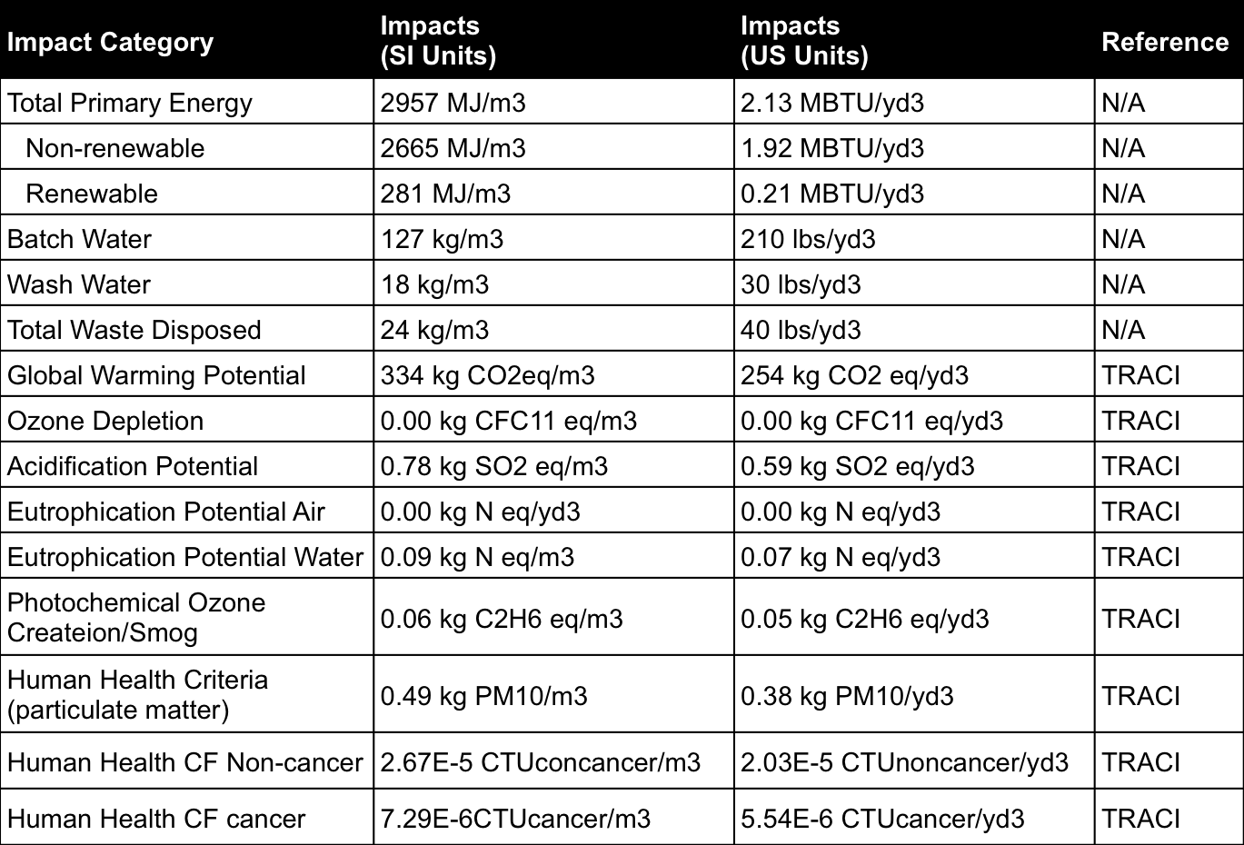
Type III EPD

Slide 20
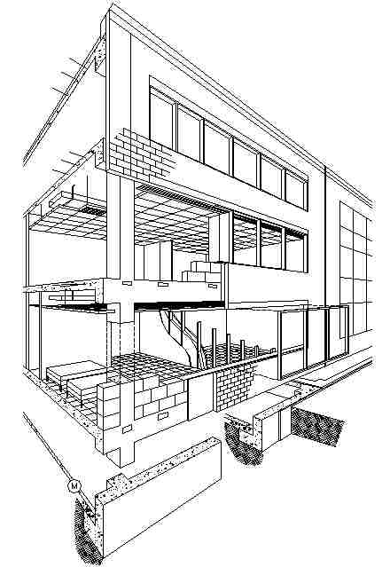
Advantage: Concrete
Roof slab
Lightweight slabs
Parapets
Normal weight slabs
Shear Walls
Lightweight beams
Stairs
Normal weight beams
Exterior walls
4000 psi columns
Sidewalks
6000 psi columns
Plazas
Basement slabs
Parking areas
Grade beams
Pervious concrete
Spread footings
Driveways
Caissons
Curbs
Piles

Slide 21
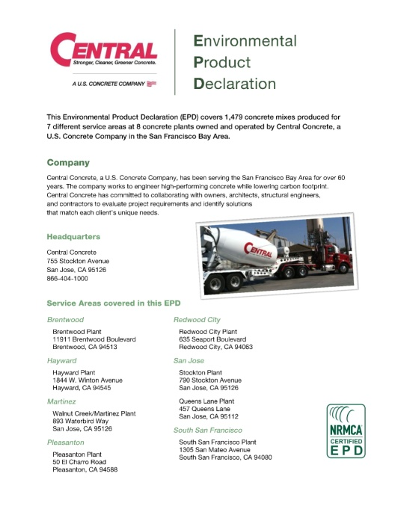
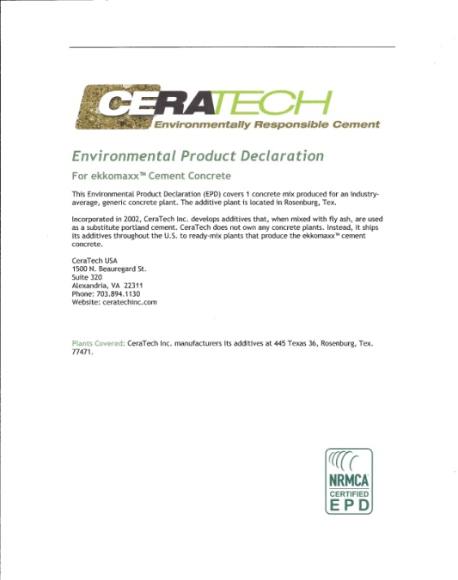
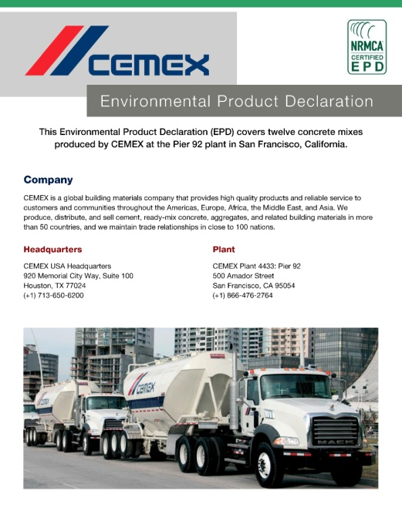
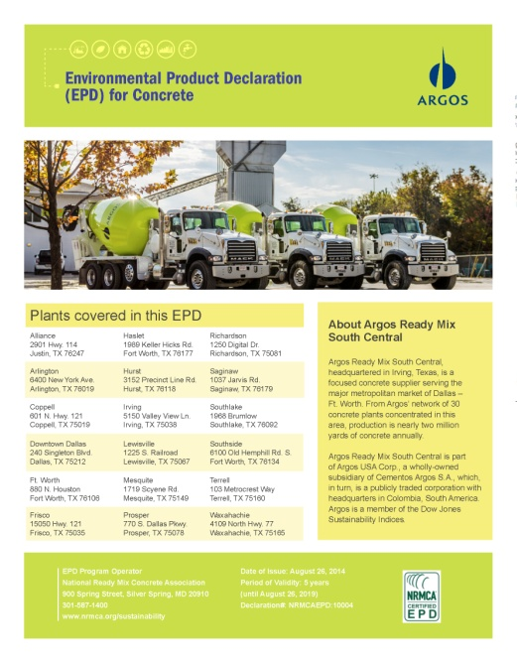
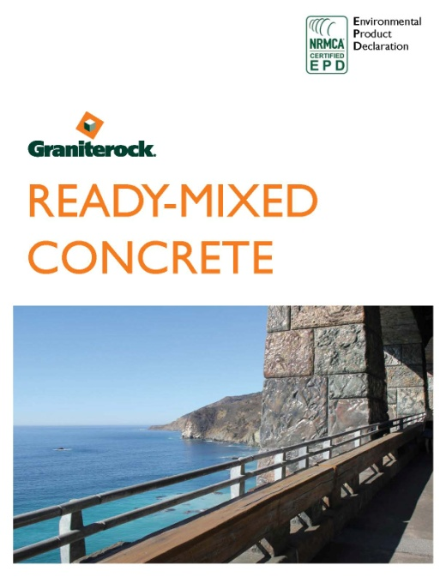
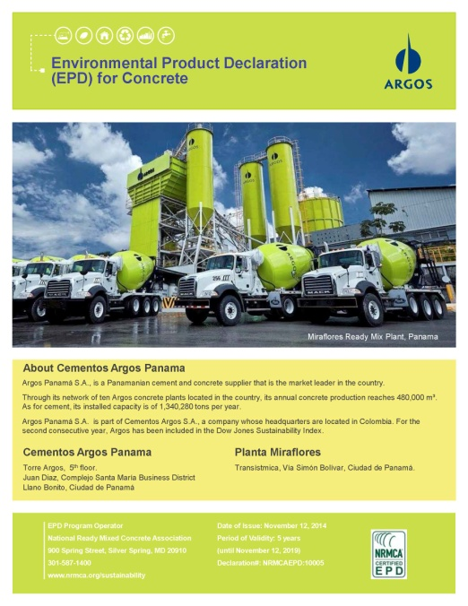
Product Specific EPDs
7 EPDs in NRMCA EPD Program
2300 products
4 EPDs in other programs

Slide 22
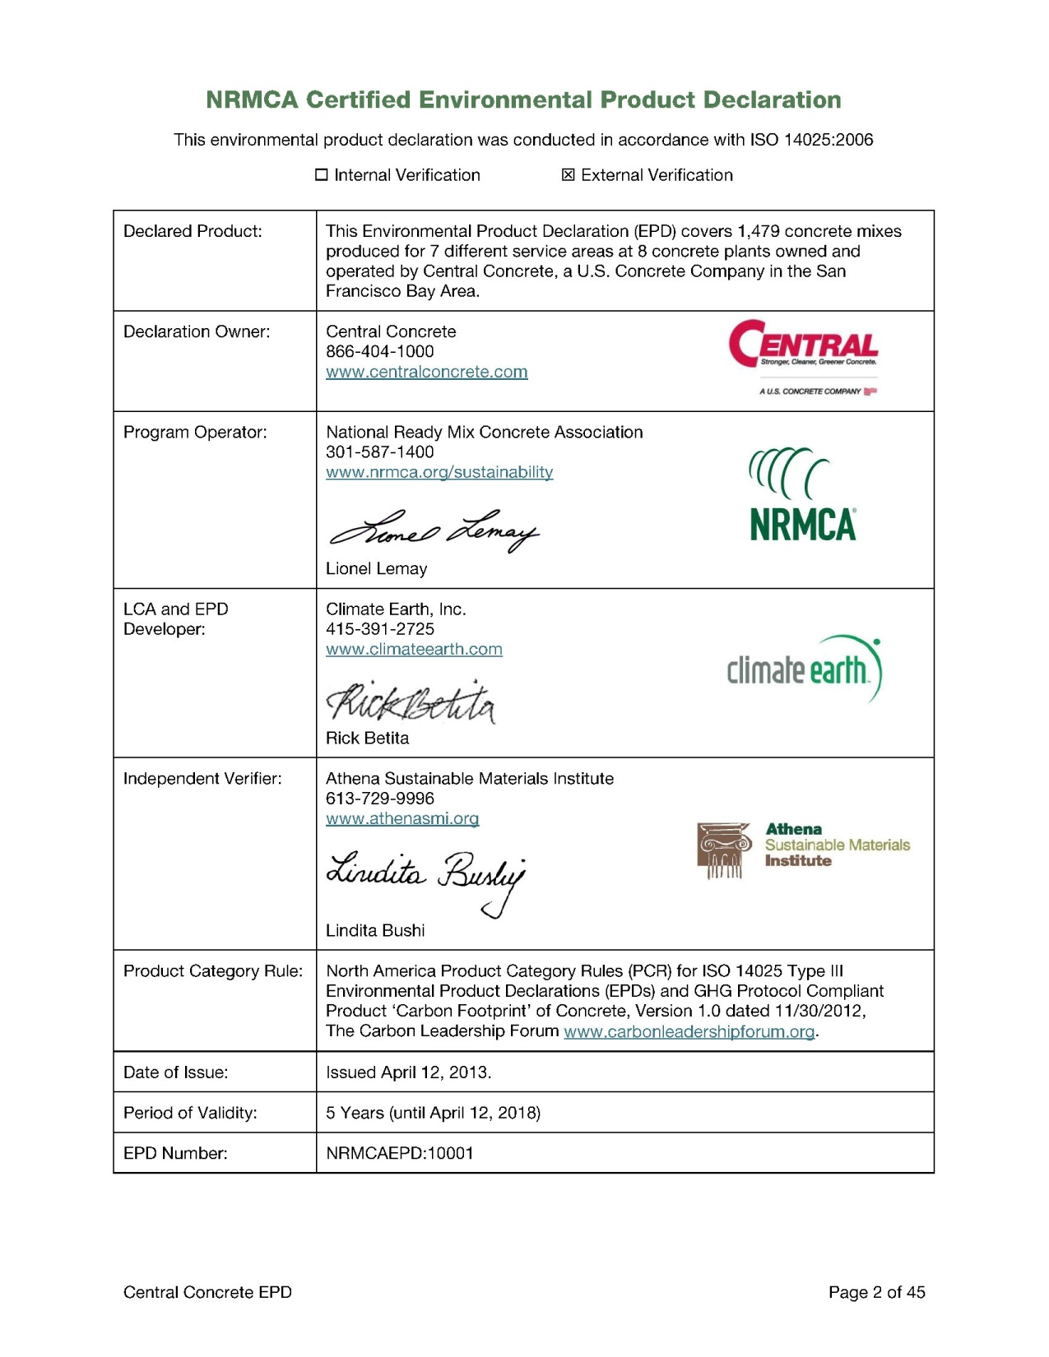
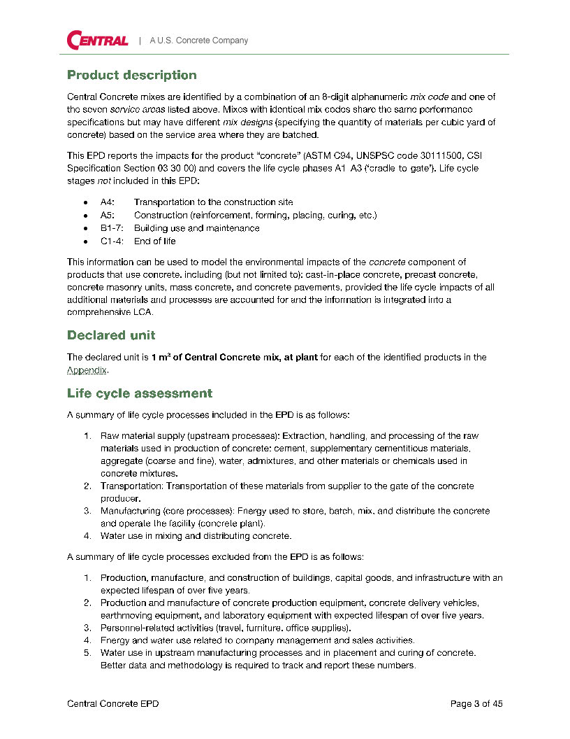
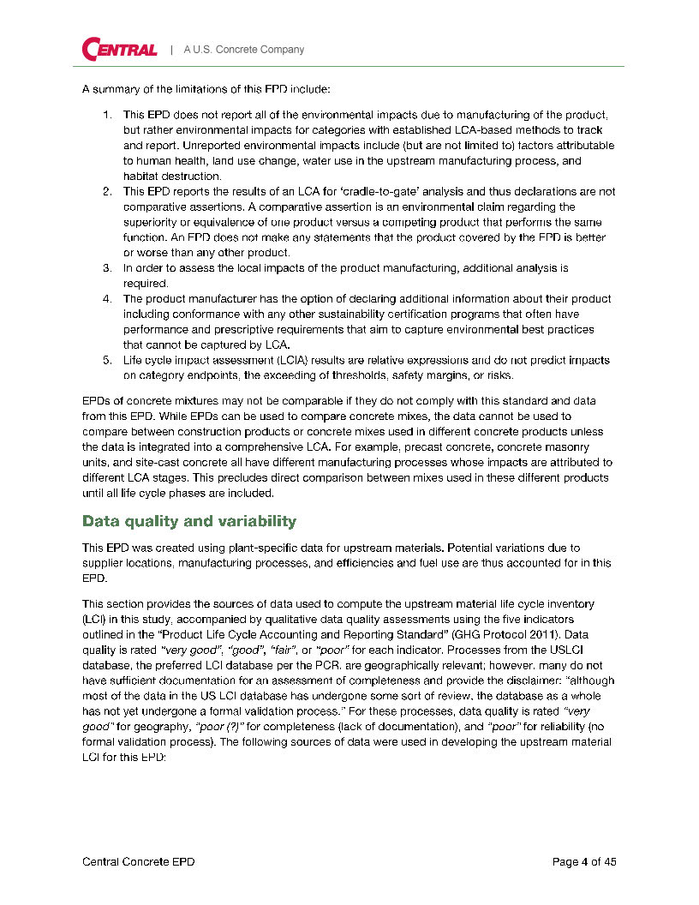
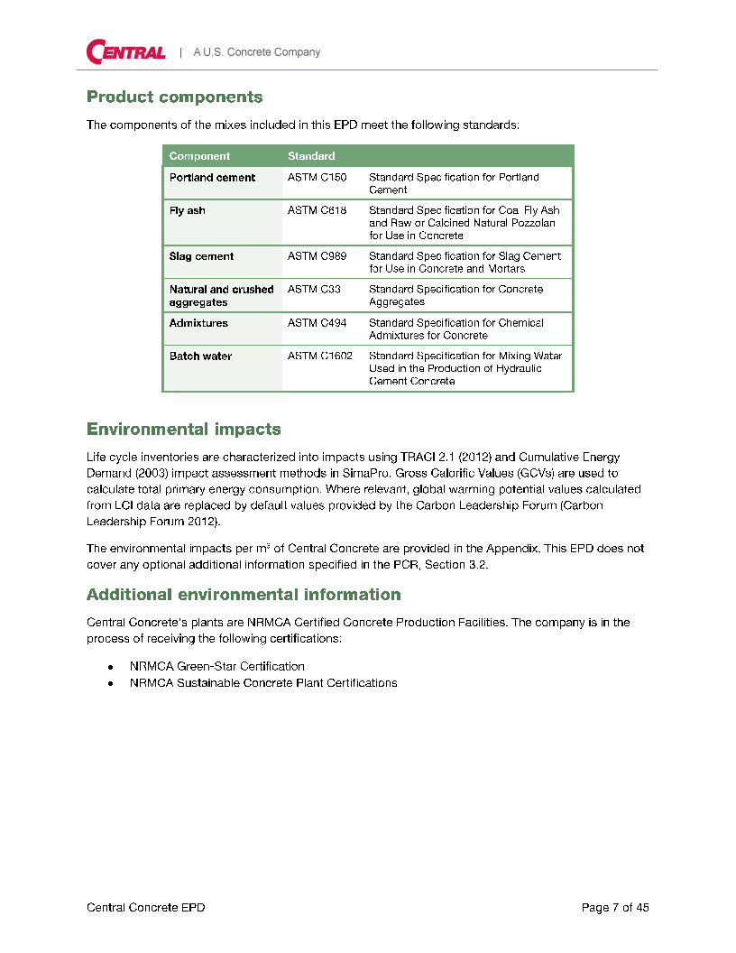
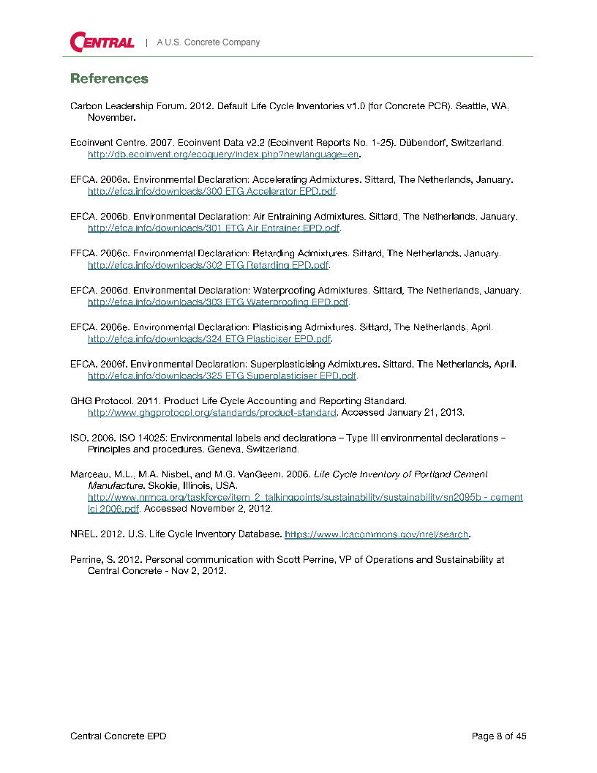
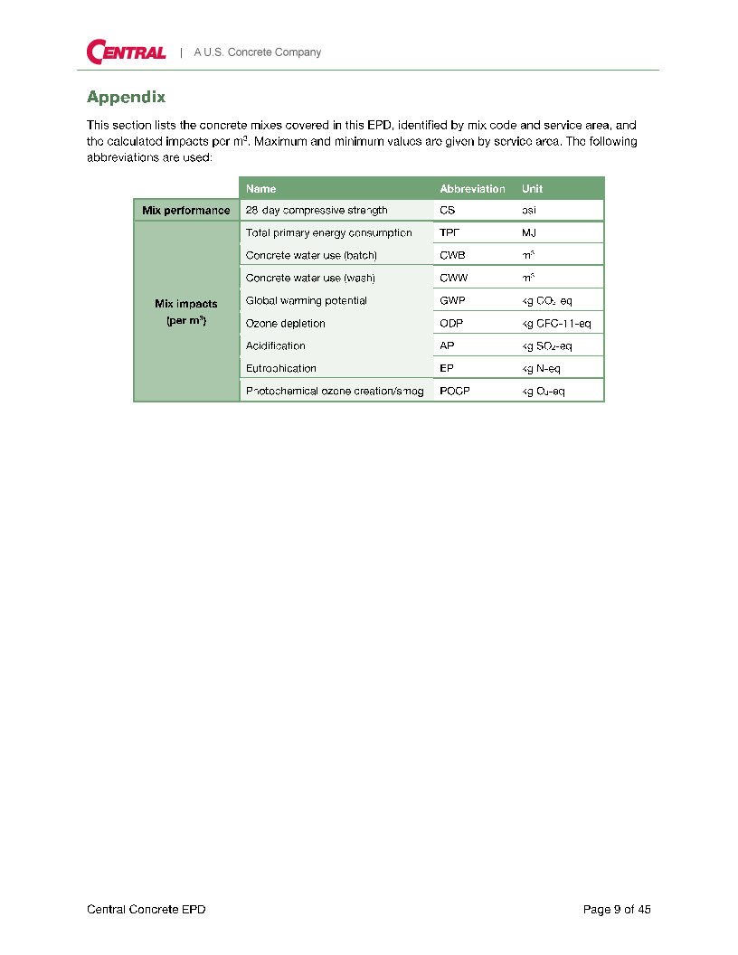
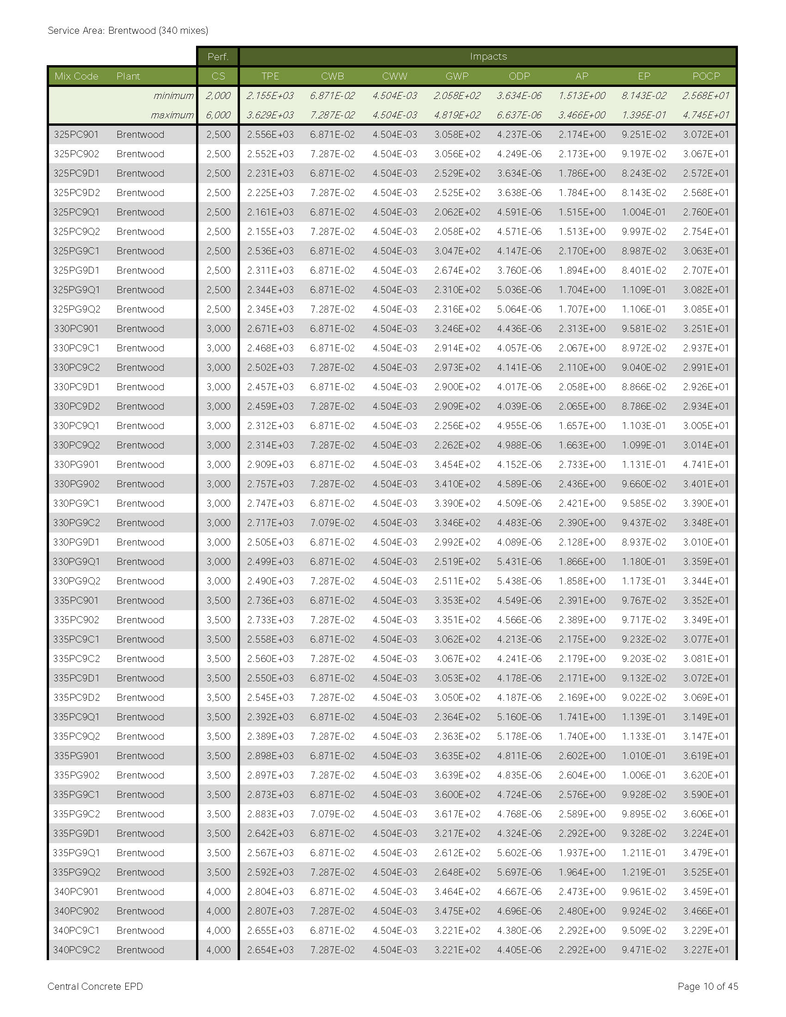
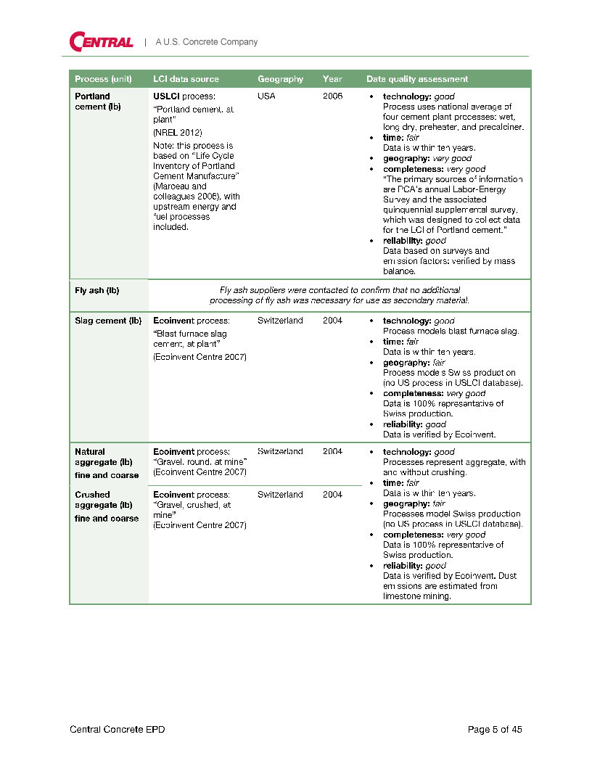
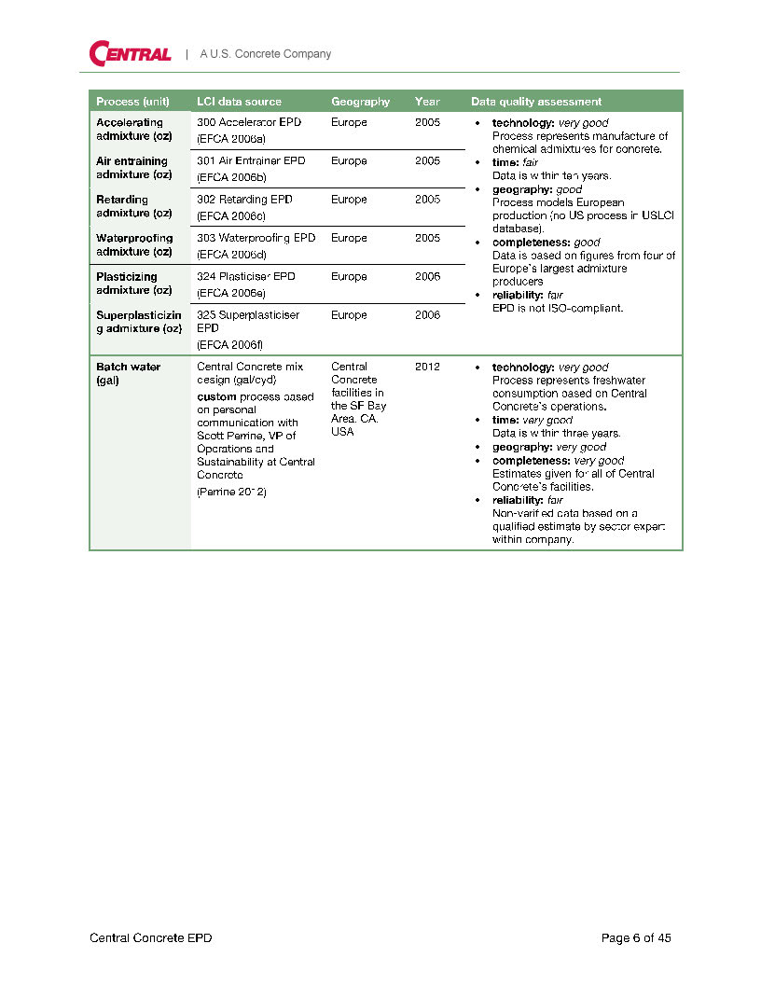

Slide 23
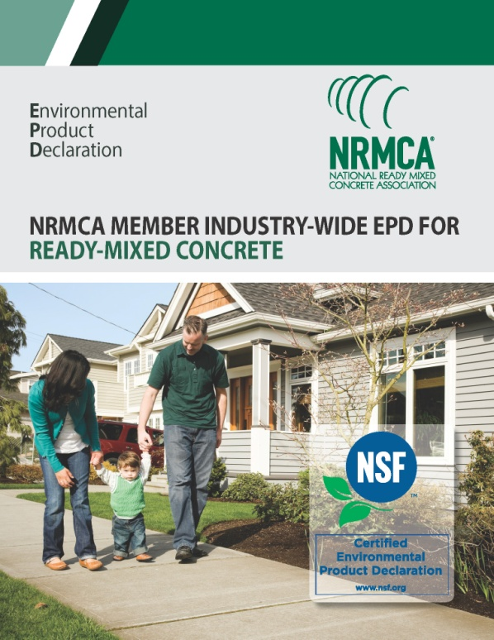
Industry Wide/Average EPD
Satisfies LEED v4 Option 1 of EPD credit (worth 1/2 product)

Slide 24
Supplier EPDs
Admix
Aggregate
Slag
Fly Ash
Cement
EPD
Supplier EPDs
Product EPD
Notes:
EPDs for products can feed into an overall life cycle assessment for a larger system like a building. Impacts from individual products or processes can be algebraically summed to get the life cycle impacts of a building for example

Slide 25
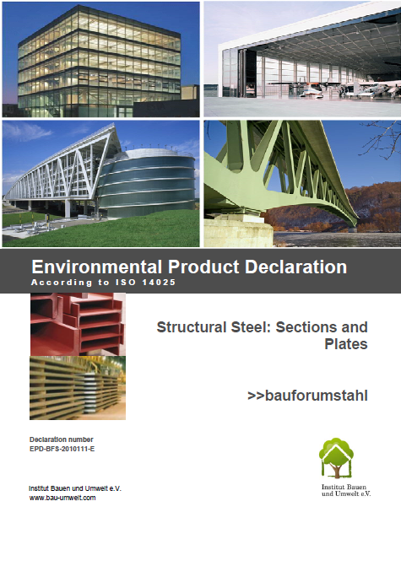
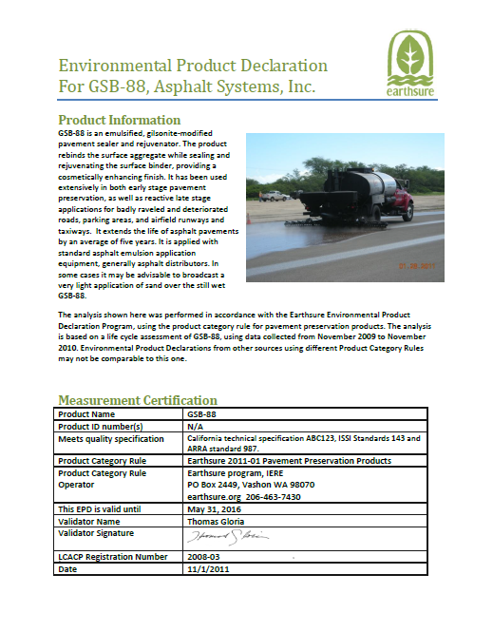
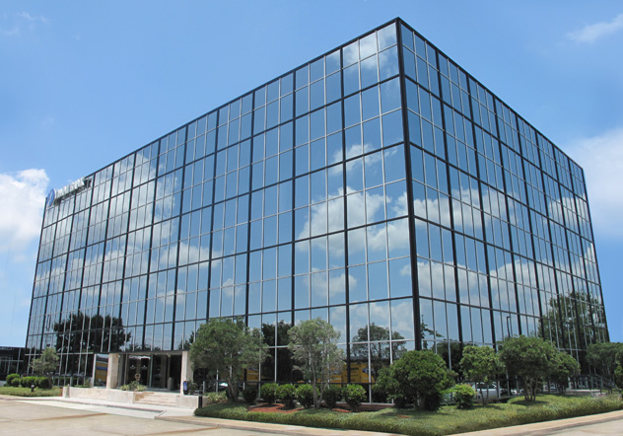
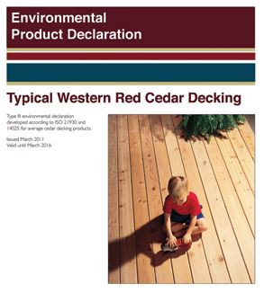
Product EPDs to Whole Building LCA
Product EPDs
Whole Building LCA
Notes:
EPDs for products can feed into an overall life cycle assessment for a larger system like a building. Impacts from individual products or processes can be algebraically summed to get the life cycle impacts of a building for example

Slide 26
Environmental Product Declarations
Option 2 – Multi-Attribute Optimization
(1 point) 50% by Cost
Environmental Impact Reduction below industry average–
GWP (req’d)
Ozone depletion
Eutrophication
Smog formation
Acidification
Depletion of nonrenewable energy
Notes:
To encourage disclosure about environmental attributes and increase the use of products and materials with environmentally, economically, and socially preferable life-cycle impacts.
Option 2. Multi-attribute Optimization (1 point)
Use products that meet at least one of the attributes below for 50%, by cost, of the total value of permanently install products in the project. Products will be valued as below.
Extended producer responsibility. Products purchased from a manufacturer (producer) that participates in an extended producer responsibility program or is directly responsible for extended producer responsibility. Products valued at 50% of their cost.
USGBC approved program. Certifications that verify impact reduction below industry average in at least three of the following:
o global warming potential (greenhouse gases), in CO2e;
o depletion of the stratospheric ozone layer, in kg CFC-11;
o acidification of land and water sources, in moles H+ or kg SO2;
o eutrophication, in kg nitrogen or kg phosphate;
o formation of tropospheric ozone, in kg NOx or kg ethene; and
o depletion of nonrenewable energy resources, in MJ.
Programs meeting the multi-attribute optimization criteria that become available will be evaluated and added as appropriate.
Products that meet the above criteria are valued according to source location (extraction, manufacture, and purchase point must be within the distances noted below):
Products sourced within 100 miles of the project site are valued at 200% of their cost.
Products sourced domestically within 500 miles of the project site are valued at 150% of their cost.
.

Slide 27
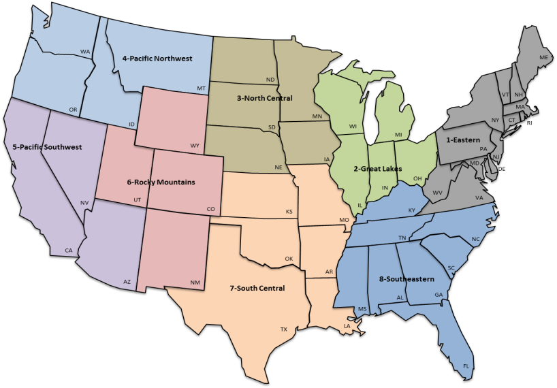
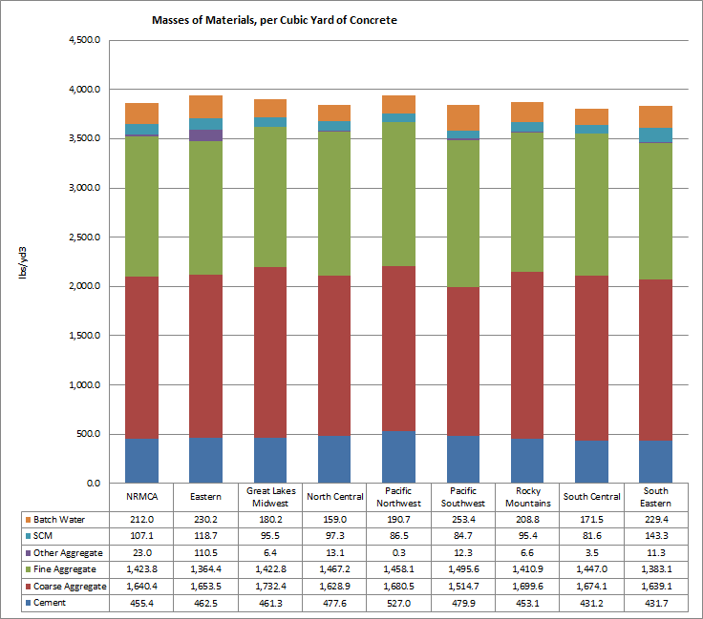
Benchmarks/Industry Averages
Average Impacts
2500 psi
3000 psi
4000 psi
5000 psi
6000 psi
8000 psi
Option 2 of LEED v4 EPD credit

Slide 28
Environmental Product Declarations (Locally Sourced still matters)
100 Miles
(200% Cost)
500 Miles (LEED 2009)
Structure and enclosure not more than 30% of the value
Notes:
Products sourced (extracted, manufactured, purchased) within 100 miles (160 km) of the project site valued at 200% of their base contributing cost
Structure and enclosure materials may not constitute more than 30% of the value of compliant building products
FINAL PRODUCT VALUE =
(base product value x valuation factor based on attribute criteria)*(valuation factor based on location)

Slide 29
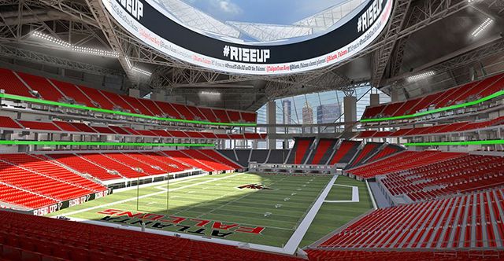
ATLANTA FALCONS STADIUM
360 ARCHITECTURE
“…will target Platinum certification under LEED 2009… is pursuing the environmental product declaration (EPD) credit from LEED v4”

Slide 30
CALIFORNIA HIGH SPEED RAIL
PARSONS-BRINCKERHOFF
“…provide EPDs for concrete mix designs used in elements of the Project, including pre-cast and cast-in-place concrete, and all steel.”

Slide 31
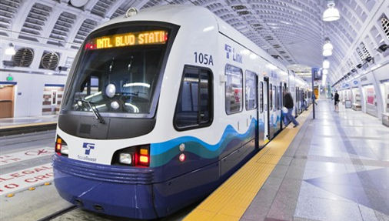
SOUND TRANSIT (SEATTLE)
SELLEN CONSTRUCTION
Proposed Spec: For 90% by volume of the cast-In-place concrete submit EPDs…demonstrate lower GWP (CO₂e) as compared to NRMCA Benchmarks for Northwest Region.

Slide 32
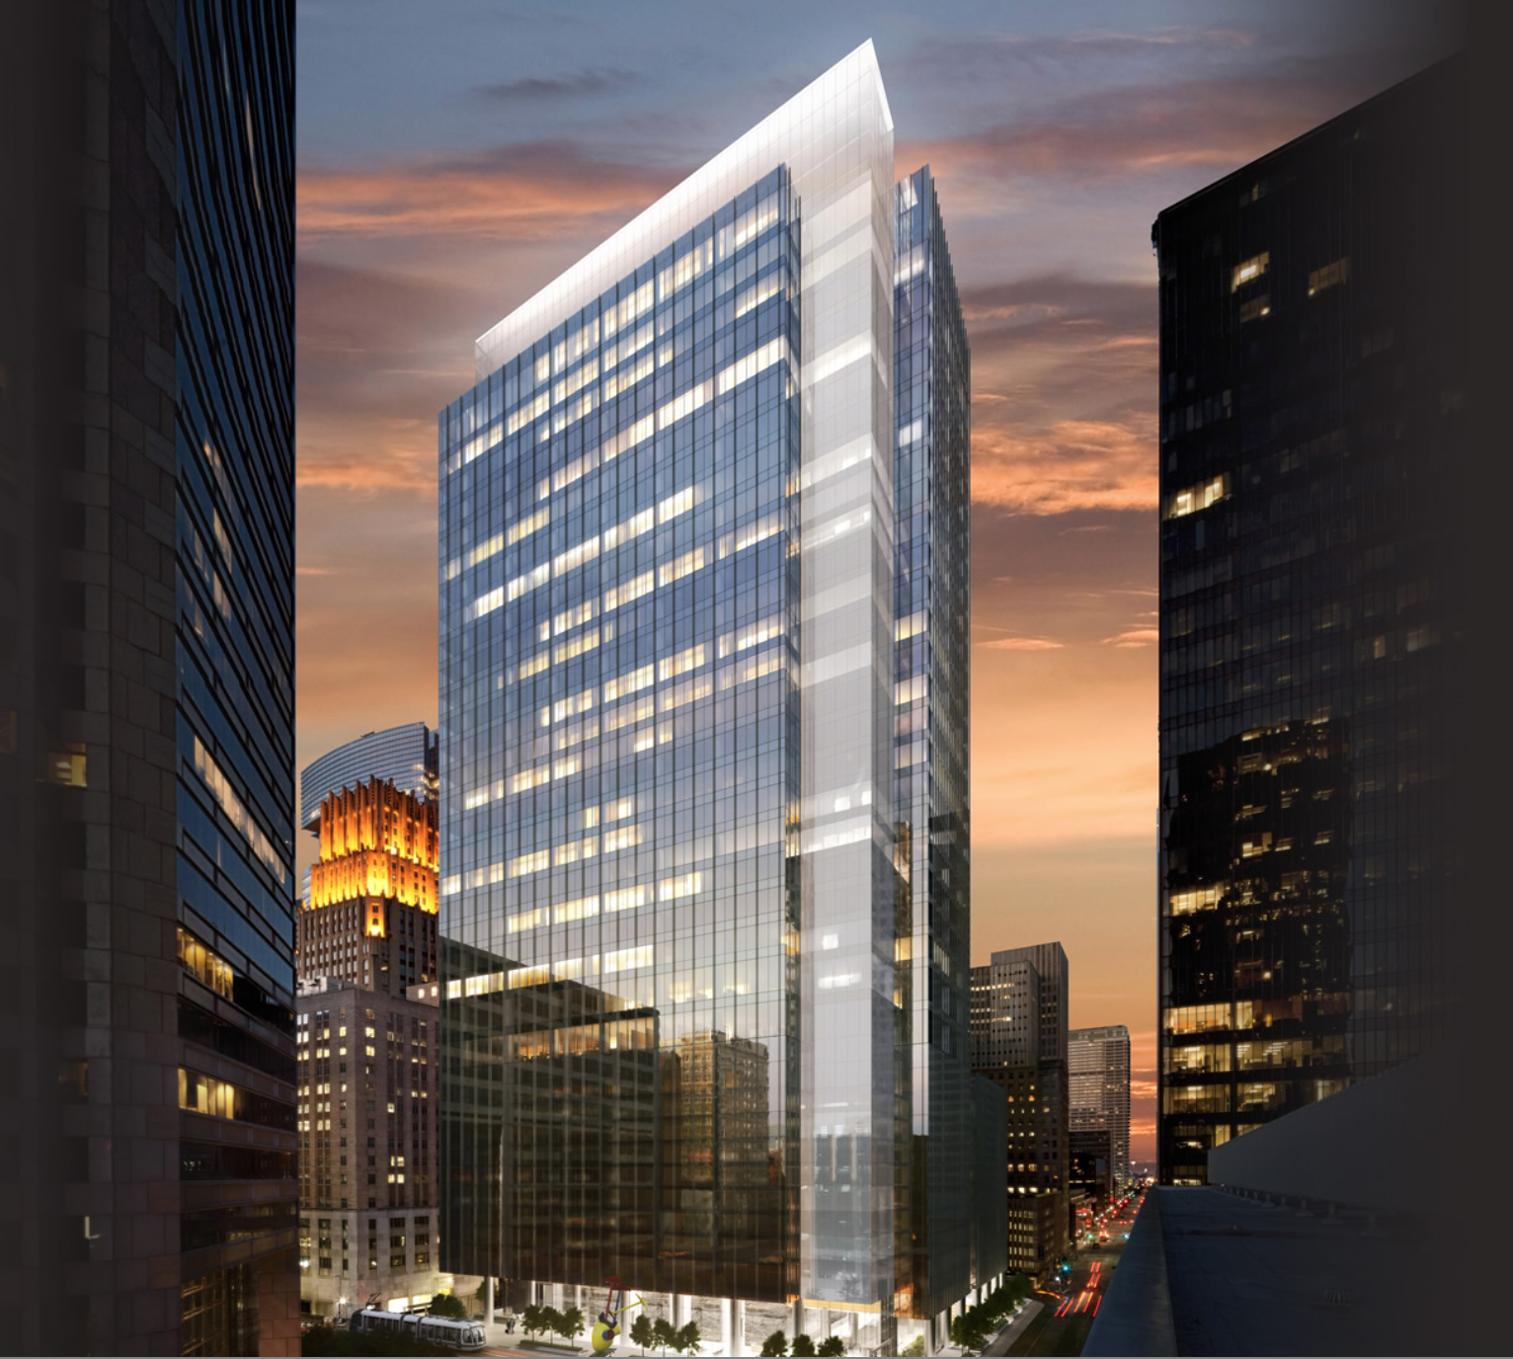
Capitol Tower
35-story, 750,000-SF Class A , Houston
MRc1: Whole Building LCA Option: 3 Points
Notes:
Dirk Kestner
Capitol Tower, a 35-story, 750,000-GSF Class A office building in downtown Houston is one of three Platinum Pre-Certified projects in the LEED V4 Beta program. As one of the first projects in the nation to pursue LEED V4, it is also one of the first (if not the first) project to pursue the new LEED V4 Whole Building Lifecycle Assessment credit.

Slide 33
1990 – American Paper Institute –Disposables
1991 – The National Association of Diaper Services – Cloth
1992 – Procter & Gamble - Reverses the conclusion
1992 – New Study by Franklin Associates
Notes:
1990 – American Paper Institute –preferable- Cloth changes uses about 10,000 gallons of water before potty trained. Also add the 5 flushes a day at the toilet which uses 20,000 gallons
1991 – The National Association of Diaper Services (cloth) concludes the opposite – Disposable – Landfill, trees cut, Dioxin, Dyes, Toluene
1992 – Procter & Gamble reverses the conclusion once more.
Each time, additional considerations were brought in: -indirect of paper production (increasing impacts of disposables) -production of detergents (increasing impacts of washing cloth)
1992 – New study by Franklin Associates, concluding that the answer is – It depends - on whether one looks at energy or water or solid waste.
"The bar is too low for green products," Norris concludes. Our current fixation on a
single dimension of "green" ignores the multitude of adverse impacts that shadow
even the most seemingly virtuous of items. As Life Cycle Assessment of just about
anything shows, virtually everything manufactured is linked to at least trace
quantities of environmental toxins of one kind or another, somewhere back in the
vast recesses of the industrial supply chain. Everything made has innumerable
consequences; to focus on one problem in isolation leaves all the other consequences
unchanged.
Using chlorine to bleach paper releases dioxins, which are one of the most potent cancer-causing chemicals out there. Dioxin exposure can also cause reproductive problems - and disposable diapers put dioxins right next to your baby's reproductive organs. Those little gel beads that absorb the liquid can actually cause asthma and airway restriction.

Slide 34
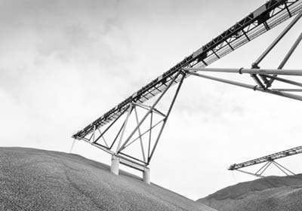
RESPONSIBLE SOURCING

Slide 35
MR Credit 3: Sourcing of Raw Materials
Option 1: Raw Material Source and Extraction Reporting (1 point)
Manufacturer declared commitment (1/2 product)
Corporate Sustainability Report (Third Party Verified CSR) (Full product)
Notes:
For permanently installed new building products
Exclude products and materials containing recycled content, salvaged, reused, or refurbished materials
Each raw material supplier must provide an independently audited checklist listing all of the Framework for Responsible Mining’s Leading Edge Issues, and identifying which Leading Edge
measures they are currently taking.
Mined or quarried materials
Bio-based materials
Other extracted materials
Calculation
Option 1 – Total material cost (10% (1 point) or 20% (2 points))

Slide 36
MR Credit 3 – Sourcing of Raw Materials
Option 2. Leadership Extraction Practices 25% by cost of all materials on a project (1 point)
Extended producer responsibility
Bio-based materials (Sustainable Agriculture Standard)
Wood products (FSC)
Materials reuse (salvaged, refurbished, or reused)
Recycled content (postconsumer + ½ preconsumer)
USGBC approved program
Notes:
Use products that meet at least one of the responsible extraction criteria below for at least 25%, by cost, of the total value of permanently installed building products in the project.
For credit achievement calculation, products sourced (extracted, manufactured, purchased) within 100
miles (160 km) of the project site are valued at 200% of their base contributing cost. For credit achievement calculation, the base contributing cost of individual products compliant with multiple responsible extraction criteria is not permitted to exceed 100% its total actual cost (before regional multipliers) and double counting of single product components compliant with multiple responsible extraction criteria is not permitted and in no case is a product permitted to contribute more than 200% of its total actual cost.
Structure and enclosure materials may not constitute more than 30% of the value of compliant building
products.

Slide 37
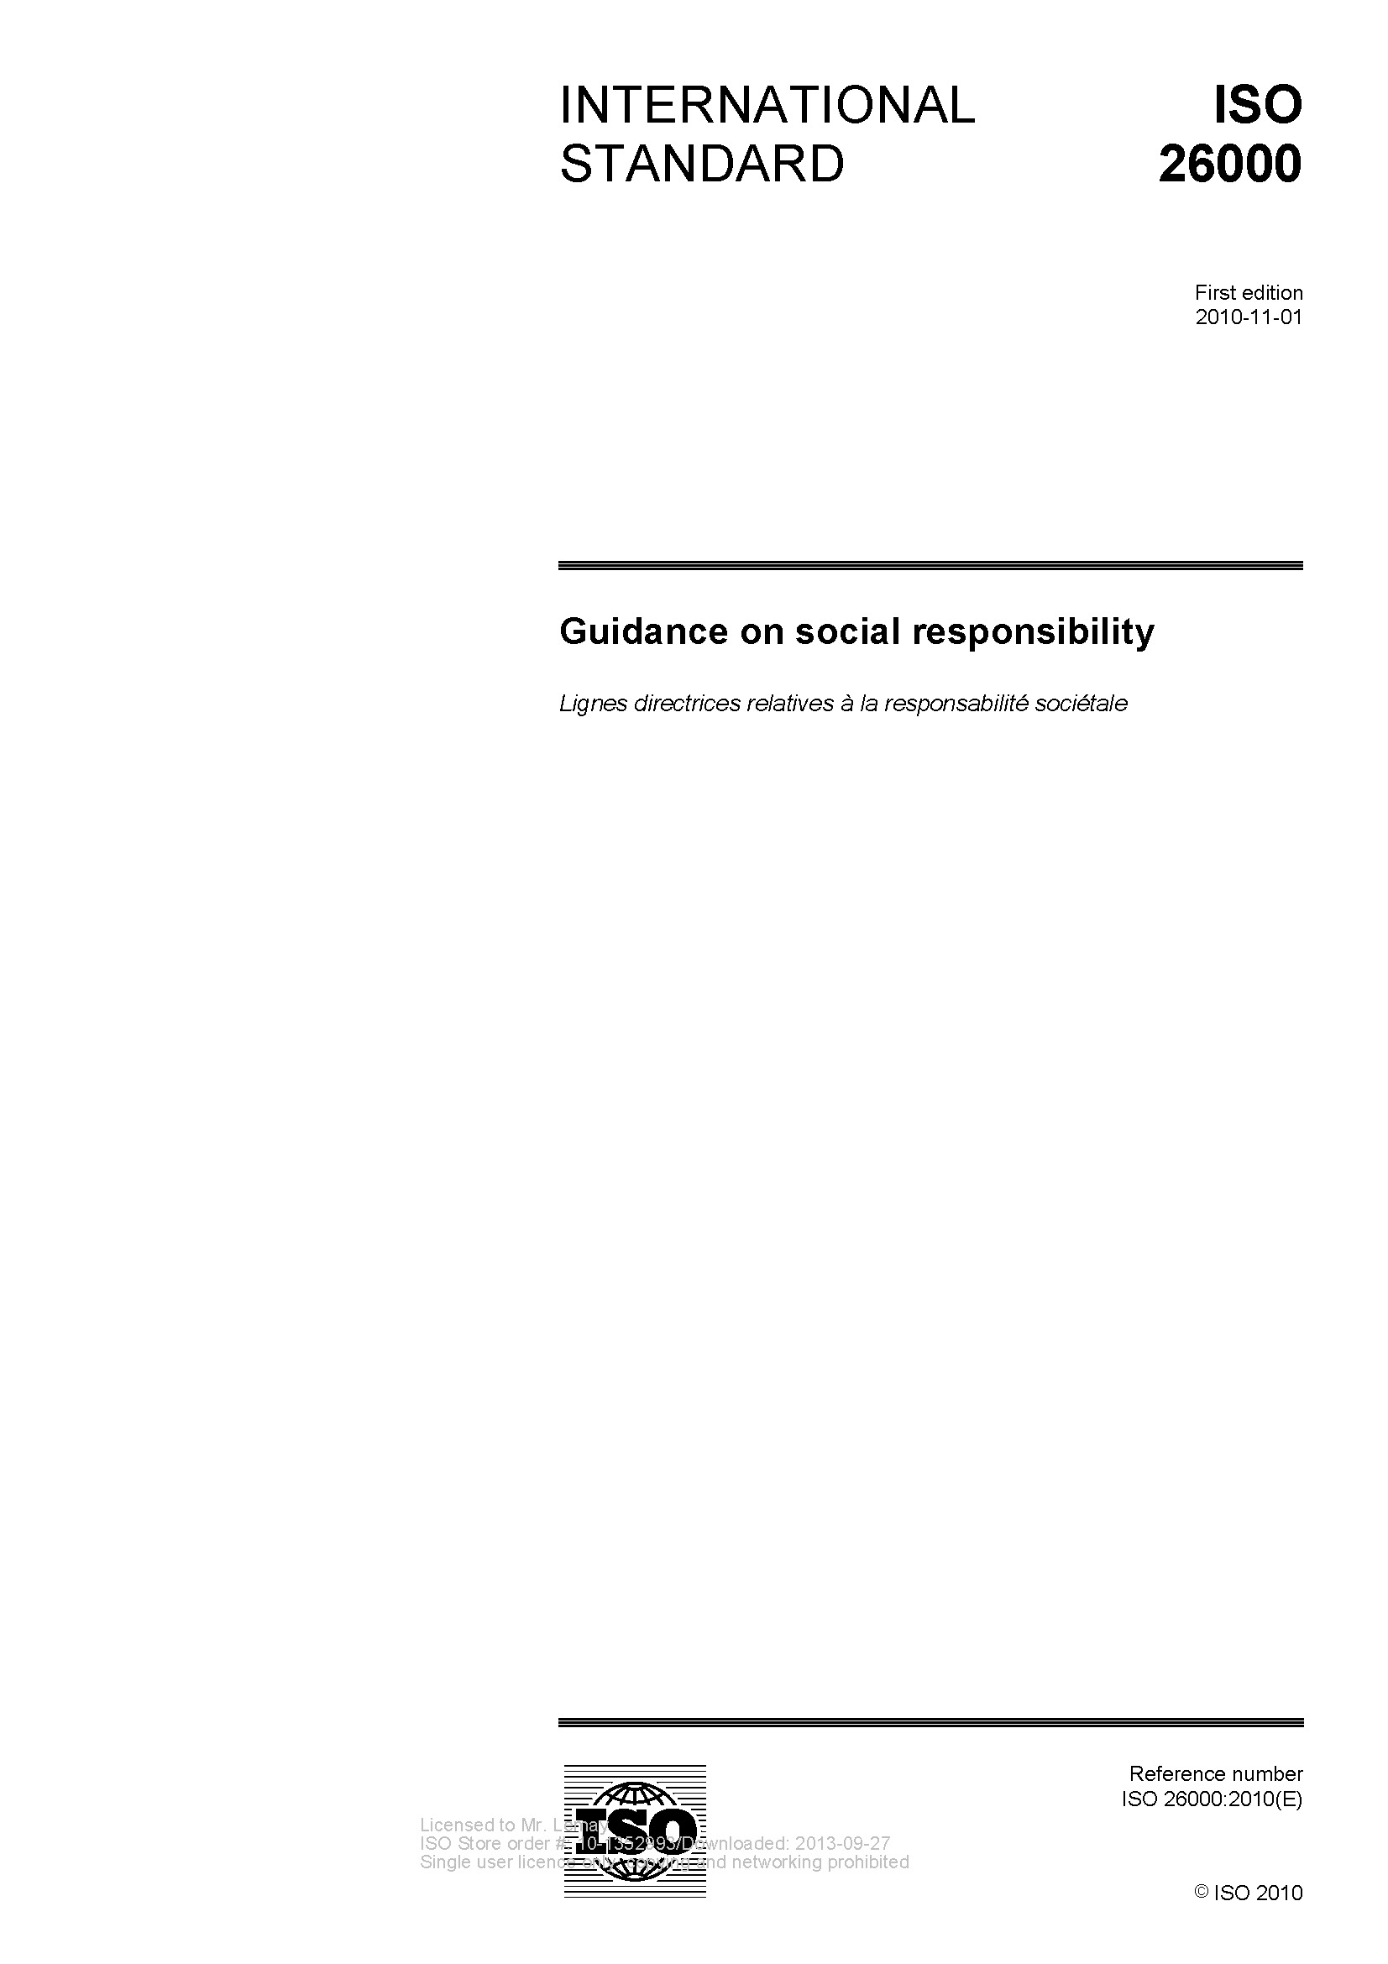
Reporting Frameworks
Notes:
CSR Reporting Trends
Started in 1997 by CERES
Became independent in 2002
Multi-stakeholder process and independent institution whose mission is to develop and disseminate globally applicable Sustainability Reporting Guidelines.
These Guidelines are for voluntary use by organizations for reporting on the economic, environmental, and social dimensions of their activities, products, and services.
Representatives from around world:
Business
Accountancy
Investment
Environmental and Human rights
Research
Labor organizations

Slide 38
RSS Different from EPD
EPD – Impacts to Environment
Carbon Emissions
Energy Consumption
Acidification
Eutrophication
Smog Creation
Ozone Depletion
Water Consumption
Waste Generation
RSS - Company Behavior
Employee Health and Safety
Fair Labor and Employment Practices
External Stakeholder Engagement
Energy Efficiency (refer to EPDs)
Bio-diversity Management
Land Stewardship
Resource Management

Slide 39
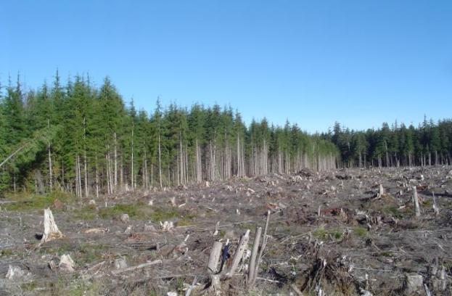
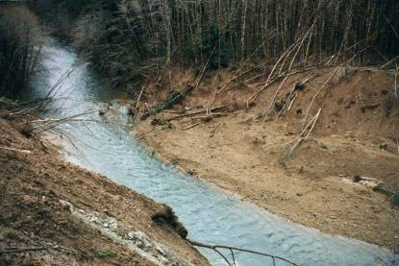
Logging for Wood
Disruption per unit of building material is high
Renewal takes generations
Stream damage from landslide is common
Pesticide use
Source: Natural Resources Canada
Notes:
For logging, the amount of land disruption per unit of building material is high.
Even if land renewal is possible, the process is measured in generations rather than years.
Common disasters from logging include stream damage from landslides and permanently damaged forests.
Forests provide many ecological and physical functions including pollution absorption, climate regulation, soil production, watershed protection, carbon recycling, wildlife habitat, and human recreational activities.

Slide 41
Concrete Sustainability Council

Slide 42
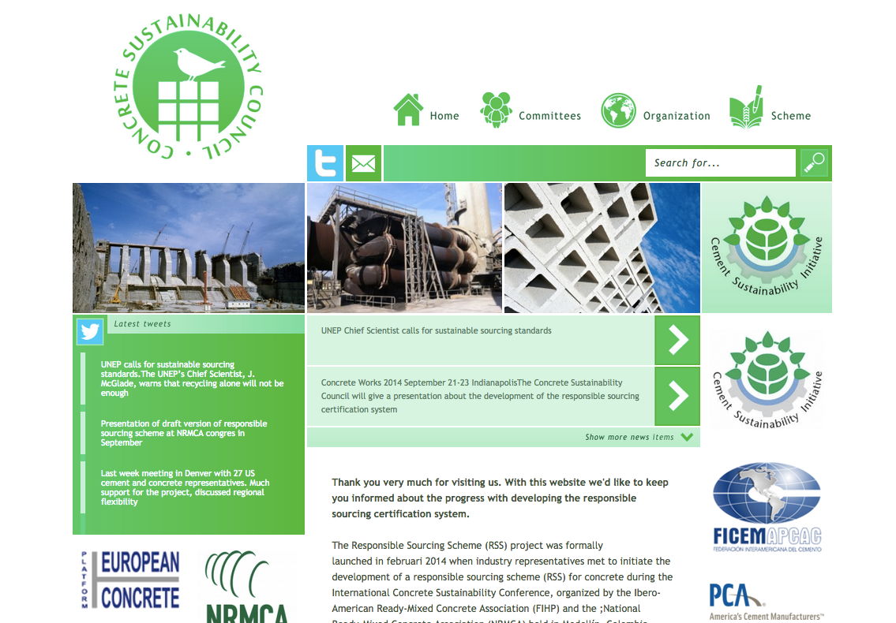
www.concretesustainabilitycouncil.org

Slide 44
Management
M1 Responsible Sourcing Policy
M2 Environmental Management
M3 Quality Management
M4 Health & Safety Management
M5 Chain of Custody
Social
S1 Product Information
S2 Local Community
S3 Health & Safety
S4 Labor practices

Slide 45
Environmental
E1 Environmental Product Information
E2 Land Use
E3 Energy use
E4 Air quality
E5 Water Use
E6 Biodiversity
E7 Secondary Materials
E8 Transport
Economical
P1 Local economy
P2 Ethical Business
P3 Innovation

Slide 46
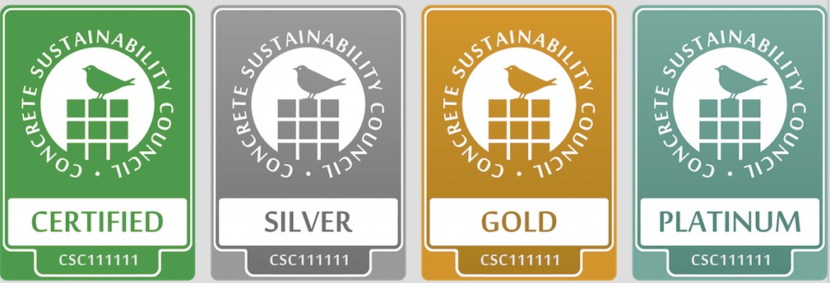
Certification Levels

Slide 47
Scope
Organizational certification
Plant certification
Product certification
Plant: 15% of credits
Organization
85% of credits
Organization
15% of credits
Product
15% of credits

Slide 48
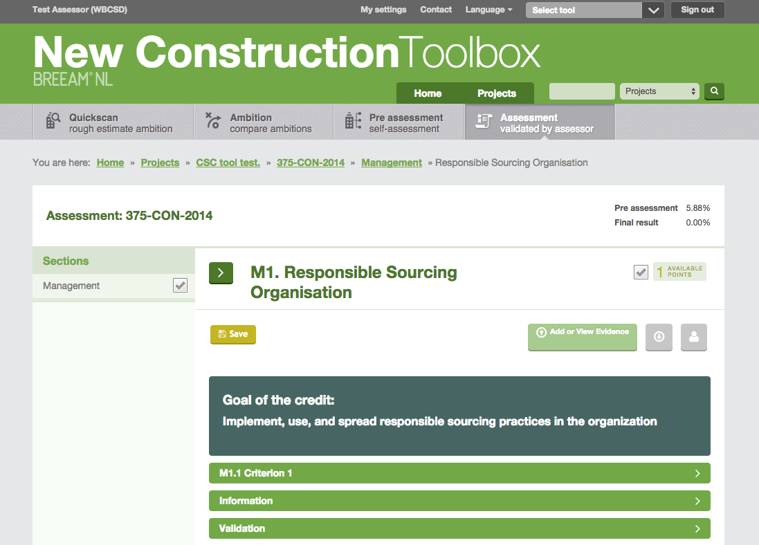
Webbased tool

Slide 49
Next steps
Pilot project in different regions – 2015
Launch v1.0 – Early 2016
U.S. Pilot Companies
Aggregate Industries
Kirkpatrick Concrete
Lehigh Hanson
Titan America
Concrete Supply Co.
Tech Ready Mix
U.S. Concrete
CalPortland Cemex
Berks Products
Notes:
What does a concrete company get?
Tooling and training aiding the organization in stepping up on responsible sourcing where required
Dedicated training on responsible sourcing (expert)
(Part of) CSR report generated from assessment
Certificate
Additional credits in LEED/BREEAM/Etc. for its clients
Publicity for its sustainable achievements
More demand / reward for its sustainable efforts

Slide 50
Responsible Sourcing (Locally Sourced still matters)
100 Miles
(200% Cost)
Structure and enclosure not more than 30% of the value
Notes:
Products sourced (extracted, manufactured, purchased) within 100 miles (160 km) of the project site valued at 200% of their base contributing cost
Structure and enclosure materials may not constitute more than 30% of the value of compliant building products
FINAL PRODUCT VALUE =
(base product value x valuation factor based on attribute criteria)*(valuation factor based on location)

Slide 51
MATERIAL INGREDIENTS

Slide 52
Material Ingredients
Option 1: Material Ingredients Reporting
(1 Point)
20 Permanently Installed Products
Manufacturer Inventory
Health Product Declaration (HPD)
Cradle to Cradle (Basic)
USGBC Approved Program
Inventoried to 1000 ppm
Notes:
Material Ingredient Reporting – 20% by Cost (1 point) 30% by Cost (2 Points)
To increase the use of products and materials with disclosed chemical ingredient data

Slide 53
Material Ingredients
Option 2: Material Ingredients Optimization
(1 Point) 25% by Cost
Manufacturer Inventory
Cradle to Cradle Certification
USGBC Approved Program
International Alternate – REACH
Option 3: Product Manufacturer Supply Chain Optimization (1 point) 25% by Cost
Transparently of chemical ingredients
Notes:
Material Ingredient Reporting – 20% by Cost (1 point) 30% by Cost (2 Points)
To increase the use of products and materials with disclosed chemical ingredient data
Project Team: Use building products that are sourced from product manufacturers who procure raw materials from suppliers meeting criteria below for at least 25%, by cost, of the total value of permanently installed products in the project.
Manufacturers: Engage in validated and robust safety, health, hazard, and risk programs. Document at least 99% by weight of the ingredients used to make the building product or building material are sourced from companies with independent third party verification of the following along the manufacturer supply chain:
o Processes are in place to communicate and transparently prioritize chemical ingredients along the supply chain according to available hazard, exposure and use information to identify those that require more detailed evaluation
o Processes are in place to identify, document, and communicate information on health, safety and environmental characteristics of chemical ingredients
o Processes are in place to implement measures to manage the health, safety and environmental hazard and risk of chemical ingredients
Processes are in place to optimize health, safety and environmental impacts when designing and improving chemical ingredients
Processes are in place to communicate, receive and evaluate chemical ingredient safety and stewardship information along the supply chain
o Safety and stewardship information about the chemical ingredients is publicly available from all points along the supply chain
Options 2 and 3 can be combined to reach 25%, by cost, of the total value of permanently installed products in the project for a total of 1 point. Products can only contribute to one option.

Slide 54
Human Health Linked to Toxins

Slide 55
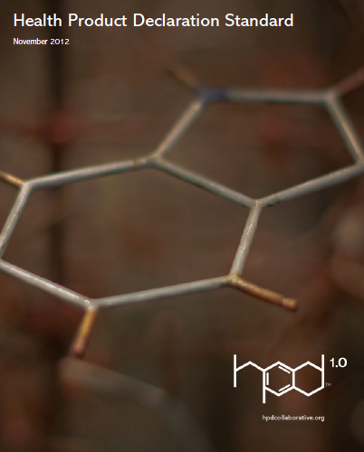
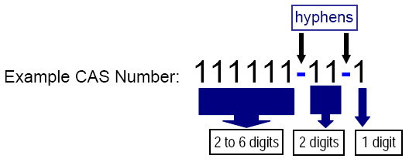
Standards for Health Hazards
CAS REGISTRYSM

Slide 56
GreenScreen

Slide 57
Process
Cement manufacturers
Aggregate industry
HPD Database
Cement and SCM HPDs
Chemical admixture HPDs
Generic aggregate hazard information
Bob’s Green RM Concrete

Slide 58
Process

Slide 59
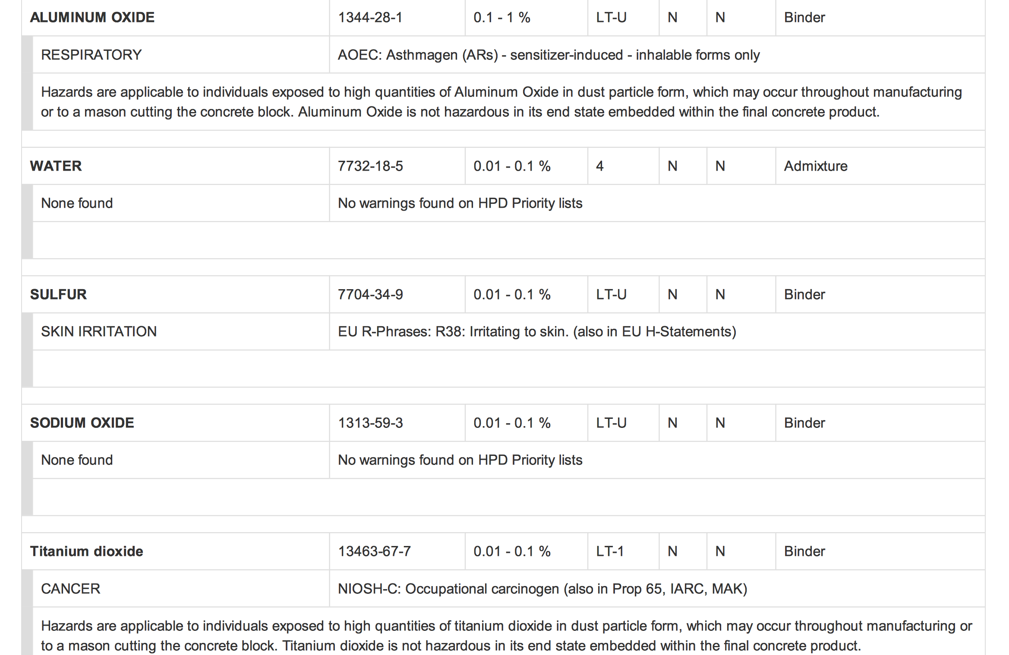

Slide 60
Material Ingredients (Locally Sourced still matters)
100 Miles
(200% Cost)
Structure and enclosure not more than 30% of the value
Notes:
Products sourced (extracted, manufactured, purchased) within 100 miles (160 km) of the project site valued at 200% of their base contributing cost
Structure and enclosure materials may not constitute more than 30% of the value of compliant building products
FINAL PRODUCT VALUE =
(base product value x valuation factor based on attribute criteria)*(valuation factor based on location)

Slide 61
Exemplary Performance (Innovation)
Environmental Product Declaration
Option 1. Source at least 40 qualifying products from 5 manufacturers.
Option 2. Purchase 75%, by cost, of permanently installed building products that meet required attributes.
Sourcing of Raw Materials
Option 1. Source at least 40 qualifying products from 5 manufacturers.
Option 2. Purchase 50%, by cost, of the total value of permanently installed building products that meet responsible extraction criteria.
Material Ingredients
Option 1. Source at least 40 qualifying products from 5 manufacturers
Option 2. Source at least 50%, by cost, of permanently installed building products that meet the credit criteria.

Slide 62
What Does This Mean To You?

Slide 63
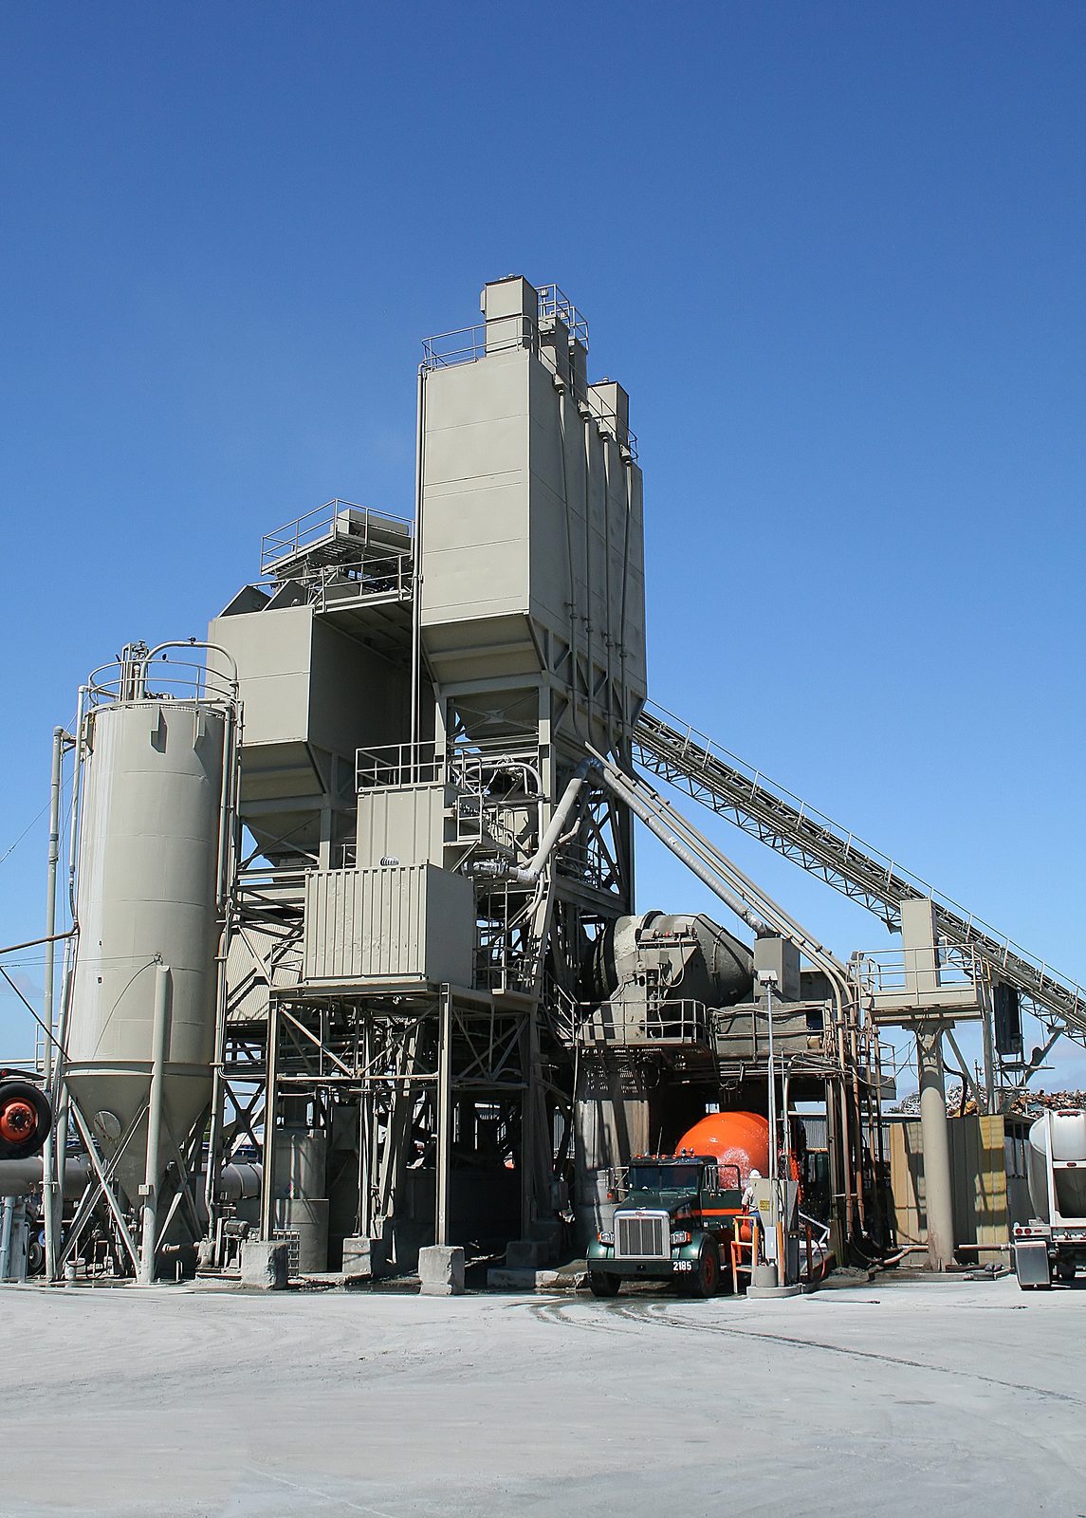
U.S. CONCRETE
INDUSTRY
5000 Plants
1000 Products/Plant
5,000,000 EPDs?

Slide 64
CHALLENGE
Will EPDs result in lower environmental impacts…
…or just increase product costs?

Slide 65
OPPORTUNITY
Prescriptive
Specification
Concrete shall have minimum fly ash content of 50%
Performance
Specification
Concrete shall have maximum Global Warming Potential of 350 kg CO2e/m³

Slide 66
Source: McGraw-Hill Green Outlook 2013

Slide 67
Customers Demanding Transparency
Notes:
Ecobuilding Pulse reported on the growing number of architecture and engineering firms requiring Environmental Product Declarations (EPDs) and/or Health Product Declarations (HPDs) from building product manufacturers. These firms including some of the largest in the US – Perkins+Will, HDR and GGLO - are establishing formal policies regarding material transparency and are collecting data on what goes into a building product.
Beck†Architecture
Boora†Architects
Cannon†Design
EHDD
FXFOWLE
GGLO
Harley†Ellis†Devereaux
HDR
HKS
KMD†Architects
Lake¸†Flato†Architects
Lord¨†Aeck†¶†Sargent
Mahlum
Miller†Hull
Perkins´Will
RTKL
SHW†Group
Siegel†¶†Strain†Architects
SmithGroupJJR
Solomon†Cordwell†Buenz†Architecture
Tsoi†Kobus†¶†Associates
Wight†¶†Company
WRNS†Studio
Yost†Grube†Hall†Architecture

Slide 68
THANK YOU
www.nrmca.org/sustainability

