Slide 1
Design and Rehabilitation Strategies for Sustainable Concrete Pavements
H. Thomas Yu
Federal Highway Administration
Office of Pavement Technology

Slide 2
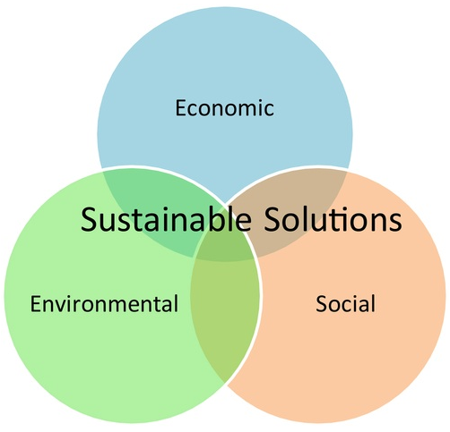
Sustainability

Slide 3
Sustainability
To a highway agency, sustainability, first and foremost, is the ability to provide pavements in its charge in an acceptable condition
Indication of unsustainable practice
  Mounting backlog of pavement rehab needs
  Annual shortfall of roadway budget for meeting critical needs is estimated at $116 billion

Slide 4
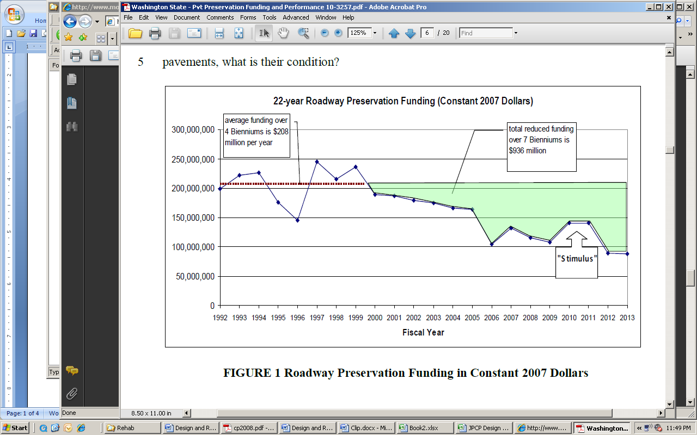
Washington State’s roadway preservation budget trend (Mahoney et. al 2010)

Slide 5
Smoothness trend of NHS (HPMS)

Slide 6
Key points
Economic sustainability is the biggest challenge facing DOTs today
The long-life pavement approach greatly enhances the highway agencies’ ability to meet the pavement needs
  Building long-life, low-maintenance pavements
  Taking proactive measures to preserve the pavement
The sustainability is improved automatically

Slide 7
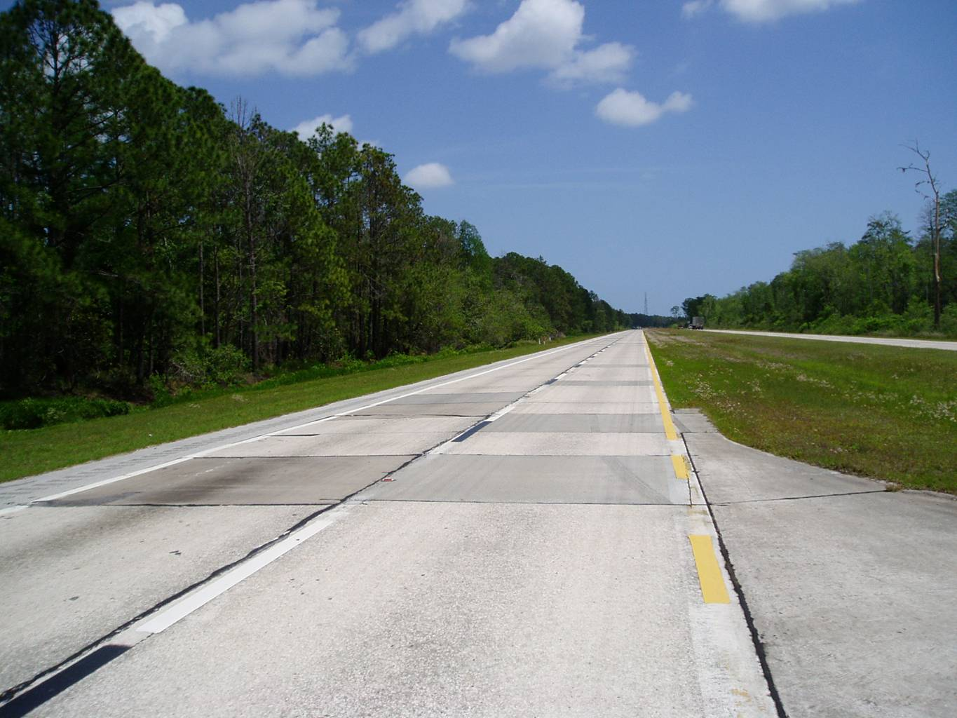
50-year-old PCC pavement

Slide 8
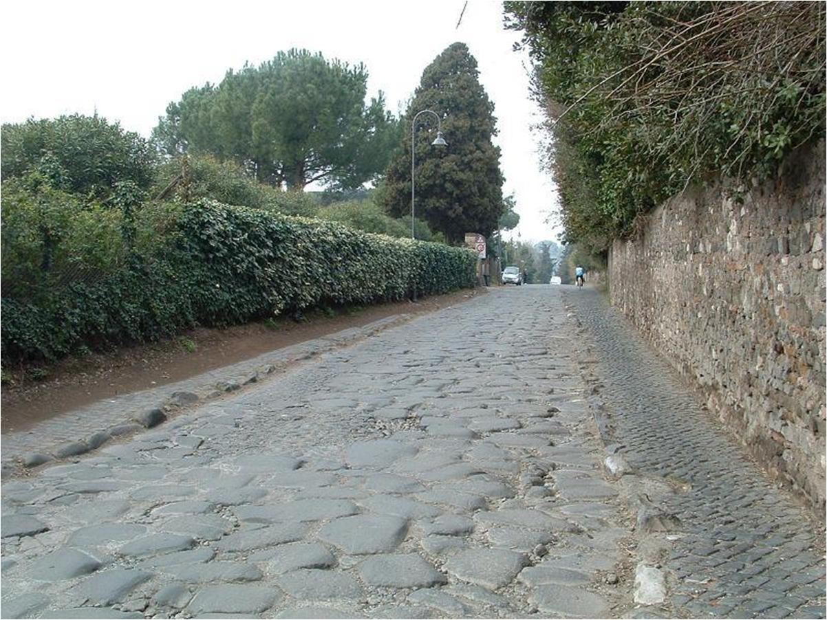
Via Apia, 312 B.C.

Slide 9
Current practice
Pavements are designed to fail
  Finite design period
  Pavements are designed for relatively high levels of distress at the end of the design period
Repairs are not made until distresses progress to high severity
Structural overlays are used primarily as a corrective measure
  Typically used on pavements in poor condition
  A thicker overlay is generally required

Slide 10
What is needed
Design pavements to last as long as the materials
  Pavements should remain distress-free within the design period
  Utilize design features that ensure good long-term performance
Apply preventive treatments to preserve the pavement structure
  For sustainability, preservation is better than reconstruction
  Prevention is the best preservation strategy

Slide 11
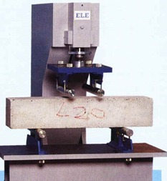
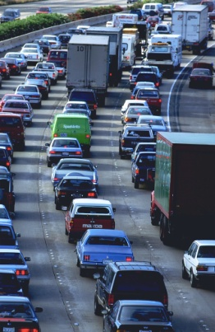


ME design
Material
Properties
Trial Design
Climatic Data
Traffic
Design Guide Software
Predicted Performance
Mechanistic Analysis
Notes:
Tie it together. The Climate effects the materials properties. The EICM is the prediction models for temperature and moisture throughout the pavement profile. The Adjusted materials modulus values are used by the mechanistic analysis engine to calculate strains at critical locations within the pavement structure. Those critical strains are then related to pavement distress by the transfer functions.

Slide 12
Effects of slab thickness on cracking (MEPDG)

Slide 13
Effects of slab thickness on traffic capacity (MEPDG)

Slide 14
Benefits of conservative design (MEPDG)

Slide 15
Sustainable rehabilitation strategy
Repair cracks while they can be effectively treated by dowel or tie bar retrofit
  Less intrusive, and is at least as effective as full-depth repair (similar service life)
  Significantly lower cost
Apply structural enhancements when structural cracks begin to develop
  A relatively thin HMA overlay can be highly effective in greatly extending service life

Slide 16
Pavement condition vs. age
Myth

Slide 17
Pavement condition vs. age – current practice

Slide 18
Pavement condition vs. age – preservation approach

Slide 19
Pavement condition vs. age – long-life pavement

Slide 20

Cost Considerations

Slide 21

Current practice

Slide 22
Cost considerations
Minimizing LCC of a single project does not provide the best results for the network
Highway investment decision is a resource allocation problem
At any given funding level, the optimum solution is one that buys the most service life for the network: total lane-mile-years

Slide 23
Remaining life over time

Slide 24
Remaining life of project in the network, year 0

Slide 25
Remaining life of project in the network, year x

Slide 26
Effects of service-life on project load
Notes:
This plot shows that in time, the number of projects to reconstruct becomes directly proportional to service life.
At 50 years, the number of projects reconstructed is
30 for 50-yr life option (the number of projects in this example)
60 for 25-yr life option, and
100+ for 15-yr life option
The ratio remain constant – i.e., doubling the service life cuts the number of projects to reconstruct by half

Slide 27

Two Dimensions of Paving
Coverage: lane-miles
Service Life: years
Unit of Paving = lane-mile-years
A network of x lane-miles of pavement requires an addition of x lane-mile-years of service life each year to maintain status quo
A Quick Check of Your Highway Network Health: FHWA-IF-07-006

Slide 28


Measure of Paving Costs
Life
Cost
Unit Cost
Option 1
15 yrs
$200
$13.33 / lane-mi-yr
1 mile
Option 2
30 yrs
$220
$7.33 / lane-mi-yr

Slide 29
Measure of Paving Costs
Life
Cost
Unit Cost
Option 1
15 yrs
$200
$13.33 / lane-mi-yr
13 yrs
$45
$3.46 / lane-mi-yr
12 yrs
$45
$3.75 / lane-mi-yr
1 mile
40 yrs
$290
$7.25 / lane-mi-yr
30 yrs
$220
$7.33 / lane-mi-yr
Option 2
10 yrs
$30
$3.00 / lane-mi-yr
10 yrs
$30
$3.00 / lane-mi-yr
50 yrs
$280
$5.60 / lane-mi-yr

Slide 30
Effects of service life on relative cost/value

Slide 31

LCC vs $/lane-mi-yr for Roman Road
Agency Cost
Life
PV
Unit Cost
23 yrs
$150 /mi
Reconstruct
99 times
$2.5 /mi
$65,220 / lane-mi-yr
2,300 yrs
$3.0 /mi
$3.0 /mi
$1,300 / lane-mi-yr

Slide 32
Summary
Current practices are not conducive to realizing the full performance potential of pavements
Preferable practices
  Design pavements to last as long as the material
  Make repairs as early as possible to prevent further deterioration
  Use overlays as a preventive treatment to preserve the pavement structure
Evaluate cost as a resource allocation problem
  Key parameter: $/lane-mi-year
  Over time, optimizing $/lane-mi-year will minimize the number of projects that needs to be reconstructed

Slide 33


