Slide 1
VRMCA Technical Committee Update
VRMCA Spring Convention May 18, 2015
George Kuhn – Chairman
What’s the Latest
and Greatest?

Slide 2
Membership
Producer Members
Supplier Members
Association Representatives

Slide 3
Meetings
Quarterly Meetings
The Place, Richmond, VA
January, April, July, October
4th Wednesday

Slide 4
Meetings
Quarterly Meetings
The Place, Richmond, VA
January, April, July, October
4th Wednesday
2015 Remaining Schedule
July 22, October 22

Slide 5
Meetings
Quarterly Meetings
The Place, Richmond, VA
January, April, July, October
4th Wednesday
2015 Remaining Schedule
July 22, October 22
10am to 12 noon

Slide 6
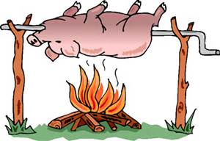
Meetings
Quarterly Meetings
The Place, Richmond, VA
January, April, July, October
4th Wednesday
2015 Remaining Schedule
July 22, October 22
10am to 12 noon
lunch provided

Slide 7
Meetings
Attendance

Slide 8
Meetings
Attendance
2012 avg 11.25

Slide 9
Meetings
Attendance
2012 avg 11.25
2013 avg 15.75

Slide 10
Meetings
Attendance
2012 avg 11.25
2013 avg 15.75
2014 avg 16.33

Slide 11
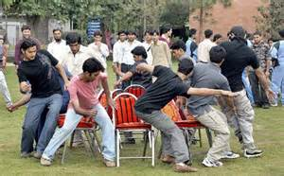
Meetings
Attendance
2012 avg 11.25
2013 avg 15.75
2014 avg 16.33
2015 avg 22.50
29 January
16 April

Slide 12
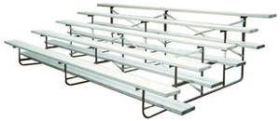
Meetings
Always Room For More

Slide 13
Meetings
Biannual Meetings (VRMCA / VDOT Cooperative Joint Committee Meetings)
VCTIR, Charlottesville, VA
January, July

Slide 14
Meetings
Biannual Meetings (VRMCA / VDOT Cooperative Joint Committee Meetings)
VCTIR, Charlottesville, VA
January, July
2015 Remaining Schedule
July 28

Slide 15
Purpose
Education of Membership
Liaison With VDOT
Review/Oversight of VRMCA Website and Educational Materials

Slide 16
Purpose: Education
Education of Membership

Slide 17
Purpose: Education
Education of Membership
Concrete Works
(Bill Denison - Titan)

Slide 18
Purpose: Education
Education of Membership
Concrete Works
(Bill Denison - Titan)
predictive behavior of
different mix designs for
early age heat generation

Slide 19
Purpose: Education
Education of Membership
Emerging Technology
For Freeze-Thaw Durability
(Richard Morrow – BASF)

Slide 20
Purpose: Education
Education of Membership
Emerging Technology
For Freeze-Thaw Durability
(Richard Morrow – BASF)
manufactured air voids
as an AE agent replacement

Slide 21
Purpose: VDOT Liaison
Liaison With VDOT
Specifications/Special Provisions

Slide 22
Purpose: VDOT Liaison
Liaison With VDOT
Specifications/Special Provisions
cooperative issues and input

Slide 23
Purpose: VDOT Liaison
Liaison With VDOT
Specifications/Special Provisions
ERS – Option Based Mix Designs

Slide 24
Purpose: VDOT Liaison
Liaison With VDOT
Specifications/Special Provisions
ERS – Option Based Mix Designs
1. Traditional ACI 211 Method
2. New ACI 301/318 Field Data
3. New ACI 301/318 Lab Curve

Slide 25
Purpose: VDOT Liaison
Liaison With VDOT
Specifications/Special Provisions
ERS – Option Based Mix Designs
1. Traditional ACI 211 Method
2. New ACI 301/318 Field Data
3. New ACI 301/318 Lab Curve

Slide 26
Purpose: VDOT Liaison
Liaison With VDOT
Specifications/Special Provisions
ERS – Option Based Mix Designs
* Waiting on VDOT

Slide 27
Purpose: VDOT Liaison
Liaison With VDOT
Specifications/Special Provisions
ERS – Option Based Mix Designs
* Waiting on VDOT
* Proposed Notification

Slide 28
Purpose: VDOT Liaison
Liaison With VDOT
Specifications/Special Provisions
ERS – Option Based Mix Designs
* Waiting on VDOT
* Proposed Notification
* Win/Win

Slide 29
Purpose: VDOT Liaison
Liaison With VDOT
Specifications/Special Provisions
ERS – Option Based Mix Designs
Testing Sublots

Slide 30
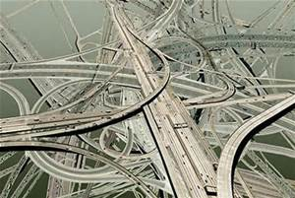
Purpose: VDOT Liaison
Liaison With VDOT
Specifications/Special Provisions
ERS – Option Based Mix Designs
Testing Sublots
* Multiple Lab Tests

Slide 31
Purpose: VDOT Liaison
Liaison With VDOT
Specifications/Special Provisions
ERS – Option Based Mix Designs
Testing Sublots
* Multiple Lab Tests
* Hierarchy

Slide 32
Purpose: VDOT Liaison
Liaison With VDOT
Specifications/Special Provisions
ERS – Option Based Mix Designs
Testing Sublots
Shotcrete

Slide 33
Purpose: VDOT Liaison
Liaison With VDOT
Specifications/Special Provisions
ERS – Option Based Mix Designs
Testing Sublots
Shotcrete
* Bag Mix
* Ready Mix

Slide 34
Purpose: VDOT Liaison
Liaison With VDOT
Specifications/Special Provisions
ERS – Option Based Mix Designs
Testing Sublots
Shotcrete
* Bag Mix
* Ready Mix

Slide 35
Purpose: VDOT Liaison
Liaison With VDOT
Aggregate Passing the #200

Slide 36
Purpose: VDOT Liaison
Liaison With VDOT
Aggregate Passing the #200
* Approval to Try Out
* Pilot Mixes Approved
* Mixes in Use
* Future Change of Spec

Slide 37
Purpose: VDOT Liaison
Liaison With VDOT
Aggregate Passing the #200
Mixer/Plant Inspection Process

Slide 38
Purpose: VDOT Liaison
Liaison With VDOT
Aggregate Passing the #200
Mixer/Plant Inspection Process
* Feb 1, 2015
a. NRMCA
b. Self Inspection

Slide 39
Purpose: VDOT Liaison
Liaison With VDOT
Ongoing Work

Slide 40
Purpose: VDOT Liaison
Liaison With VDOT
Ongoing Work
* Lightweight Concrete

Slide 41
Purpose: VDOT Liaison
Liaison With VDOT
Ongoing Work
* Lightweight Concrete
* Mass Concrete

Slide 42
Purpose: VDOT Liaison
Liaison With VDOT
Ongoing Work
* Lightweight Concrete
* Mass Concrete
* Retarder Set Times For Deck Pours

Slide 43
Purpose: VDOT Liaison
Liaison With VDOT
Ongoing Work
* Lightweight Concrete
* Mass Concrete
* Retarder Set Times For Deck Pours
* Permeability Payment Penalties

Slide 44
Purpose: Review/Oversight
VRMCA Website and Educational Materials
Reference Documents

Slide 45
Purpose: Review/Oversight
VRMCA Website and Educational Materials
Reference Documents
removed ghost articles

Slide 46
Purpose: Review/Oversight
VRMCA Website and Educational Materials
Reference Documents
Technical Bulletins

Slide 47
Purpose: Review/Oversight
VRMCA Website and Educational Materials
Reference Documents
Technical Bulletins
updated #5 – within test
strength variability

Slide 48
Purpose: Review/Oversight
VRMCA Website and Educational Materials
Reference Documents
Technical Bulletins
Committee Minutes

Slide 49
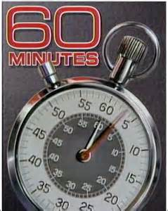
Purpose: Review/Oversight
VRMCA Website and Educational Materials
Reference Documents
Technical Bulletins
Committee Minutes

Slide 50
Purpose: Review/Oversight
VRMCA Website and Educational Materials
Reference Documents
Technical Bulletins
Committee Minutes
filled in missing gaps

Slide 51
Purpose: Review/Oversight
VRMCA Website and Educational Materials
Reference Documents
Technical Bulletins
Committee Minutes
filled in missing gaps
complete – June 2010

Slide 52
Summary
Continued Progress & Success

Slide 53
Summary
Continued Progress & Success
Invitation to Join Group

Slide 54
Summary
Continued Progress & Success
Invitation to Join Group
Welcome Participation, Ideas and Topics

Slide 55
Questions

Slide 56
Questions

Slide 57
Questions

Slide 58
Questions
Thank You

