Slide 1

Water Resource Engineering Technical Update
Presented By:
Scott Blossom, P.E., CFM, LEED A.P.
Date:
September 16, 2014

Slide 2

A Safety
Moment
Notes:
To get started, we’d like to share a safety moment <customize – e.g., fire exits, etc.>
We are committed to best-in-class health, safety, and environmental standards that protect our employees, our clients, and our environment.

Slide 3
Williamsburg Environmental Group has joined the Stantec family!
Stantec at a glance:
Founded in 1954
Over 13,000 employees in more than 200 locations
Diverse range of services and sectors
GSA Schedule Contract Holder
Practice Areas include:
  Architecture
  Buildings Engineering
  Community Development
  Environmental Services
  Geotechnical Engineering
  Mining Engineering
  Oil & Gas Engineering
  Power Engineering
  Project Management
  Transportation Infrastructure Engineering
  Water and Wastewater Engineering

Slide 4
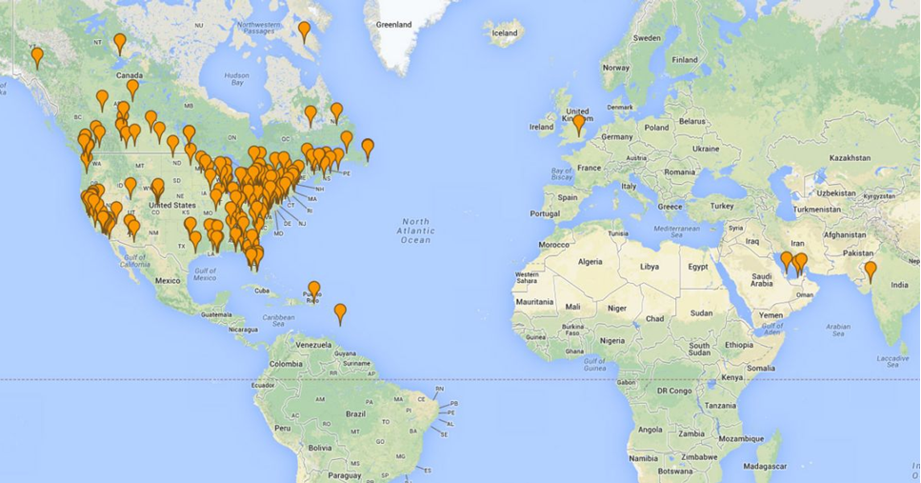
200+ Locations
13,000 Professionals

Slide 5
Multi Disciplinary Approach
Our Local Environmental Staff includes:
  Water Resources Engineers
  Environmental Planners
  Regulatory Specialists
  Wetland Ecologists
  LEED Accredited
  Landscape Architects
  Environmental Technicians
  CAD/GIS Specialists
Water Resources
Stream
Restoration
Client
Environ- mental Planning
Regulatory
Landscape Architecture
Wetland Ecology
…responsive services and high-quality deliverables on-time and within budget

Slide 6
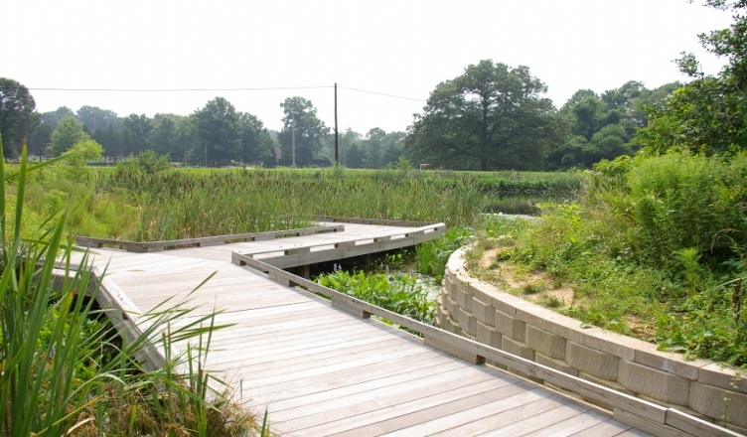
Stormwater Stakeholders
Stantec (formerly WEG) supports a variety of public- and private-sector clientele, including:
  Local, State, and Federal Government/Municipalities
  Commercial and Residential Developers
  Engineers/Surveyors/Planners
  Institutions
  Colleges and Universities
  K-12 Schools
  Home Owners Associations
  Utilities
  Non-profit Organizations
  Golf Courses, Parks, and Recreational Facilities
…timely, cost-effective solutions to today’s complex environmental issues without “headaches” for our clients

Slide 7

Federal Considerations
Regulatory Drivers
  National Environmental Policy Act (NEPA) Compliance/Documentation
    Environmental Assessments (EAs)
    Categorical Exclusions (CATEXs)
  Executive Order 13514 and 13423
  Section 438 of the Energy Independence and Security Act (EISA) Compliance
  Integrated Natural Resources Management Plan (INRMP) Review
  Environmental Management System (EMS) Support
…capacity and expertise to conduct simultaneous, collaborative, large-scale, complex projects which are focused on sustainability and LID techniques

Slide 8
1 Water Resources: General
2 Regulatory Drivers
3 Technical Review
4 Best Management Practices
5 Case Studies
…team of exceptional professionals with extensive experience supporting federal clients in their efforts to achieve objectives

Slide 9
Water Resources: General
1

Slide 10
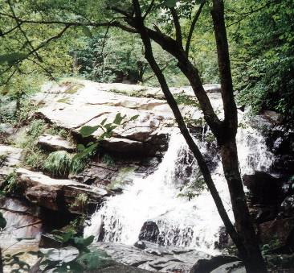
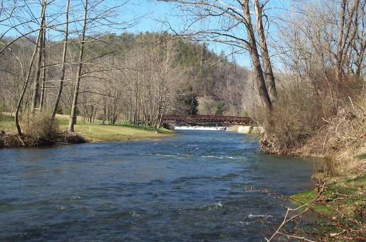
Water Resources & Sustainability
Lake/BMP Design
Dam Safety Permits
Master Drainage Plans
Erosion and Sediment Control Plans
Water Quality Impact Assessments
Watershed Planning and Design
Hydrologic and Hydraulic Analysis
Floodplain Analysis
Stream Restoration
Low Impact Development Design
Water Supply Studies/Evaluations

Slide 11
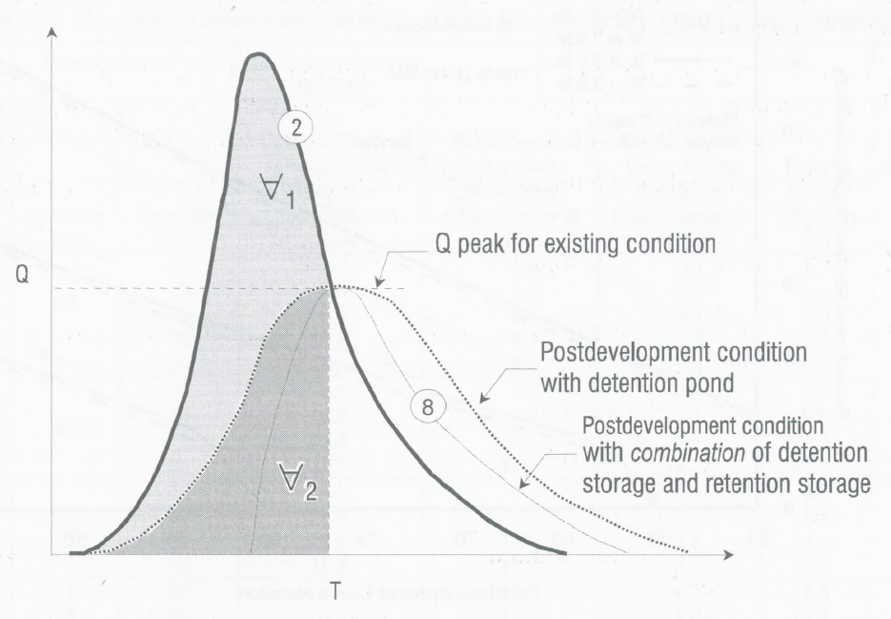
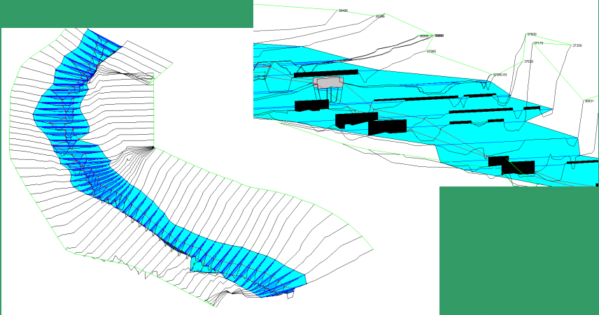
Hydrologic & Hydraulic Analysis
Replicate Predevelopment
Hydrograph
Increase Initial Abstraction
Watershed Connection to River & Stream Hydraulics
Responsible Floodplain Management
Stream Stability & Restoration
Source: LID Hydrologic Analysis
Prince George County 2000

Slide 12
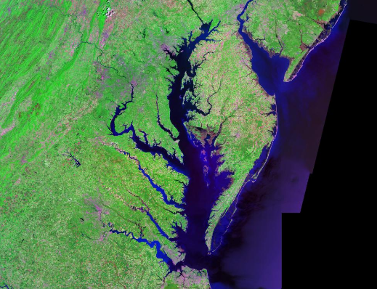
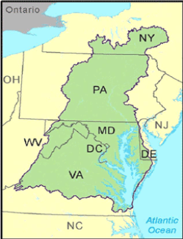
Sandy
Notes:
Majestic – Great waters , home of the great blue heron, blue crab, striped bass – bald eagle
In terms of H & H:
64000 SQ miles
150 major rivers and streams
The Chesapeake Bay is the ria, or drowned valley, of the Susquehanna, meaning that it was where the river flowed when the sea level was lower.
North of Baltimore, the western shore borders the hilly Piedmont region of Maryland; south of the city the Bay lies within the state's low-lying coastal plain, with sedimentary cliffs to the west, and flat islands, winding creeks and marshes to the east.
The largest rivers flowing directly into the bay, from north to south, are:
Susquehanna River
Patapsco River
Chester River
Choptank River
Patuxent River
Nanticoke River
Potomac River
Pocomoke River
Rappahannock River
York River
James River

Slide 13

Regional Priorities
Notes:
Resiliency
Forces of Nature that affect regionally, nationally and globally – without getting into political aspects of climate and its relationship to human population – fact of the matter is disasters happen – often involving the fundamental aspects of Water Resources.
In additional to being in a “response’ mode – water resources also presents the technical tools to be in a preparedness mode.
Now relating back to H&H –
Rainfall amounts of 10 to 14 inches have already occurred over a large portion of eastern North Carolina and extreme southeastern Virginia, with the highest amount so far, 14 inches, reported at Bunyan, N.C.
The preliminary water level at the Chesapeake Bay Bridge Tunnel has recently peaked near the record level that was established during Hurricane Isabel in 2003.

Slide 14
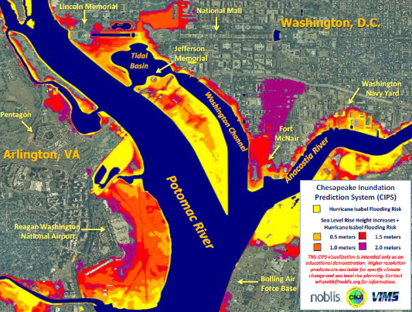
Sandy

Slide 15
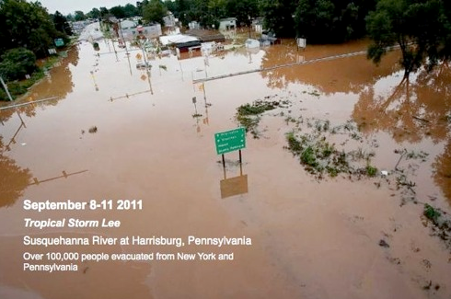

Slide 16
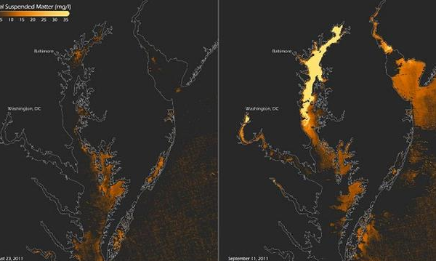
Regional Priorities
Notes:
Here we see a little different view or aspect of water resources – now shifting slightly to the inter relationship of water QUANTITY to water QUALITY
According to a new USGS report, the Susquehanna River delivered more phosphorus and sediment to the Bay during 2011 than from than any other year since monitoring began in 1978.
Flooding from Tropical Storm Lee made up a large fraction of the Susquehanna River’s inputs to the Bay for both 2011 and over the last decade. During the flooding the Susquehanna River delivered about 2 percent of total water to the Bay for the last decade; however, it delivered 5 percent of the nitrogen, 22 percent of the phosphorus, and 39 percent of the suspended sediment.
Lets look UPSTREAM
The lower reaches of the Susquehanna River, just upstream from Chesapeake Bay, include three reservoirs: Safe Harbor Dam and Holtwood Dam in Pennsylvania and Conowingo Dam in Maryland. Over the past several decades these reservoirs have been gradually filling with sediment.
“The upstream reservoirs have served previously to help reduce nutrient pollutant loads to the Chesapeake Bay by trapping sediment and the pollutants attached to them behind dams,” explained USGS Director Marcia McNutt. “Now that these reservoirs are filling to capacity with sediment, they have become much less effective at preventing nutrient-rich sediments from reaching the Bay.
http://www.chesapeake-bay.org/index.php/tag/sediment/

Slide 17
Regulatory Drivers
2

Slide 18
Chesapeake Bay TMDL – A Commitment to Clean Water
The Bay TMDL is a key part of an accountability Framework to ensure that all pollution control measures needed to fully restore the Bay and its tidal rivers are in place by 2025, with practices in place by 2017 to meet 60 percent of the necessary pollution reductions.
Crosses State lines
Notes:
Annually based maximum daily loads are derived for each of the 92 tidal segments and for each of the three pollutants—nitrogen, phosphorus, and sediment—as a direct product of the Chesapeake Bay TMDL and associated modeling.
Principles and Guidelines
The nitrogen and phosphorus basin-jurisdiction allocation methodology was developed to be consistent with the following guidelines adopted by the partnership:
The allocated loads should protect the living resources of the Bay and its tidal tributaries and result in all segments of the Bay mainstem, tidal tributaries, and embayments meeting WQS for DO, chlorophyll a, and water clarity.
Major river basins that contribute the most to the Bay water quality problems must do the most to resolve those problems (on a pound-per-pound basis).
All tracked and reported reductions in nitrogen and phosphorus loads are credited toward achieving final assigned loads.
Actions are being taken across six states and the District of Columbia to reduce water pollution in local streams and rivers in connection with EPA's Total Maximum Daily Load to restore the Chesapeake Bay.
The Bay TMDL, a historic and comprehensive "pollution diet," was established in December 2010 based largely on implementation plans

Slide 19
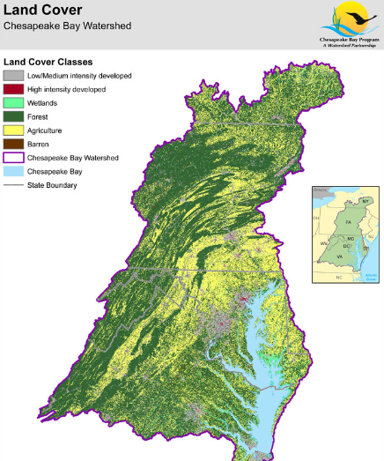
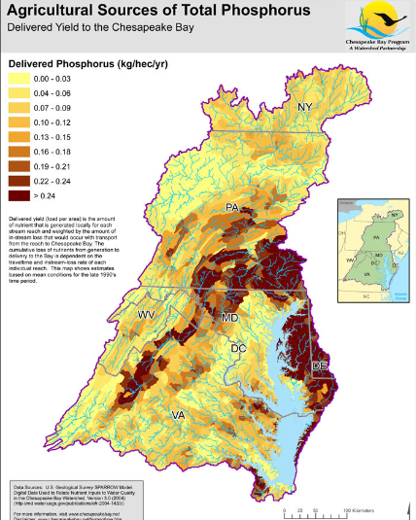
Notes:
Using the 1991 to 2000 hydrologic period, calibrate the Bay Water Quality Model to Bay water quality monitoring data.
Run a model simulation for a given loading scenario (usually a management scenario resulting in lower loads relative to the calibration scenario) through the Phase 5.3 Chesapeake Bay Watershed Model (Bay Watershed Model) and Bay Water Quality Model.
Determine the model simulated change in water quality from the calibration scenario to the given loading scenario.
Apply the change in water quality as predicted by the Bay Water Quality Model to the actual historical water quality monitoring data used for calibration and evaluate attainment on the basis of that scenario-modified data set.
If WQS are met, use the allocations, if not, re input a new scenario
The full process for establishing the nitrogen and phosphorus basin-jurisdiction allocations is described below:
Established the atmospheric deposition allocations on the basis of addressing the requirements of the CAA to meet existing national air quality standards out through 2020.
Set the basinwide nitrogen and phosphorus loads on the basis of attaining the applicable DO criteria in those Bay segments (middle Chesapeake Bay mainstem and the lower tidal Potomac River) and designated uses (deep-water and deep-channel) whose water quality conditions are influenced by major river basins and jurisdictions throughout the Bay watershed.
Distributed the basinwide nitrogen and phosphorus loads by major river basin and jurisdiction following the methodology developed by the partnership (see Section 6.2).
Made certain discretionary adjustments to the allocations to New York and West Virginia.
Allowed for individual jurisdictions to exchange nitrogen and phosphorus loads within and between their major river basins using specific exchange ratios, as long as the exchanges still resulted in attainment of all WQS.
Identified those individual Bay segments still not attaining their applicable DO/chlorophyll a WQS at the allocated basinwide nitrogen and phosphorus loads and addressed the remaining nonattainment segments.
Derived the final basin-jurisdiction nitrogen and phosphorus allocations to achieve the applicable WQS for DO and chlorophyll a in all 92 Bay segments.

Slide 20
MS4 Permits
  Discharges from municipal separate storm sewer system regulations were developed and implemented in two phases.
    Implementation of the first phase began in the early 1990s and required that operators of MS4s serving populations of greater than 100,000 people (per the 1990 decennial census) apply for and obtain a permit to discharge stormwater from their outfalls.
    The second phase of MS4 regulations became effective March 23, 2003, and required that operators of small MS4s in "urbanized areas" (as defined by the latest decennial census) obtain a permit to discharge stormwater from their outfalls.
Many Federal facilities are MS4 permit holders.
Notes:
Individual Permits
Stormwater discharges from Phase I (large and medium) municipal separate storm sewer systems are authorized under individual permits. Under these permits, the MS4 owner/operator must implement a collective series of programs to reduce the discharge of pollutants from the given storm sewer system to the maximum extent practicable in a manner that protects the water quality of nearby streams, rivers, wetlands and bays.
The programs must include elements to:
Operate and maintain structural stormwater controls
Control discharges from areas of development and significant redevelopment
Operate and maintain public streets, roads and highways
Identify, monitor and control discharges from municipal waste treatment, storage or disposal facilities
Control pollutants related to application of pesticides, herbicides and fertilizers
Implement an inspection program to enforce ordinances, which prohibit illicit connections and illegal dumping into the MS4
Screen the MS4 for illicit connections and illegal dumping
Implement standard investigative procedures to identify and terminate sources of illicit connections or discharges
Prevent, contain and respond to spills that may discharge into the MS4
Limit the infiltration of sanitary seepage into the MS4
Identify, monitor and control discharges from municipal landfills; hazardous waste treatment, storage, disposal and recovery facilities; facilities subject to EPCRA Title III, Section 313; and any other industrial or commercial discharge the permittee determines to be contributing a substantial pollutant loading to the MS4
Control pollutants in construction site runoff
Conduct public education on stormwater

Slide 21
MS4 Permits
Small MS4s include storm sewer systems operated by cities, counties, towns, federal facilities such as military bases, Veteran’s Affairs hospitals and research facilities, Department of Defense facilities and parkways, and state facilities such as VDOT, community colleges and public universities.
Many Federal facilities are MS4 permit holders.
Notes:
General Permits
Stormwater discharges from Phase II (small) MS4s are regulated under the General Permit for the Discharge of Stormwater from Small Municipal Separate Storm Sewer Systems. Small MS4s include storm sewer systems operated by cities, counties, towns, federal facilities such as military bases, Veteran’s Affairs hospitals and research facilities, Department of Defense facilities and parkways, and state facilities such as VDOT, community colleges and public universities.
Under the general permit, small MS4s must develop, implement and enforce a program that includes the following “six minimum control measures":
Public education and outreach on stormwater impacts
Public involvement and participation
Illicit discharge detection and elimination
Construction site stormwater runoff control
Post-construction stormwater management in new development and redevelopment
Pollution prevention/good housekeeping for municipal operations
Similar to the Phase I programs, small MS4 programs must be designed and implemented to control the discharge of pollutants from their storm sewer system to the maximum extent practicable in a manner that protects the water quality in nearby streams, rivers, wetlands and bays.

Slide 22
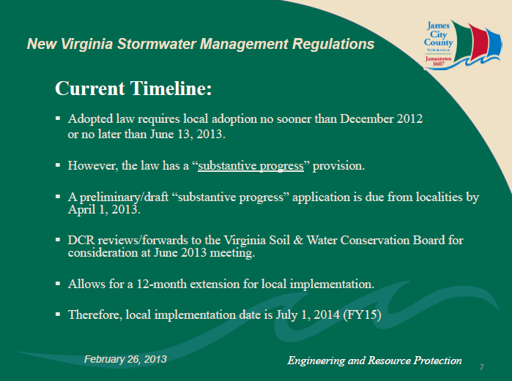
Stormwater Regulations
Summer 2014.
Notes:
TARGET IS 0.41 LBS/AC YEAR
Virginia Stormwater Management Program" or "VSMP" means a program approved by the Soil and Water Conservation Board after September 13, 2011, and until June 30, 2013, or the State Water Control Board on and after June 30, 2013, that has been established by a VSMP authority to manage the quality and quantity of runoff resulting from land-disturbing activities and shall include such items as local ordinances, rules, permit requirements, annual standards and specifications, policies and guidelines, technical materials, and requirements for plan review, inspection, enforcement, where authorized in this article, and evaluation consistent with the requirements of this article and associated regulations.
Fairfax County is preparing a Stormwater Management Ordinance in response to state regulations requiring localities to adopt ordinances and take over reviews and inspections for Virginia Stormwater Management Program (VSMP) general permits relating to stormwater runoff from construction sites effective July 1, 2014.
ASK attorney for Grandfathering
Pull permit before July 2014 – continue for 2 cycles…

Slide 23
VPDES Permit
  Effective July 1, 2014 and expires on June 30, 2019.
  Grandfathering: Shall remain subject to the Part II C technical criteria for stormwater for one additional state permit cycle (until June 30, 2019). After that time, portions of the project not under construction shall become subject to any new technical criteria adopted by the board.
  Permit Reissuance
  New SWPPP Template, Inspection Frequency
  Discharge to TMDL/Impaired Waters/Exceptional Waters
WEG (now Stantec) information bulletin
Notes:
July 1 2014 – 2019
Continued Coverage – must get registration statement in by 6/1/14
By 4//14 DEQ should be ready to receive
Locally Administered – all City’s and County’s (+ some towns) & MS4s are required to become an ‘authority’
SWPPP – new template, localities will be reviewing - new language says it must be “approved” E&S plans and SWM plans
- very tricky for phased developments – continued coverage?
Inspection Frequency
old every 5 days or 10 days within 48 hrs after measurable event
Enhanced: new every 4 days or 5 days within 48 hrs of measurable event (enhanced is likely all TMDL watershed)
Fees (see fee table) ->100 acres 9K+
Single family lots – not required to have reg statement and SWPPP if part of a common form of development
Record Drawings/Eng Cert: maintenance agreement required to approval, record drawings for all SWM facilities

Slide 24

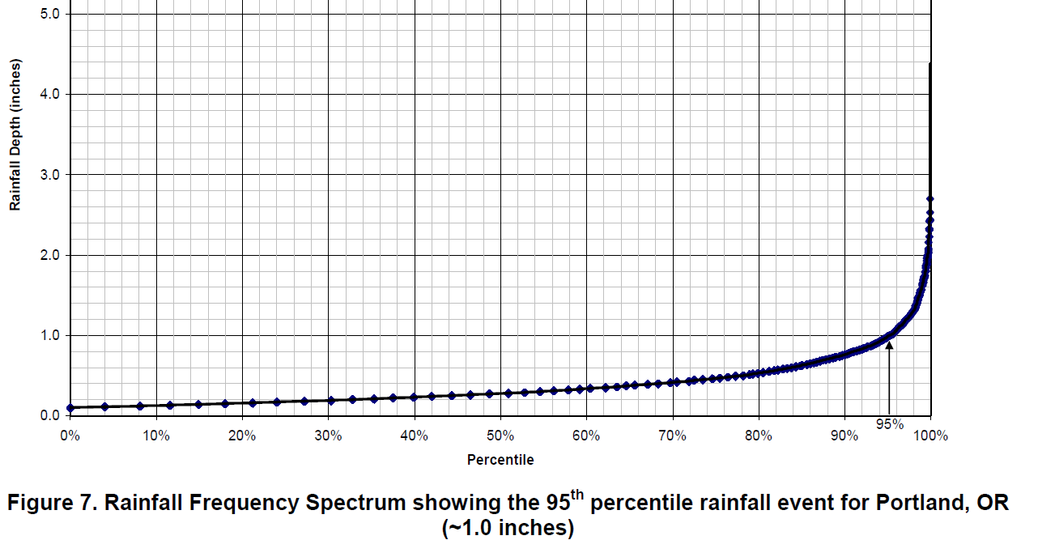
Section 438
Site and region specific…..
Notes:
Energy and Security Independence Act of 2007
5000 SF or greater to maintain or restore pre development hydrology
Retaining rainfall on site through infiltration, re use, ET
1.) retain on site the total volume from the 95th percentile rainfall event
2.) site specific hydrologic analysis
Green infrastructure and LID
EO 13514 – October 5th 2009 required EPA to develop technical guidance
Atlas 14 historic rainfall dataset
Portland OR 1 inch
DC 1.7 inches

Slide 25
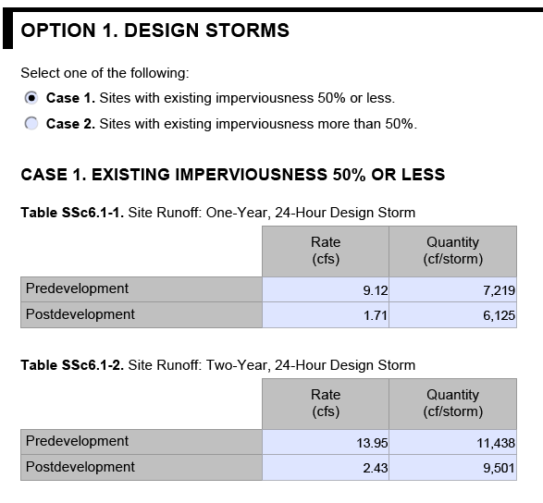
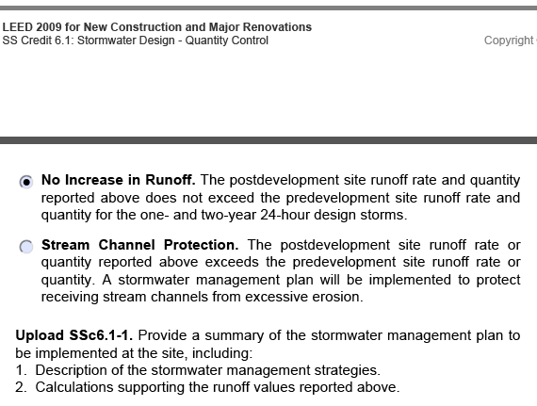
LEED Credits (SSc6.1) LEED 2009

Slide 26
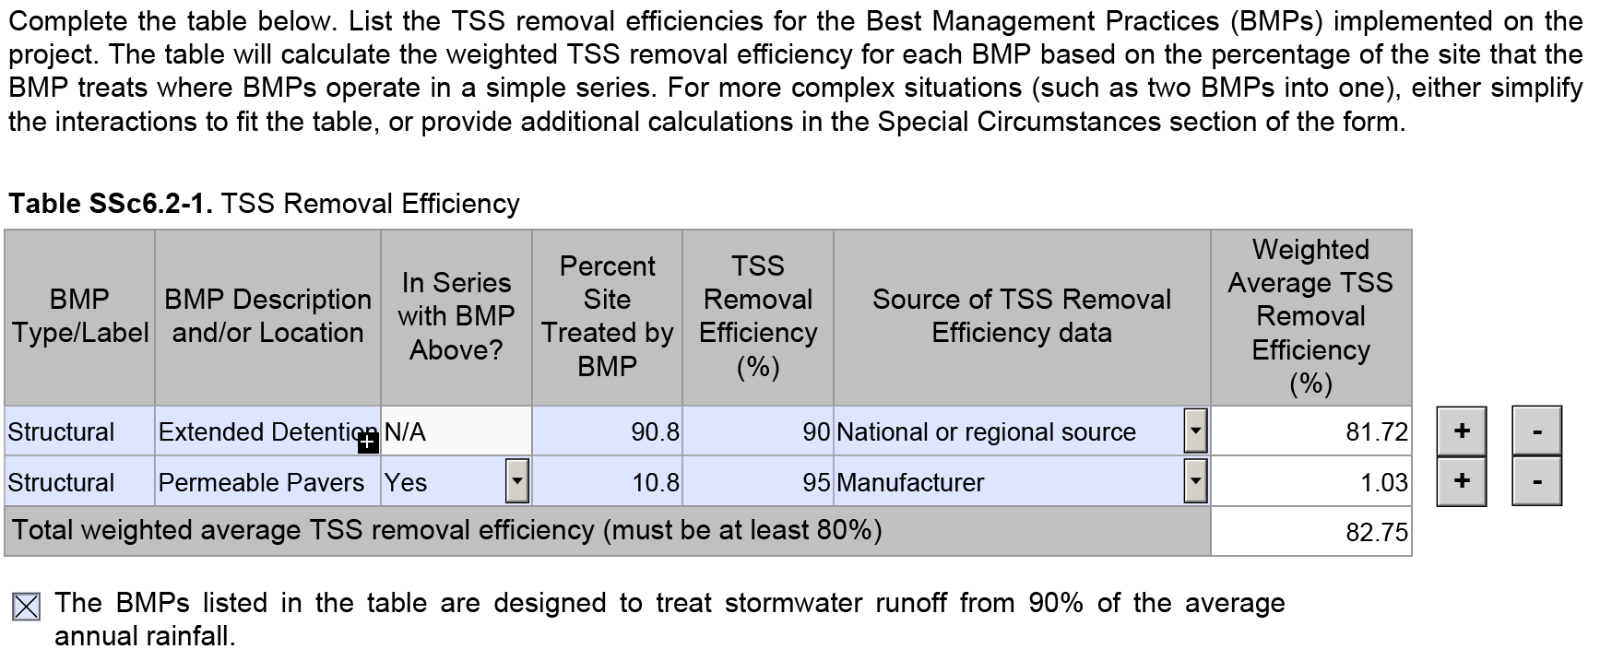
LEED Credits (SSc6.2) LEED 2009

Slide 27
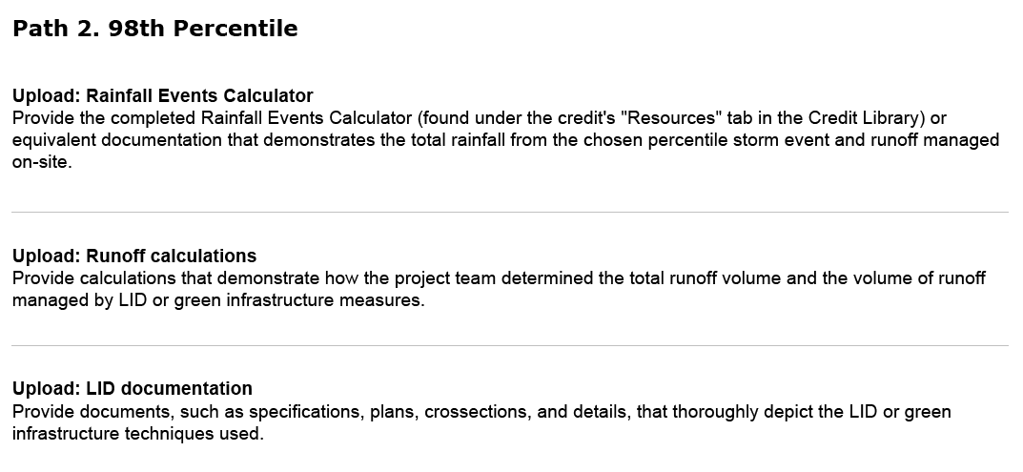
Rainwater Management LEED V4

Slide 28
Technical Review
3
VA Stormwater Regulations

Slide 29
Stormwater Regulations:
Runoff Reduction Method
Total Phosphorus (TP) is used as the target pollutant for compliance with proposed Water Quality criteria (4 VAC50-60-63 through 65). Total Nitrogen (TN) is also calculated and BMP designs address TN removal, as well as the removal of other stormwater pollutants.
Each site also has a Treatment Volume (Tv).
Stormwater BMPs are assigned Runoff Reduction (RR) and Pollutant Removal (PR) rates. These rates vary based on the “level of design” used.
BMP Clearinghouse Technical References
Notes:
Total Phosphorus (TP) is used as the target pollutant for compliance with proposed Water Quality criteria (4 VAC50-60-63 through 65). Total Nitrogen (TN) is also calculated and BMP designs address TN removal, as well as the removal of other stormwater pollutants.
▪ Compliance is based on the overall site; however, stormwater BMP planning can be done on a drainage area basis. The spreadsheet has tabs for multiple drainage areas.
▪ Each site also has a Treatment Volume (Tv). The method uses post-development land covers (forest and open space, managed turf, impervious cover) to compute the Tv.
▪ Stormwater BMPs are assigned Runoff Reduction (RR) and Pollutant Removal (PR) rates. These rates vary based on the “level of design” used. Level 1 designs represent good, current design standards with regard to sizing and BMP features.
Level 2 BMPs have design enhancements to boost runoff reduction and pollutant removal performance. Each Level 1 and 2 design has associated design standards and specifications that should be followed to achieve the assigned RR and PR rates.
▪ There is a tab in the spreadsheet for Channel and Flood Protection.
The spreadsheet assists users with computing runoff volumes and Curve Numbers (CN). The user must then use available hydrologic and hydraulic models and programs to calculate peak discharges for various design storms and verify compliance with the various conditions of the Water Quantity section. If Runoff Reduction practices are used for Water Quality compliance, then these are given credit for Channel Protection and Flood Control, chiefly by allowing the user to compute an Adjusted CN. The designer, with concurrence from the local program authority, may also take other hydrologic “credits” for RR practices, such as increasing the time of concentration (Tc).
▪ In the spreadsheet,…..covered later on in presentation

Slide 30
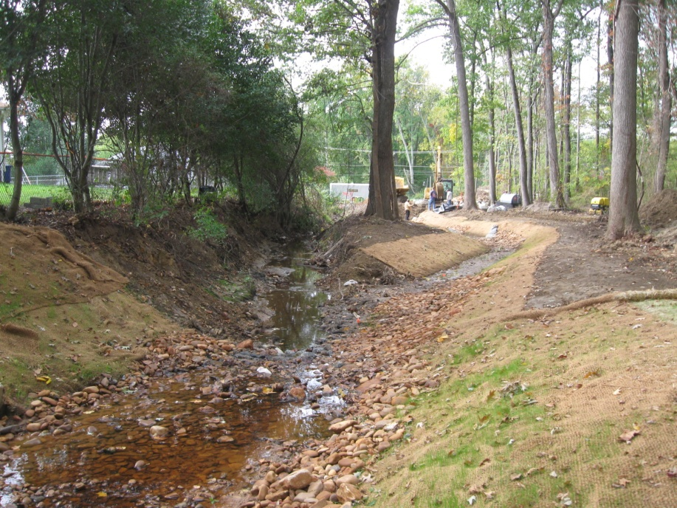
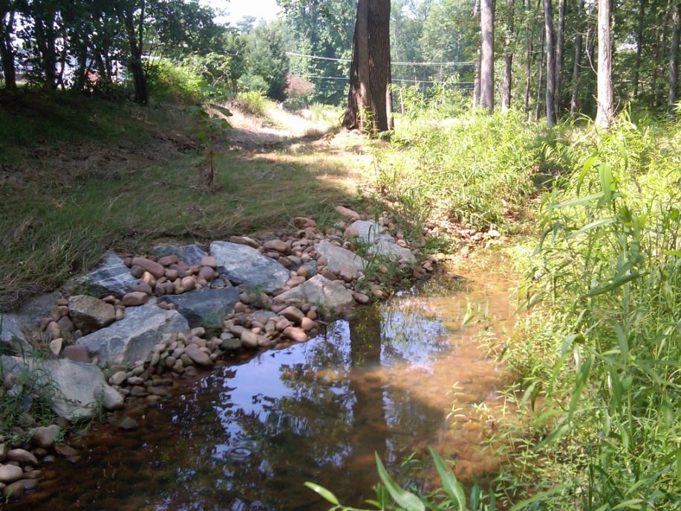
Stormwater Regulations:
Energy Balance Method
Maximum Peak Flow Rate
Allowable QDeveloped <
I.F. x QPre-Developed x RVPre-Developed/ RVDeveloped
Assess, Evaluate, Stabilize, Restore.
Notes:
Where:
I.F. (Improvement Factor) = 0.8 for sites > 1 acre or 0.9 for sites < 1 acre
Allowable QDeveloped = the maximum allowable peak flow rate of runoff for the
drainage area in the developed condition (cubic feet per second)
QPre-Developed = the peak flow rate of runoff for the drainage area in the predeveloped
condition (cubic feet per second)
RVPre-Developed = the volume of runoff from the site in the pre-developed condition
(inches)
RVDeveloped = the volume of runoff from the site in the developed condition including
runoff reduction (inches)
3x = 1/3
2x = ½
Net improvement

Slide 31
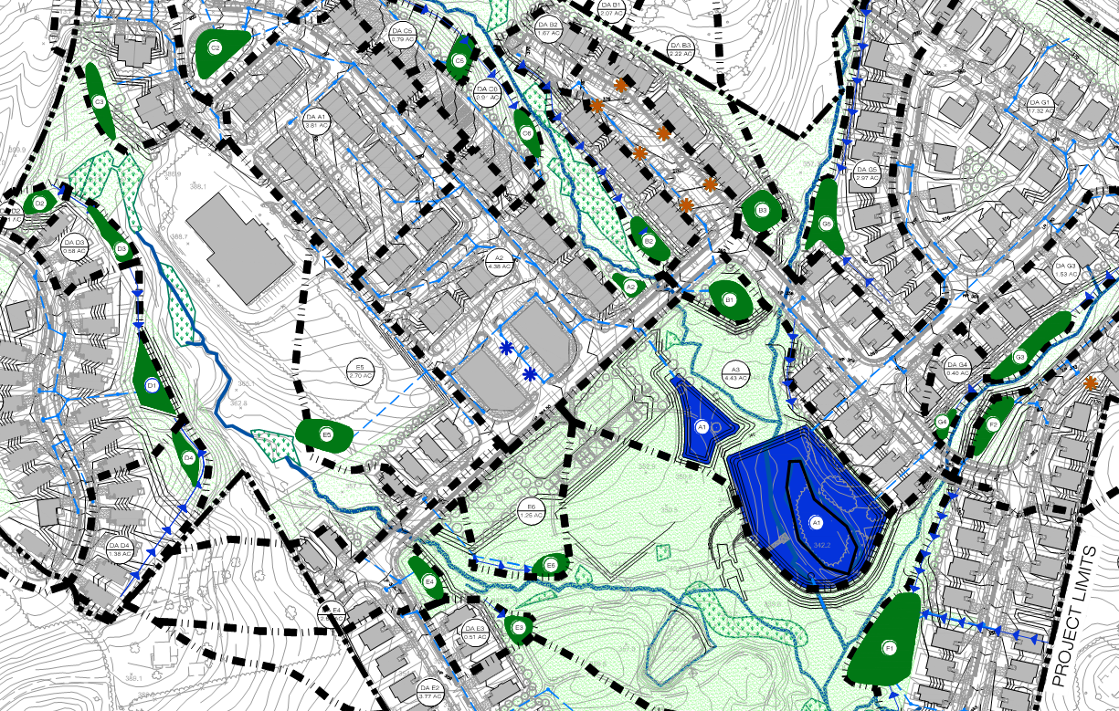
Runoff Reduction Example
Hybrid Approach

Slide 32
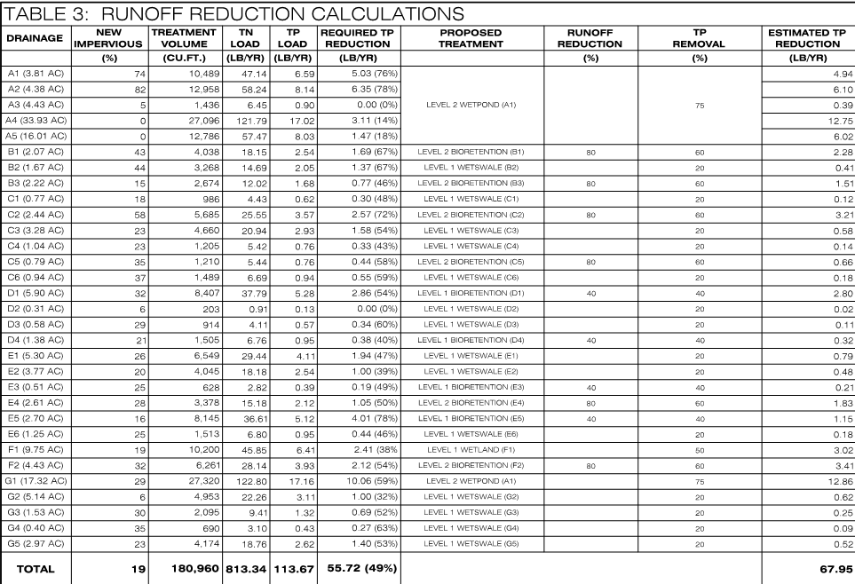
Runoff Reduction Example
RR Summary

Slide 33
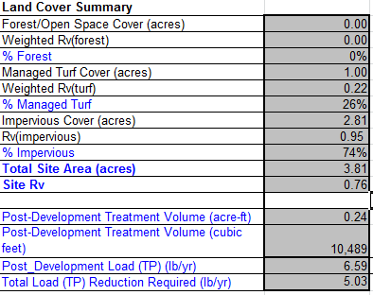
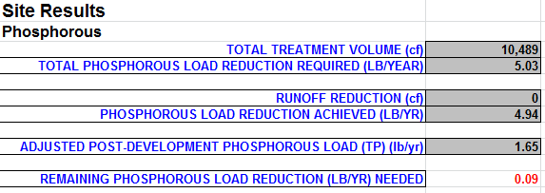
Mixed Use Development:
Runoff Reduction Example
Drainage Area and BMP Specific

Slide 34
Best Management Practices
4

Slide 35
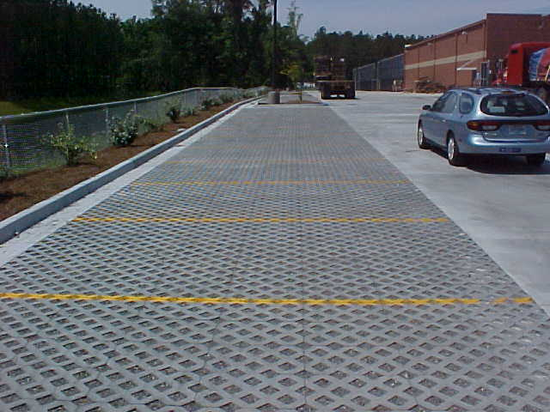
Permeable Pavement
VIRGINIA DEQ STORMWATER DESIGN SPECIFICATION No. 7

Slide 36
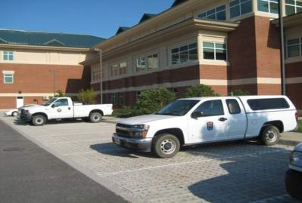
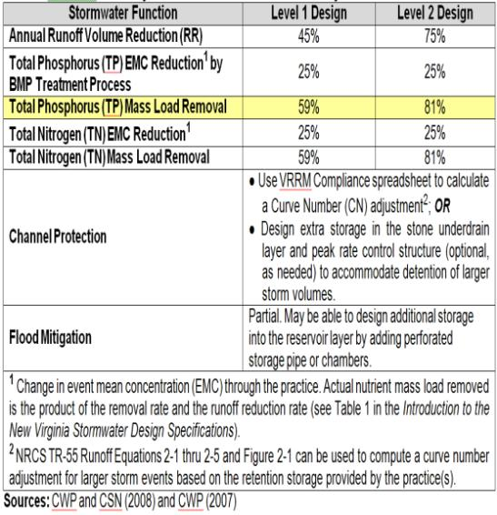
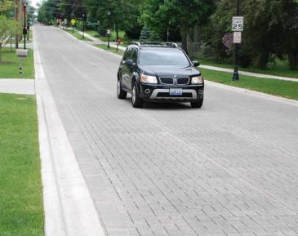
Permeable Pavement
VIRGINIA DEQ STORMWATER DESIGN SPECIFICATION No. 7
Summary of Stormwater Functions ¹

Slide 37
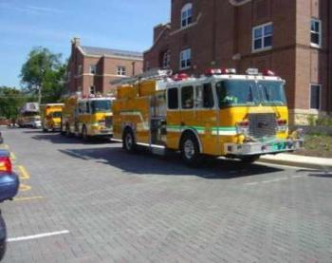
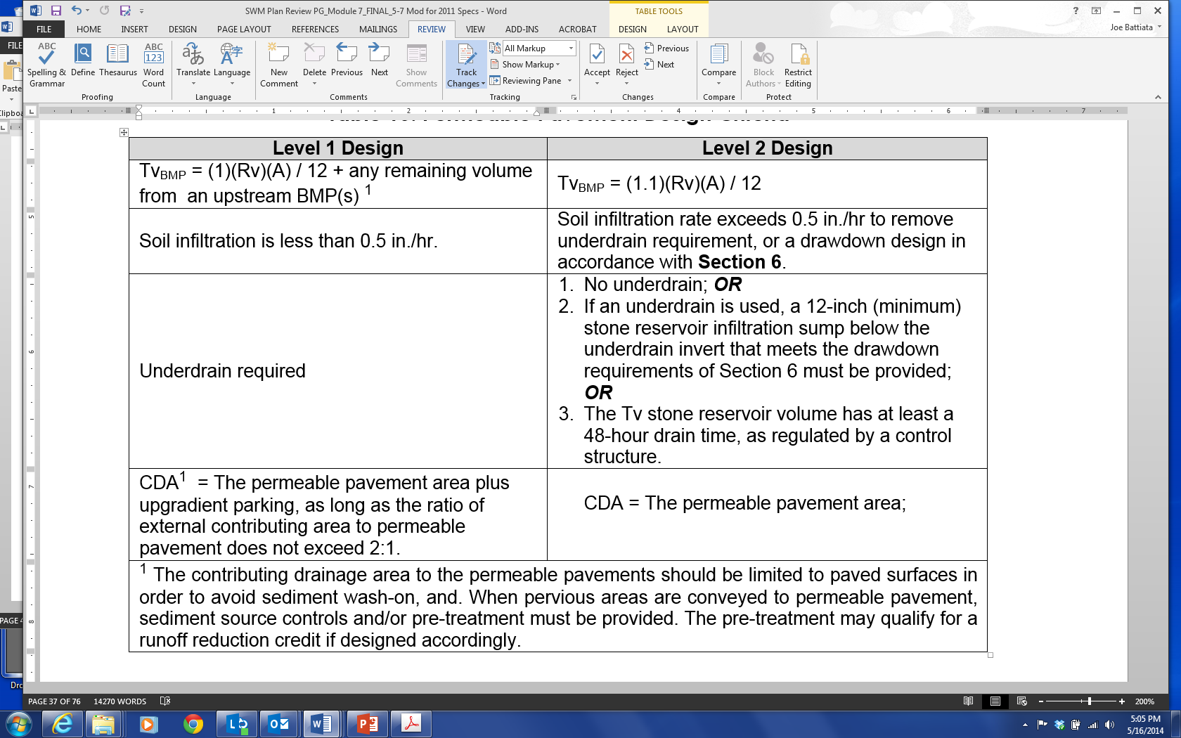
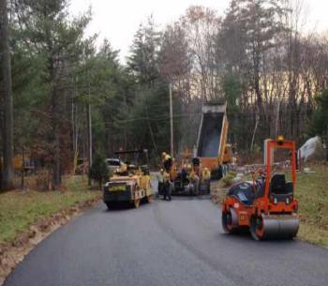
Permeable Pavement
VIRGINIA DEQ STORMWATER DESIGN SPECIFICATION No. 7
Permeable Pavement Design Criteria

Slide 38
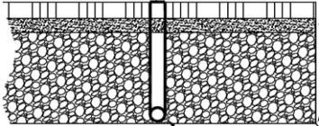
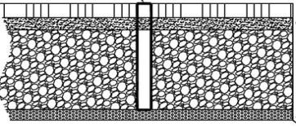
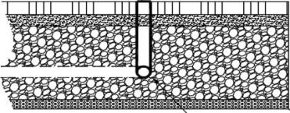
Permeable Pavement
VIRGINIA DEQ STORMWATER DESIGN SPECIFICATION No. 7
Level 1
Level 2 (infiltration)
Level 2 (infiltration sump)

Slide 39
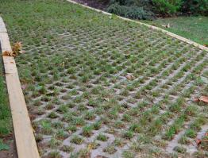
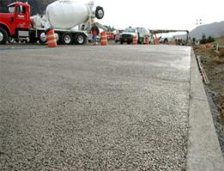
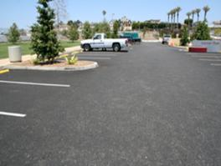
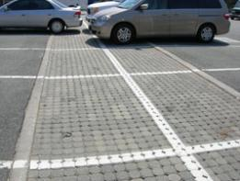
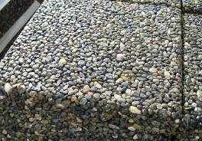
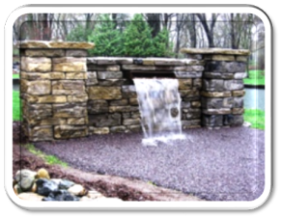
Permeable Pavement
VIRGINIA DEQ STORMWATER DESIGN SPECIFICATION No. 7
Type of pavement materials
Concrete Grid Pavers
Pervious Concrete
Porous Asphalt
Permeable Interlocking Concrete Pavers
Pervious Composites
Permeable Rubber Overlays

Slide 40
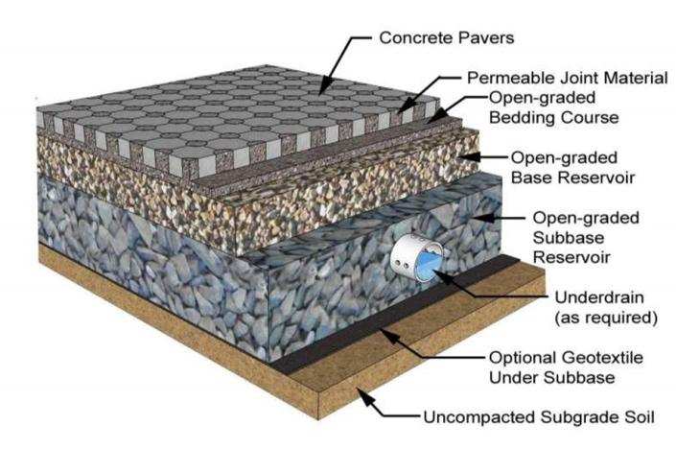
Permeable Pavement
VIRGINIA DEQ STORMWATER DESIGN SPECIFICATION No. 7

Slide 41
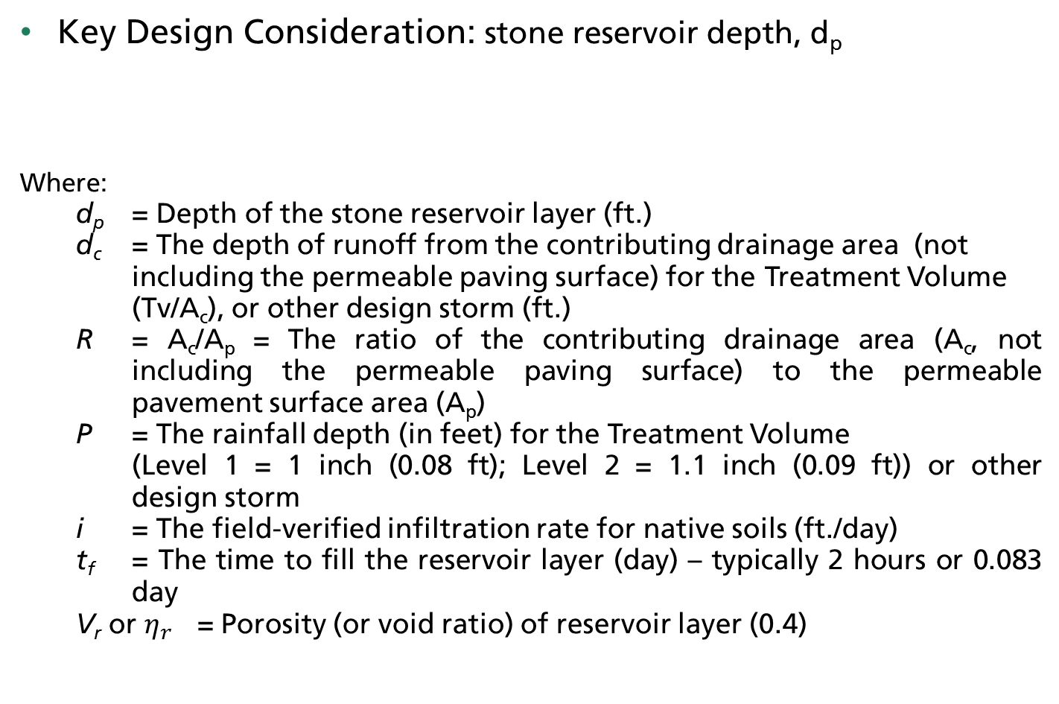
Permeable Pavement
VIRGINIA DEQ STORMWATER DESIGN SPECIFICATION No. 7
Key Design Consideration: stone reservoir depth, d_{p}
Where:
d_{p} = Depth of the stone reservoir layer (ft.)
d_{c} = The depth of runoff from the contributing drainage area (not including the permeable paving surface) for the Treatment Volume (Tv/A_{c}), or other design storm (ft.)
R = A_{c}/A_{p} = The ratio of the contributing drainage area (A_{c}, not including the permeable paving surface) to the permeable pavement surface area (A_{p})
P = The rainfall depth (in feet) for the Treatment Volume
(Level 1 = 1 inch (0.08 ft); Level 2 = 1.1 inch (0.09 ft)) or other design storm
i = The field-verified infiltration rate for native soils (ft./day)
t_{f} = The time to fill the reservoir layer (day) – typically 2 hours or 0.083 day
V_{r} or $η_{r}$ = Porosity (or void ratio) of reservoir layer (0.4)

Slide 42
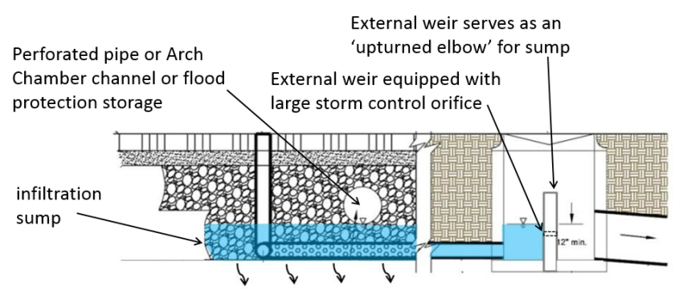
Permeable Pavement
VIRGINIA DEQ STORMWATER DESIGN SPECIFICATION No. 7
  Key Design Consideration: ‘Upturned Elbow’

Slide 43
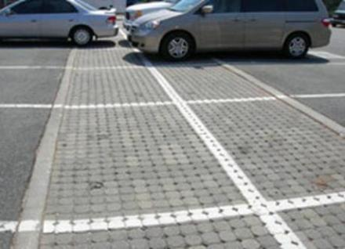
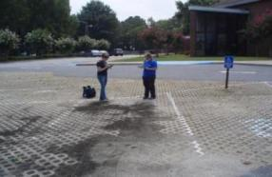

Permeable Pavement
VIRGINIA DEQ STORMWATER DESIGN SPECIFICATION No. 7
  Key Design Consideration: External Drainage Areas
  The maximum external drainage area is limited to ratio with area of permeable pavement: 2:1
In all cases, external drainage areas should be limited to impervious surfaces to reduce potential sediment loading

Slide 44
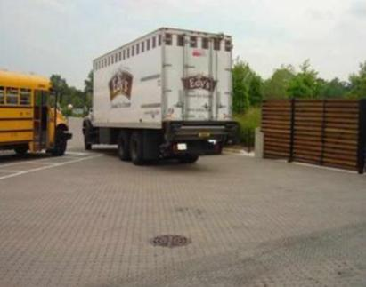
Permeable Pavement
VIRGINIA DEQ STORMWATER DESIGN SPECIFICATION No. 7
  Key Design Consideration: Pavement Structural Design
  Thickness of permeable pavement and reservoir layer must be sized to support structural loads
Four primary design elements:
Anticipated traffic loads
Underlying soil properties
Environmental/climate factors
Surface, bedding, and reservoir strength coefficients and layer thicknesses (strength coefficients vary for materials used)

Slide 45


Permeable Pavement
VIRGINIA DEQ STORMWATER DESIGN SPECIFICATION No. 7
  Key Design Consideration: Maintenance Agreements
  Permeable Pavement (like all BMPs) must have a maintenance agreement, and should include provisions for owner awareness of routine (frequent) and infrequent maintenance requirements.

Slide 46
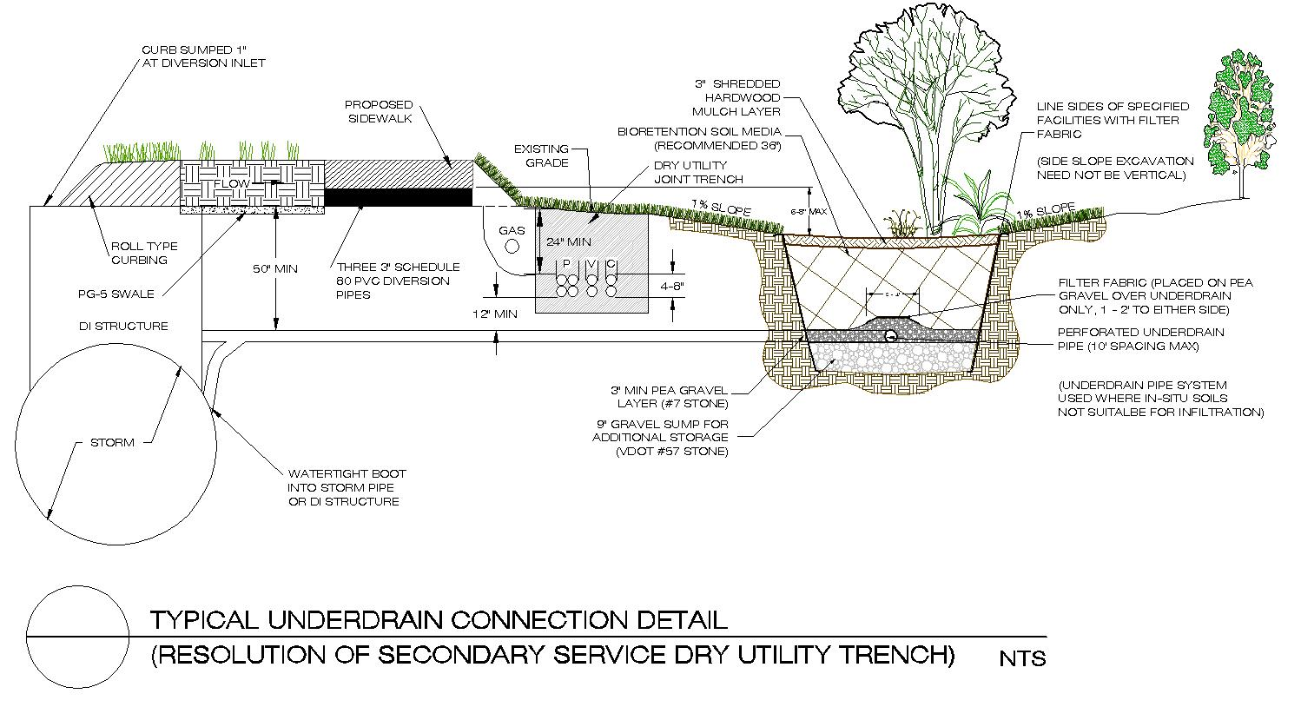
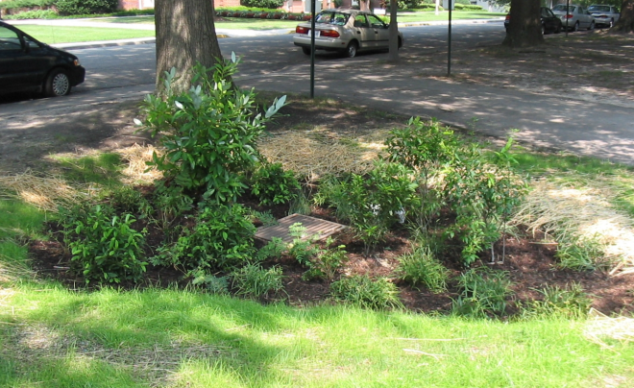
Integrated Management Practice:
Biofiltration

Slide 47
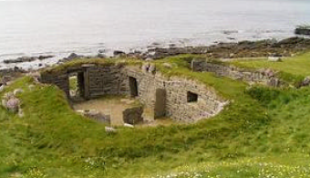





Site Design Techniques:
Architectural Green Roofs
Hanging Gardens – 500 B.C.
Vidimyri Church – 1834
Orkny Isles of Scotland – 2500 B.C.
Kansas Prairies – 1903
Clam House - 2001
“Evolution of a Historic Technology”
Incas, Peru – 1450

Slide 48





Site Design:
Green Roofs
Source: Test Results - NC State: “Hydrologic & Water Quality Performance From Greenroofs in Goldsboro and Raleigh.” (Extensive: 3 inch depth, Sedum album)
Note: Relationship and Importance of rainfall patterns, intensities etc.

Slide 49


Rainwater Harvesting
St. Thomas: United States Virgin Islands

Slide 50

Regenerative Techniques
Engineered Soil Medium, EPA Protocols

Slide 51


Regenerative Techniques
Engineered Soil Medium, Swale Design, BANCS

Slide 52


Restoration and Nutrient Banking
WEG (now Stantec) is a leader in Ecosystem Banking with unparalleled experience in design of mitigation compensation areas.
  1,000 miles of stream assessment
  30,000 acres of wetland mitigation assessment and feasibility
  ~ 41.93 lbs of Total Phosphorus reduction generated/certified on the Virginia Nutrient Credit Exchange; WEG employee serves on the Nutrient Credit Exchange Study Committee
Pre-Restoration
Post-Restoration
…WEG (now Stantec) has entitled 20 mitigation banks with 7 additional banks nearing final approval

Slide 53
Case Studies
5
…team of exceptional professionals with extensive experience supporting federal clients in their efforts to achieve objectives

Slide 54

Undisclosed DoD Location
WEG (now Stantec) is providing on-going environmental engineering, LID, BMP, and planning support at this 1000+ acre Department of Defense (DoD) location
  Stormwater and Pollution Prevention
    Total Maximum Daily Load (TMDL)
    Municipal Separate Storm Sewer System (MS4)
  Living Shoreline (Innovative Design Approach)
Representative photo, not actual location.
…WEG (now Stantec) is integrating Low Impact Development (LID) design and practices without disrupting everyday activities

Slide 55

Ft Belvoir - History
Full service inventory and inspection
  What is on base and what is the current performance?
  Integrated GIS database
  User Friendly decision making
  MS4 Documentation
…WEG (now Stantec) is currently under contract

Slide 56



Upper Machodoc Creek
NSF Dahlgren
WEG (now Stantec) is providing stormwater retrofit and constructed wetlands for a 6-acre project area on this Naval Support Facility.
  Designs are compliant with:
    Current State Standards
    Section 438
    Executive Order 13514
  Innovative retrofitting for nutrient reduction with habitat component
…WEG (now Stantec) has provided detailed stormwater BMP and LID engineering services for NAVFAC

Slide 57


FBI Building
WEG (now Stantec) pursued a Design Build contract as part of a team proposing on this LEED Gold Facility
  Security Buffer
  “Covered” Parking
  Meet SFO & POR
  GSA Design Excellence Program
… renderings prepared by Skanska and SOM

Slide 58



U.S. Virgin Islands
WEG (now Stantec) is part of a team providing sustainable and innovative building design using green development techniques.
Design plans included:
  Bioswales
  Permeable Pavements
  Rainwater Harvesting
  Photovoltaics
  Local Building Materials
  Recycled Products
  Innovative Wastewater Technologies
  Daylighting Strategies
  Climate Needs
… registered with the United States Green Building Council for the Leadership in Energy and Environmental Design (LEED) program and is considering Gold Level Certification.

Slide 59


Development/Re-Development
15 Acre Site, ½ Acre IMPs, ($20/S.F.)*
  Reclaimed area for a third building

Slide 60
Thank you
Questions?
Scott Blossom, P.E., CFM, LEED A.P.
scott.blossom@stantec.com
(757) 220-6869

